Slide 1
Texas Gulf Region Cooperative Weed Management Area
A new regional partnership to address invasive Brazilian peppertree on the Texas coast

Slide 2
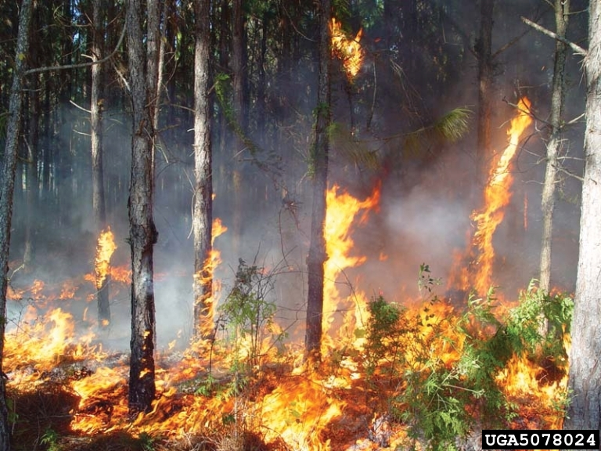
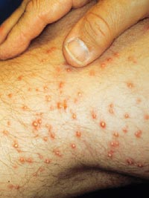
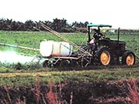
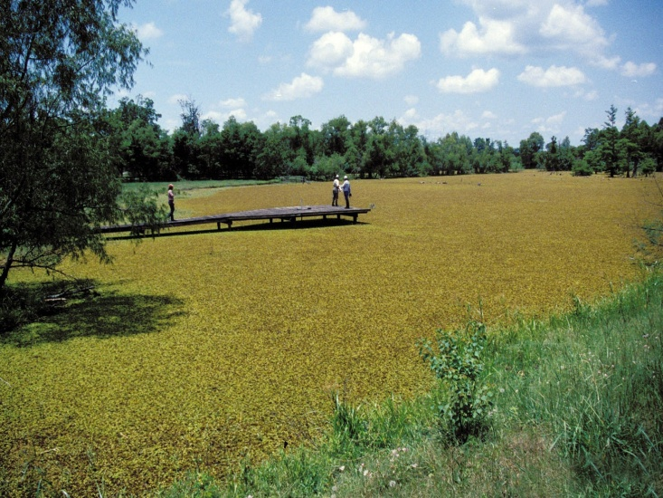
Invasive Species Background
The Federal Definition
An invasive species is defined as a species that is non-native (or alien) to the ecosystem under consideration and whose introduction causes or is likely to cause economic or environmental harm or harm to human health. (Executive Order 13112)

Slide 3
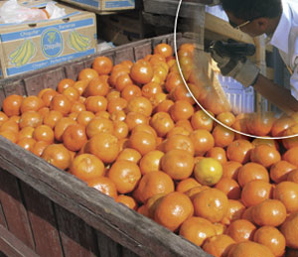
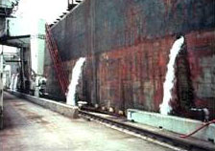
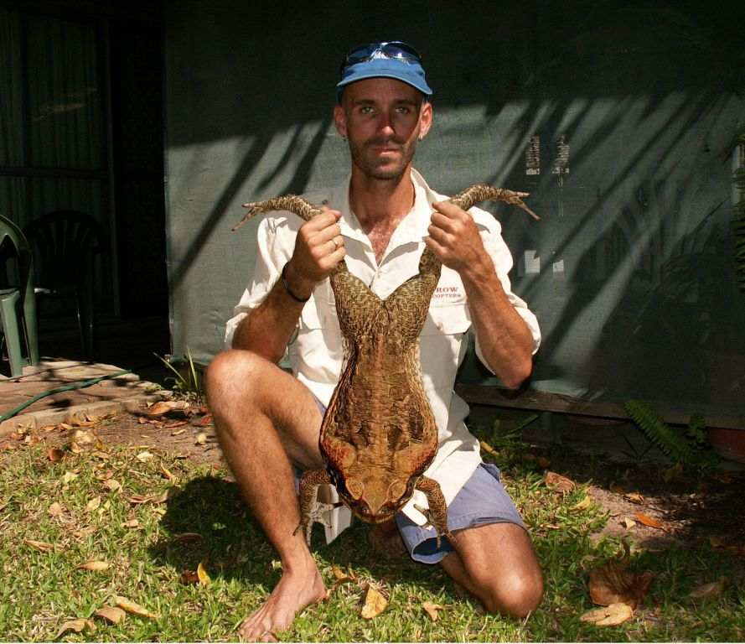
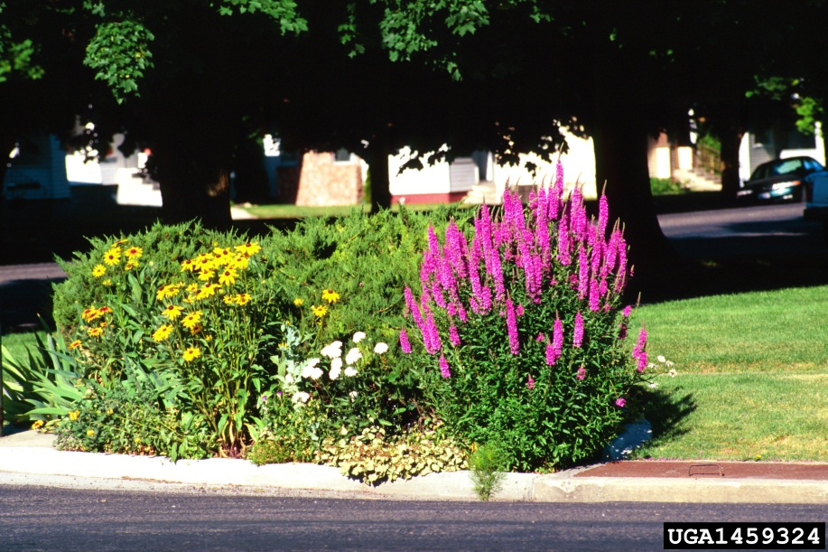
How do they arrive?
Accidental
Produce
Nursery stocks
Ship ballasts
Packing materials & shipping containers
Recreational travelers
Purposeful
Biological Controls
Ornamentals
Agriculture
Pets/Aquariums

Slide 4

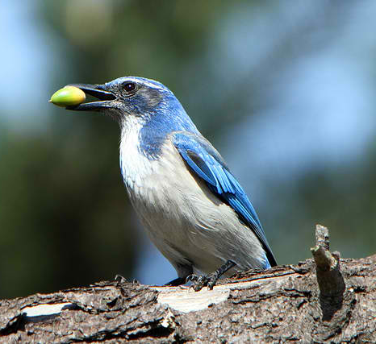
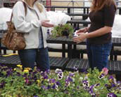
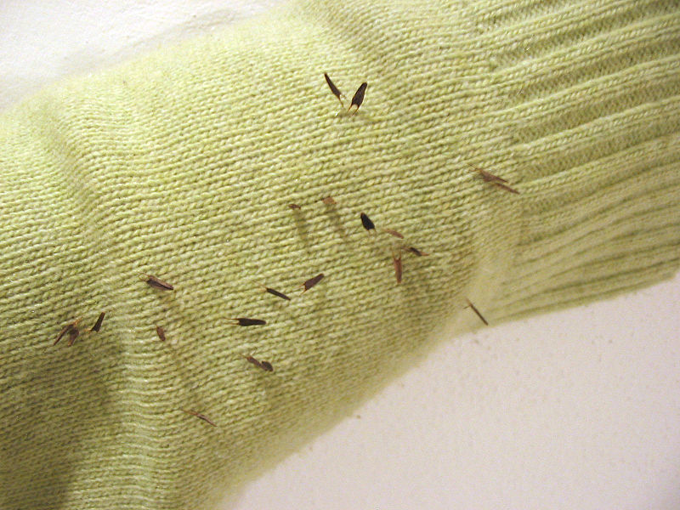
How do they spread within the environment?
Natural
The Elements
Flight
Wildlife
Humans
Ornamental planting
Erosion control
Mowing practices
Vehicles
Firewood
Boots and gear

Slide 5
What are the economic damages?
50,000 non-native species in the U.S. costs over $138 billion annually:
Examples:
Agricultural Losses: 65% of crop losses ($21 billion) attributed to non-native plant pathogens¹
Urban Pest Management: Pigeons cost over $1 billon/year in control and damages¹
Aquatic Nuisances: Zebra mussels cause $100 million/year in damages to pipes and filtration systems¹
Insect Damage and Control: Fire ants cause $500 million/year in livestock, wildlife, and public health damages and control efforts in TEXAS alone²
Feral Animals: cats kill approximately 465 million birds/year and cost an estimated $14 billion/year¹

Slide 6
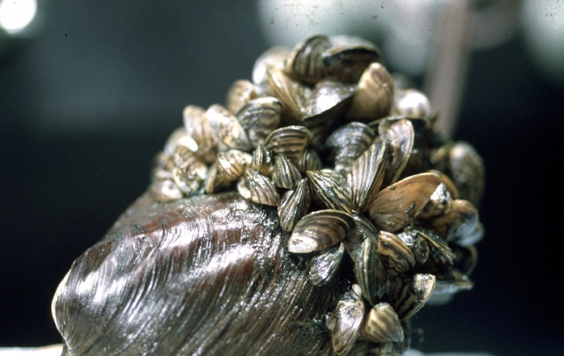
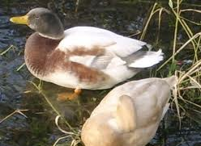
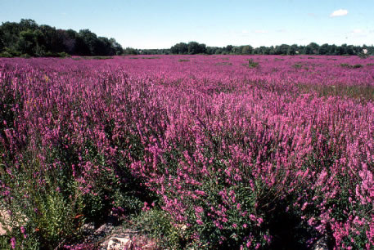
Environmental Damages
Genetic & Individual Impacts:
Hybridize with native species
Changes in morphology
Changes in behavior
Population Impacts:
Competition
Predation
Physical

Slide 7
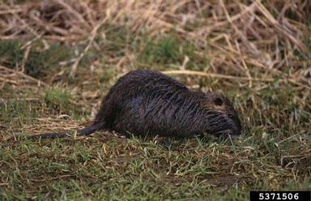
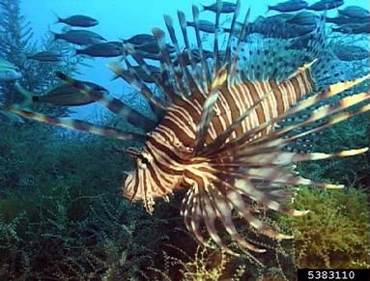
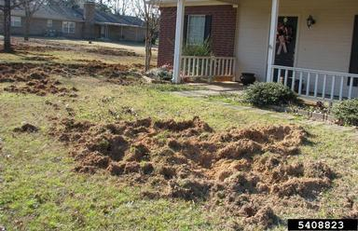
Environmental Damages
Community Impacts:
Species composition
Extinction
Ecosystem Impacts:
Fire
Soil health
Hydrology
Water yield
Erosion
Nutrient cycling
Biodiversity

Slide 8
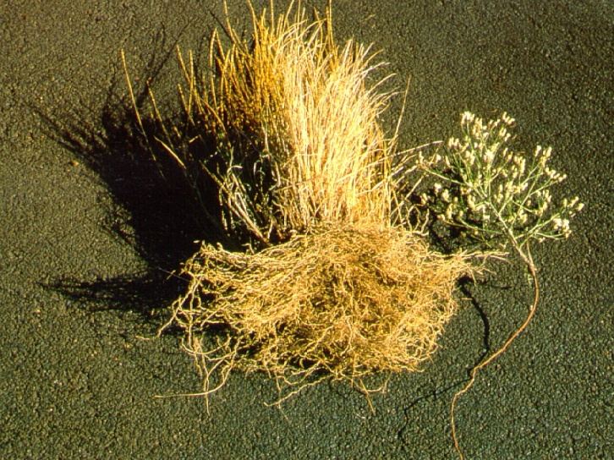
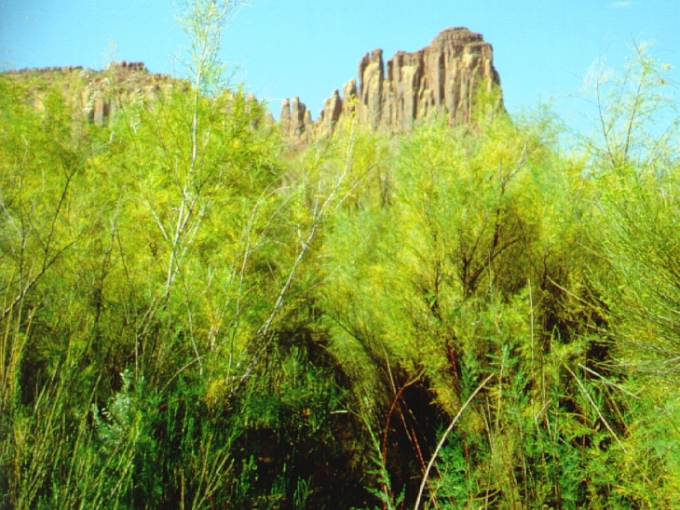
Ecosystem Function Damages
FIRE REGIMES
HYDROLOGY
EROSION
AQUATIC NUTRIENTS

Slide 9






What is being done nationally?
Administrative Committees: Examples
National Invasive Species Council
Federal Interagency Weed Committee
Texas Invasive Plant and Pest Council
Texas Invasive Species Coordinating Committee
Agencies:
Department of Agriculture (USDA)
Animal and Plant Health inspection Service (APHIS)
Natural Resources Conservation Service (NRCS)
Forest Service (FS)
Department of Commerce
Department of Interior
Many more…..

Slide 10



What is being done in Texas?
Texas Invasive Plant and Pest Council
Texas Invasive Plant and Pest Conference
Texasinvasives.org
Statewide partnership between agencies, universities, non-profits and others.
Informational hub
Invaders of Texas Citizen Science Program

Slide 11
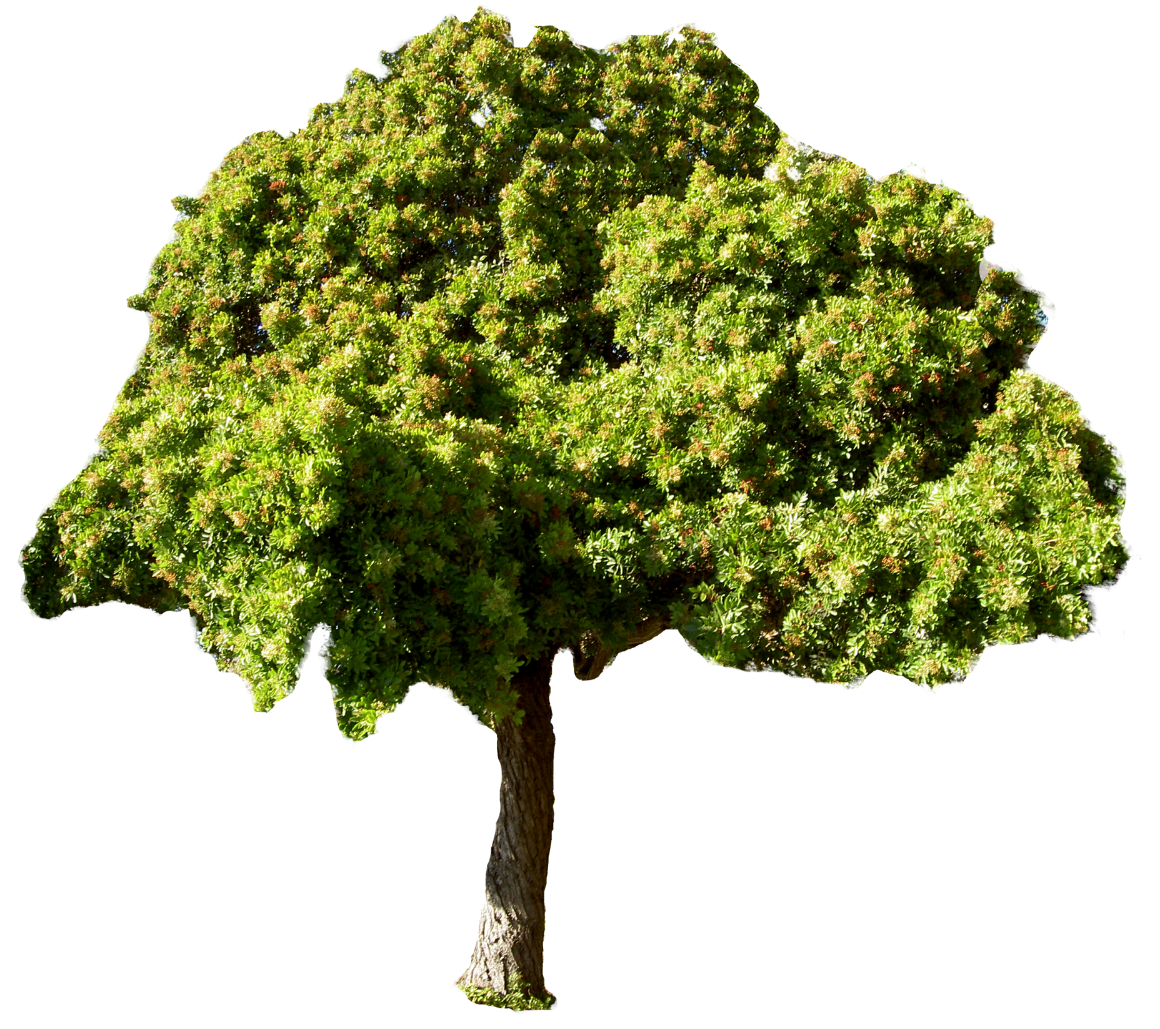
What’s going on locally?
Brazilian peppertree (Schinus terebinthifolius)
Native to Brazil, Argentina and Paraguay
Originally introduced as an ornamental species in 1800s
Displaces beneficial, native vegetation by forming dense thickets
A relative of poison ivy, sensitive persons can be affected by dermatitis

Slide 12
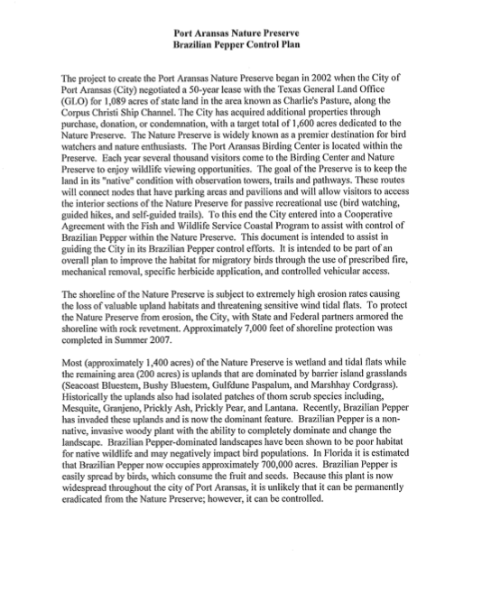
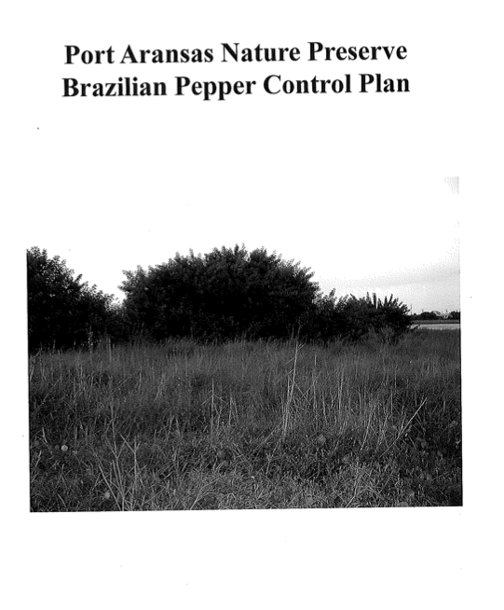
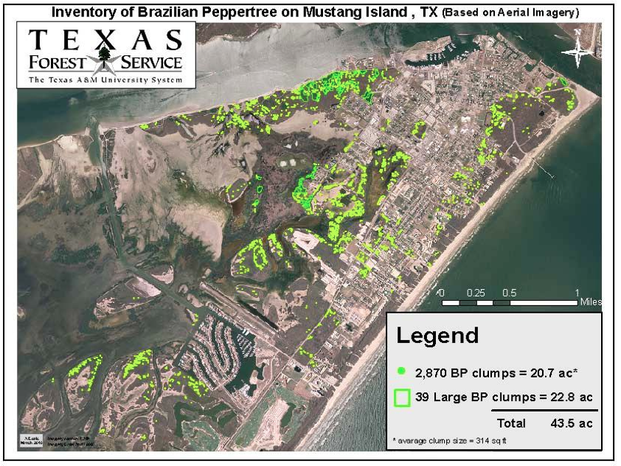
History of Control in Port Aransas
Port Aransas Nature Preserve Brazilian peppertree Control plan in 2008
Request to Texas A&M Forest Service for assistance in 2010
Applied for National Fish and Wildlife Foundation, Pulling Together Initiative in 2013

Slide 13
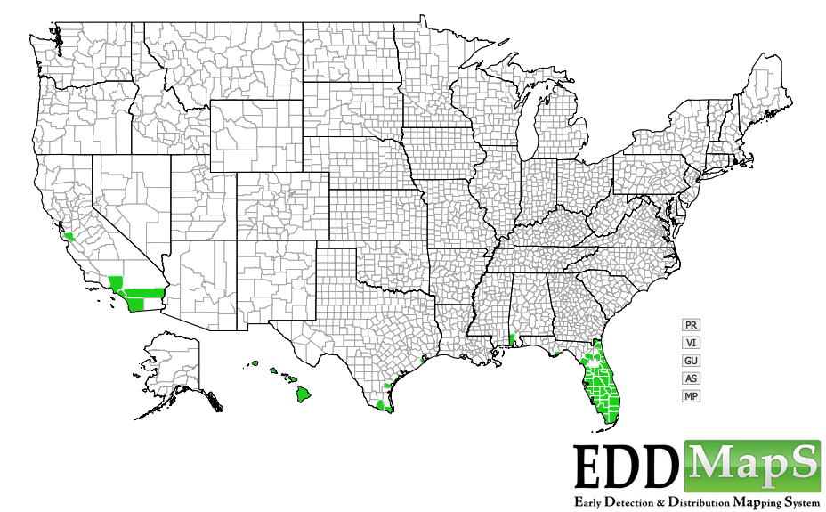
Need for a larger partnership
Brazilian peppertree distribution
Introduced to Florida in 1800s, as an ornamental species.
Now infests over 700,000 acres in Florida alone.
First reported in Texas in 2003 on Galveston Island.
Since has been report over 385 mile stretch of coastline, threatening sensitive coastal habitats.

Slide 14
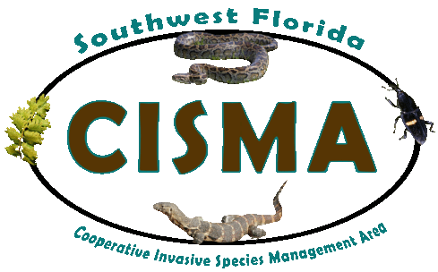


What is a CWMA?
Cooperative Weed Management Areas (CWMAs) are:
local
Informal
Non-regulatory
That facilitate collaboration across jurisdictional boundaries for more effective management.
Invasive species cross borders! Mangers should too.

Slide 15
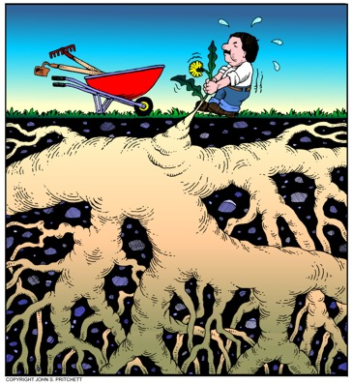
Benefits of a CWMA?
A CWMA can provide:
Support to partners working on similar issues.
A way for partners to share and leverage limited resources.
Visibility and better raise public awareness.
An early detection and rapid response network to new issues.

Slide 16
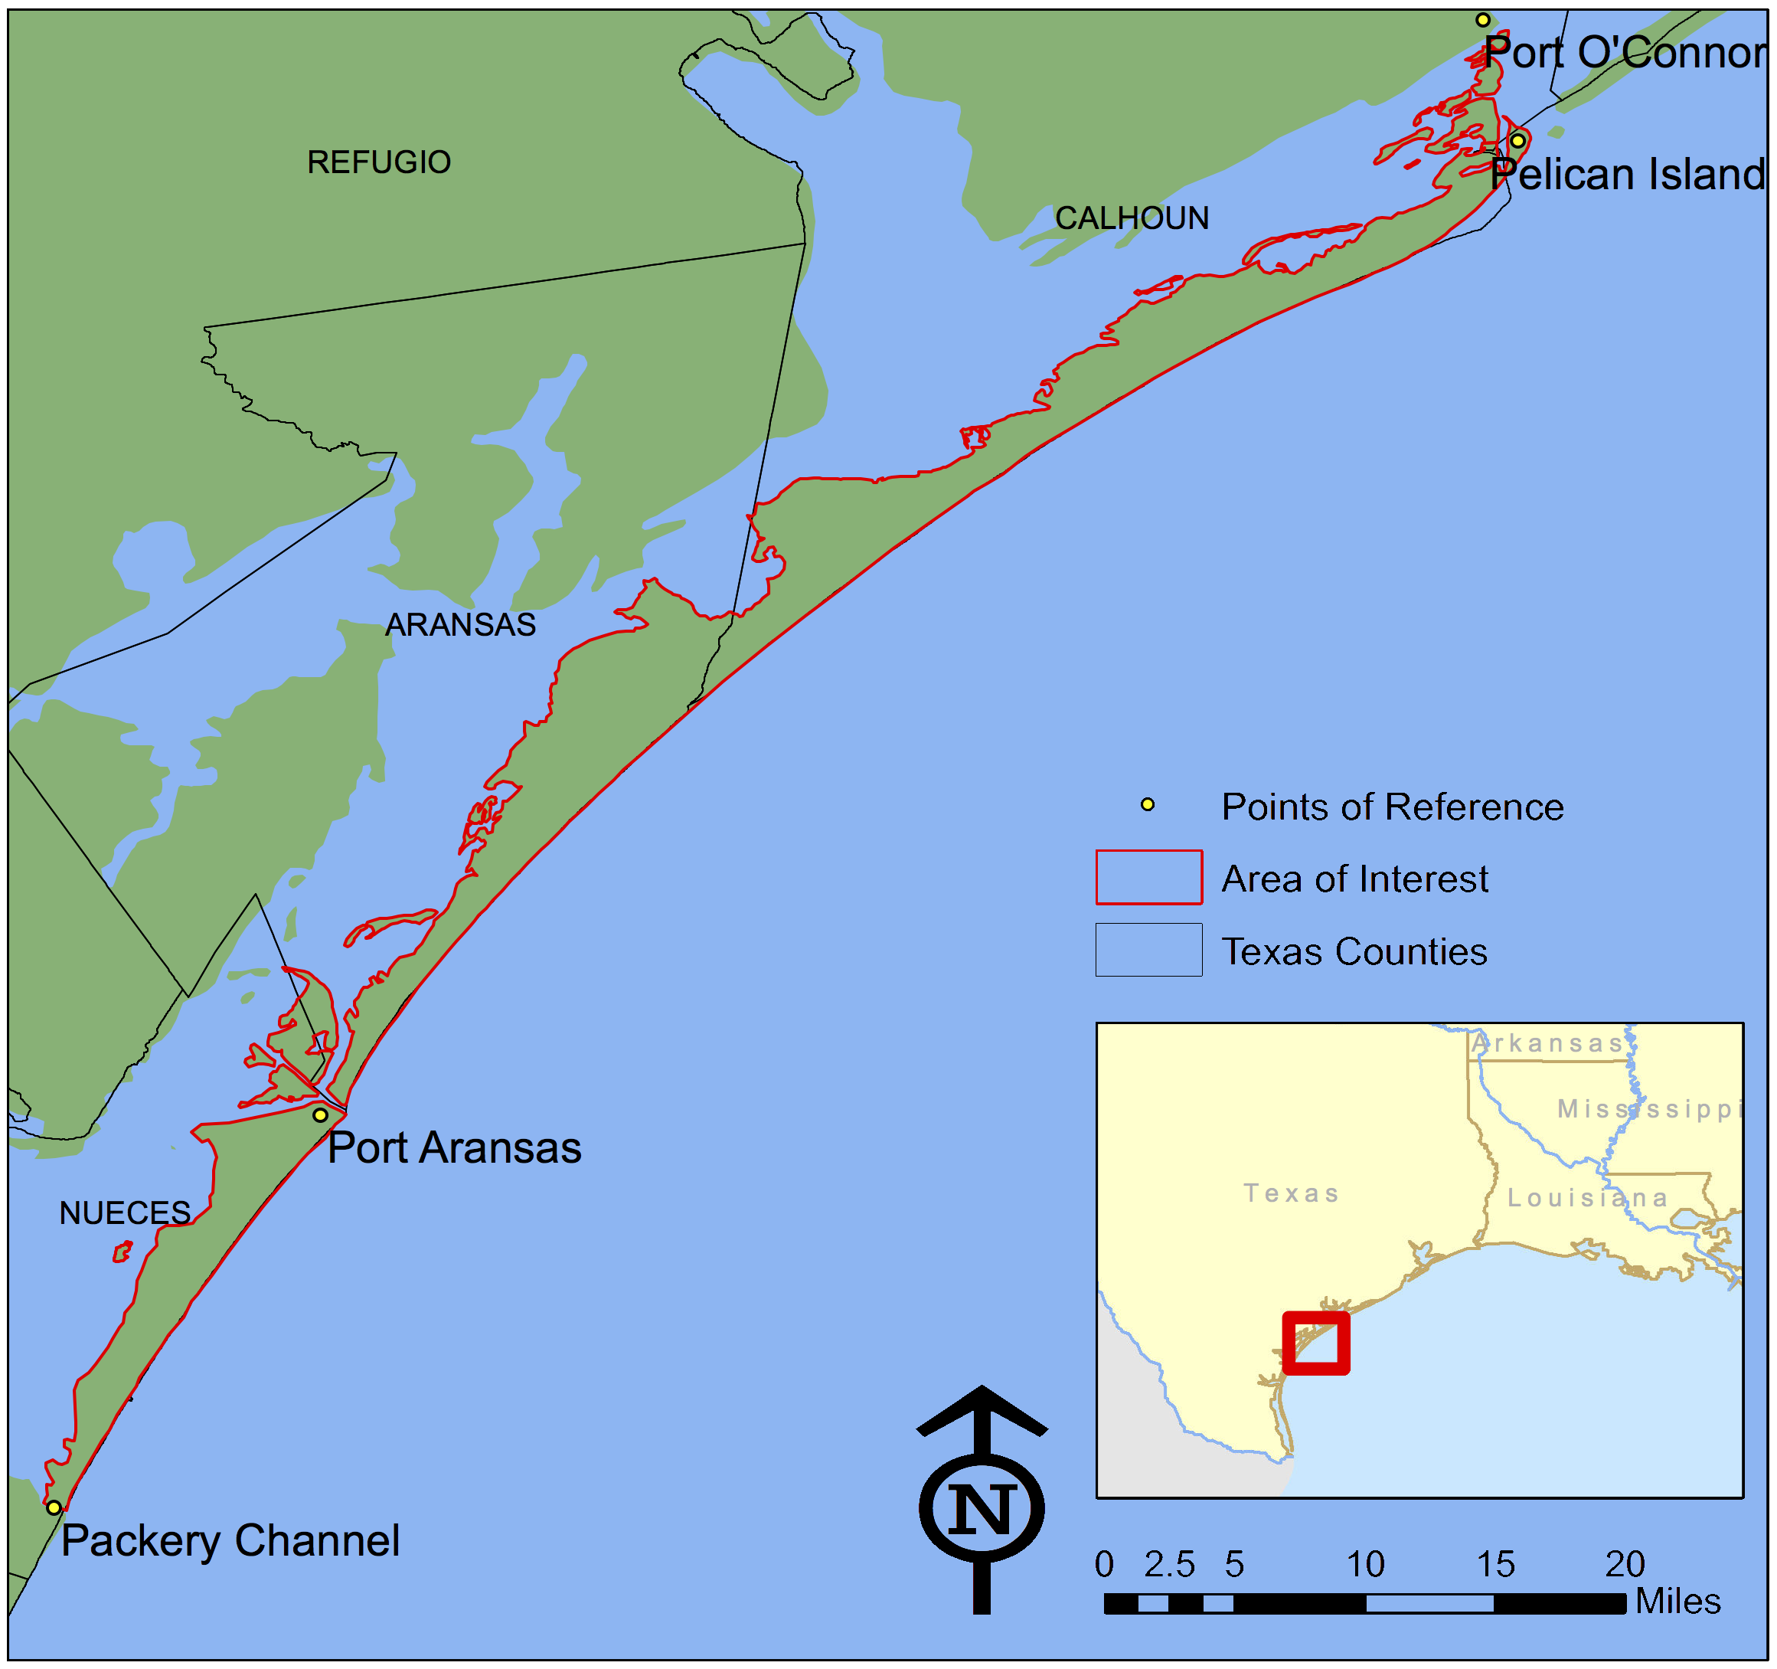

The project
Formation of one of Texas’ first CWMAs
Establishment of baseline distribution and impacts
Implementation of a control pilot project
Increased public awareness

Slide 17



Project partners
Members include public and private stakeholders concerned with management of invasive species.
CWMA includes private landowners, city/county public works departments, state agencies, conservation districts, universities and non-profits.
Founding partners:

Slide 18
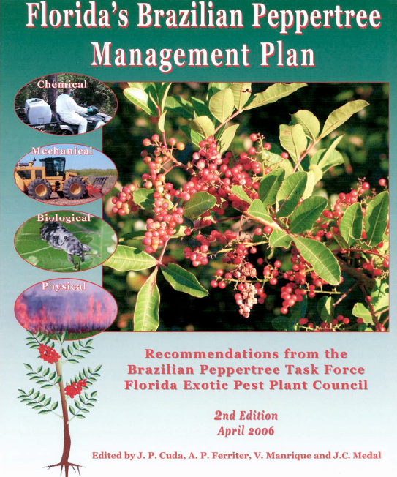
Project overview
Building institutional capacity:
Establish a CWMA for Brazilian peppertree.
Outreach and recruitment of additional partners.
Develop strategic management plan and organizational structure for long term success.

Slide 19
Project overview
Planning, Research, Monitoring:
Establish baseline information
Determine geographic extent of CWMA.
Compile known data from agency partners.
Development of database and GIS systems for tracking inventory and treatment.
Conduct surveys for new populations.

Slide 20
Project overview
Develop a pilot project for control and management of Brazilian peppertree:
Determine treatment areas
Design and implement EDRR
Develop an IWM strategy and risk assessment
Treat approximately 500 gross acres
Restore 15 acres of treated area and monitor efficacy
Identify
Control
Restore

Slide 21
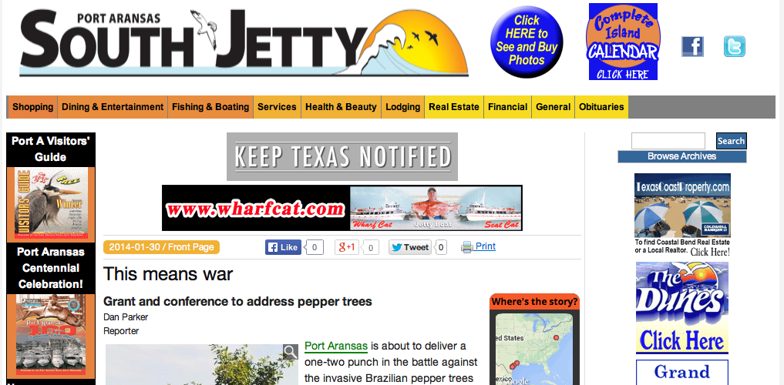
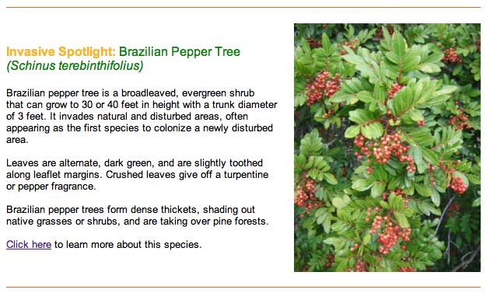
Project overview
Outreach, Education, Technical Assistance:
Create public engagement strategy for raising awareness
Direct outreach to 100 households adjacent to public lands
Outreach events:
Workshops, project presentations, public workdays

Slide 22
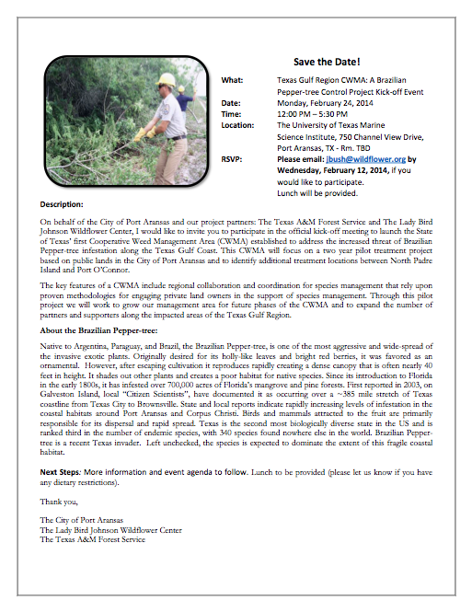
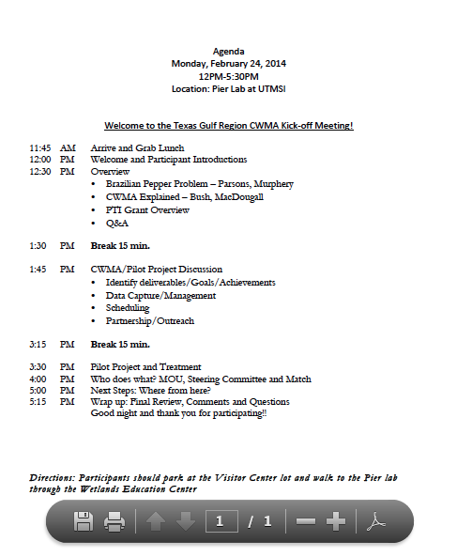
The kick-off
Kick-off meeting held in Port Aransas on February 24th.
Attended by 18 participants.
Formed a steering committee
Formed outreach subcommittee
Began to draft a MOU
Scheduled next meeting for April

Slide 23
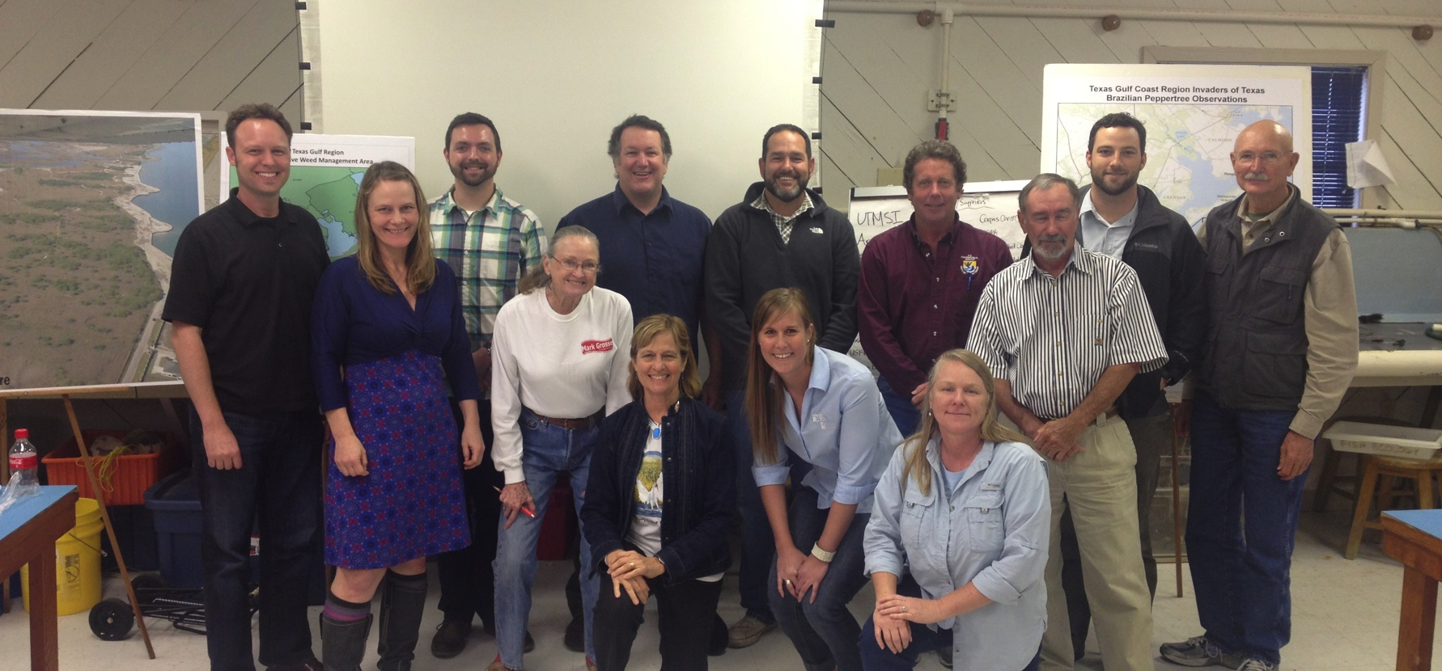
The kick-off

Slide 24
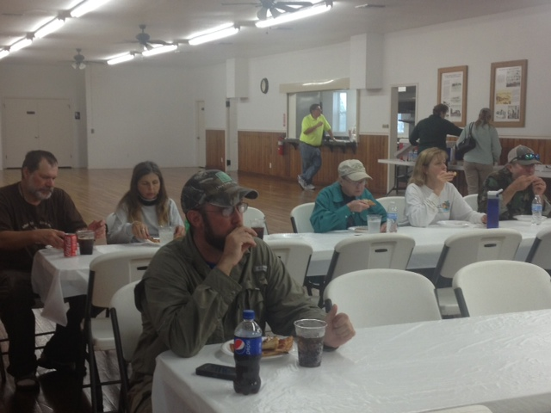
Community open house
Informational open house about the new community partnership
Participation from 25 members of the local community
Information included an
Brazilian peppertree impacts
Control
CWMA goals and objectives

Slide 25
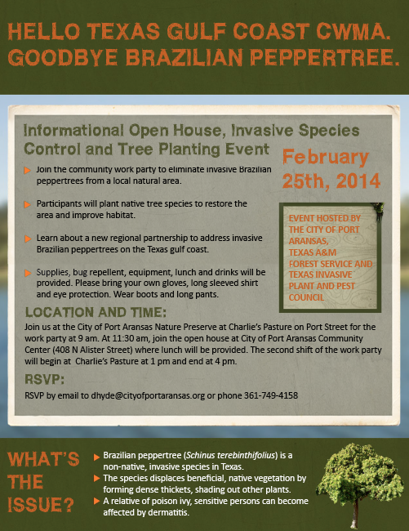
Community workday
Volunteer work event
City of Port Aransas and Texas A&M Forest Service led 75 volunteers and agency partners in control and restoration at Charlie’s Pasture
Community Open House
Education about Brazilian peppertree
Overview of CWMA and project plans

Slide 26
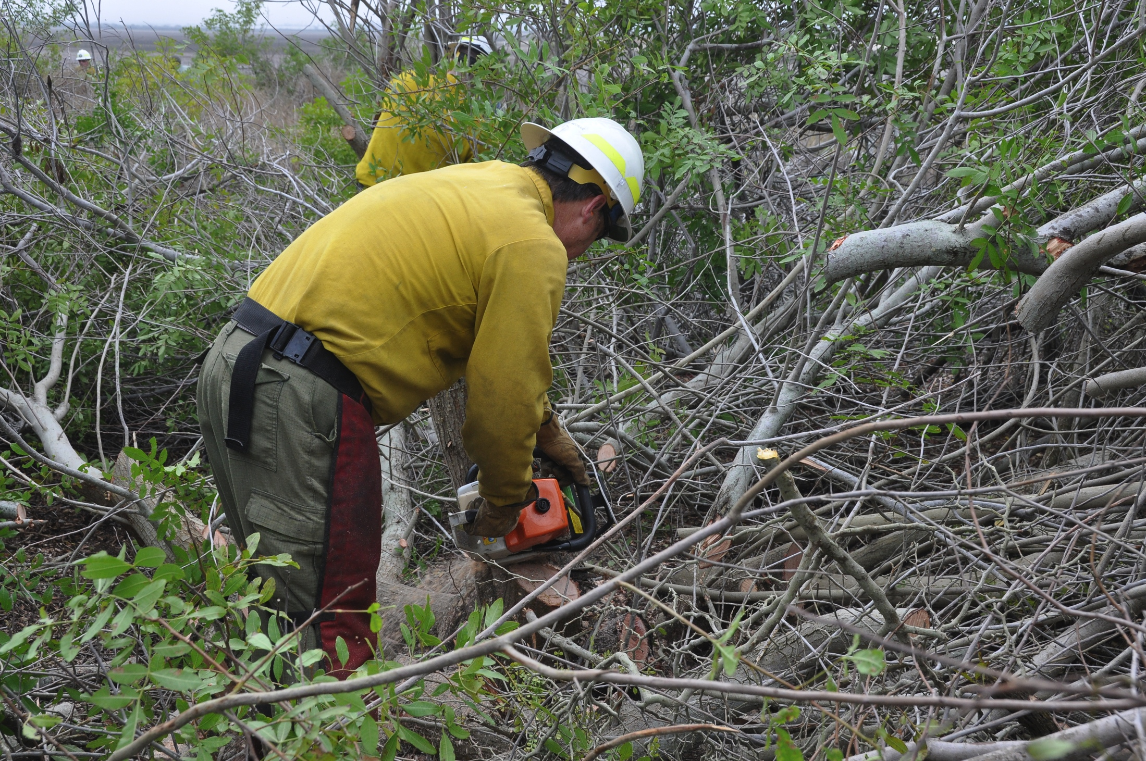
Community workday

Slide 27
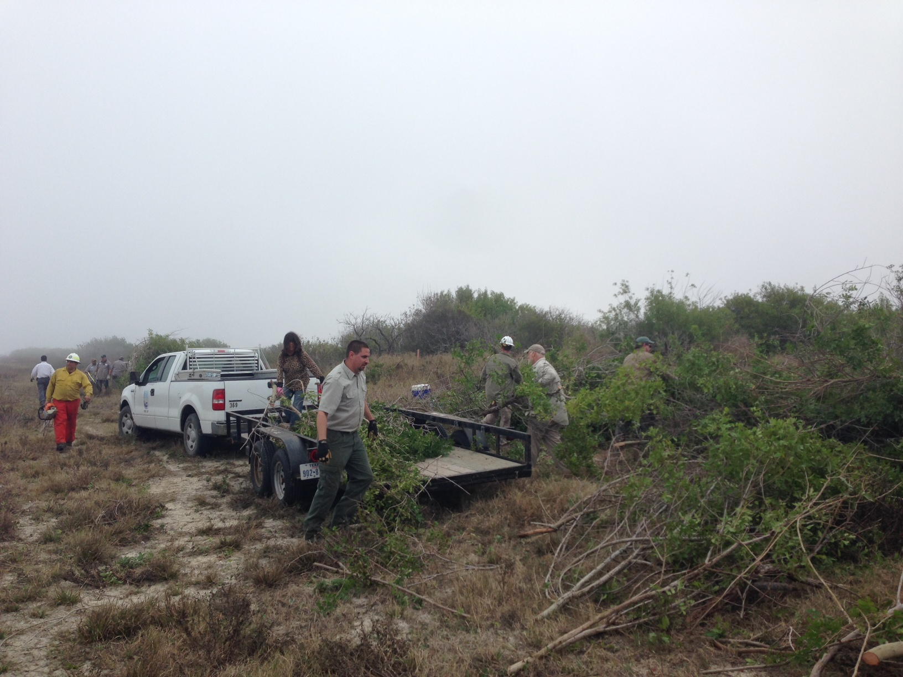
Community workday

Slide 28
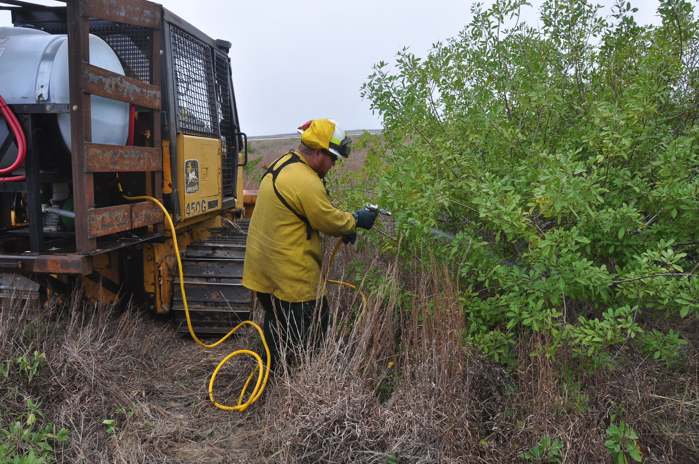
Community workday

Slide 29
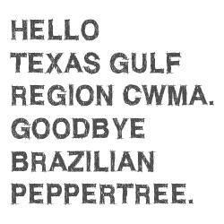
The future
Bi-monthly CWMA meetings
Formation of CWMA committees
Leadership
Funding
Outreach
Long term-strategic plan
Public awareness campaign
Identification of pilot control locations
Community workshops and workdays

Slide 30
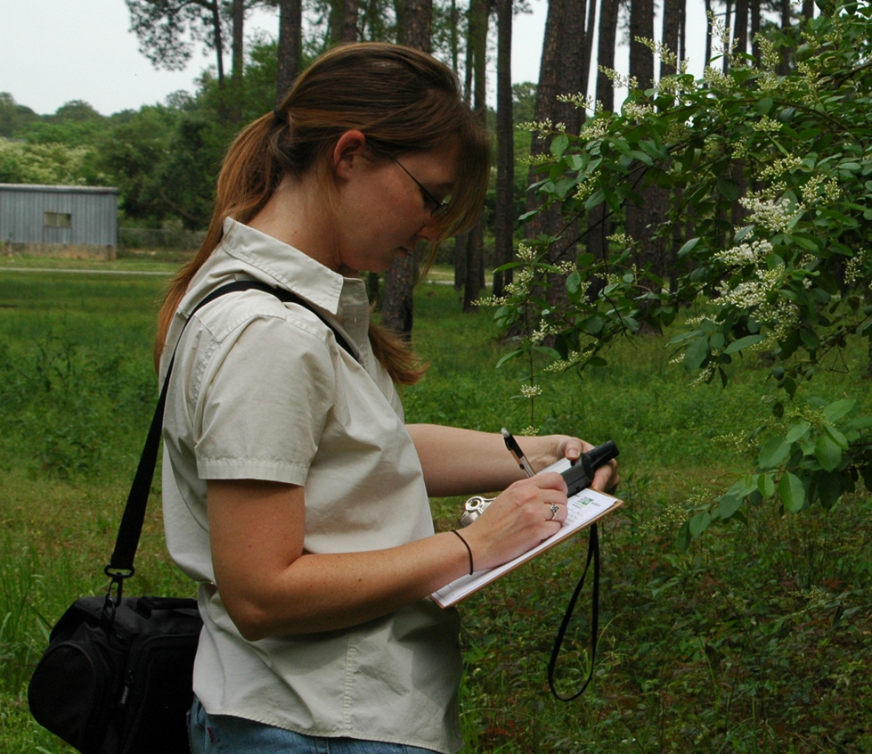
How can you get involved?
Contact the City of Port Aransas to learn about upcoming work parties to remove Brazilian peppertree.
Contact invaders@texasinvasives.org to learn about upcoming Invaders of Texas Citizen Scientist workshops in your area.
Remove Brazilian peppertrees from your own landscape and plant only native plant species.
Find and report Brazilian peppertrees using the TX Invaders phone app!

