Slide 1
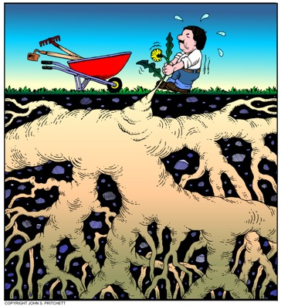
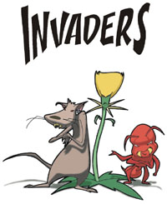





LADY BIRD JOHNSON WILDFLOWER CENTER
INVASIVE SPECIES INITIATIVES OUTREACH
CITIZEN SCIENCE
MANAGEMENT
RESEARCH
Jessica Strickland
Lady Bird Johnson Wildflower Center
Spring 2013

Slide 2

Let’s Talk About It: Overview
A Cause for Concern: Invasive Species
Background
Invasive Species Defined
Introduction and Spread
Damages
Environmental
Economic
Human health & Social/Recreational
Response
Policy
Education & Outreach
Texas Invasives
Invasive species in Texas
Texas Department of Agriculture Noxious Plant List
City of Austin Top 24 Invasive Plants List
Texas “Dirty Dozen” Pest List
How To Take Action: You!
Texasinvasives.org & The Invaders of Texas Program
Monitoring and Reporting
Alternative Planting & Eradication
1
2
¹www.nv.blm.gov/invaders/ ²www.dferoafferro.wordpress.com/2010/02/20/film-quote-lonesome-jim-2005/

Slide 3
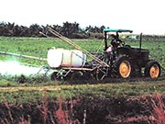
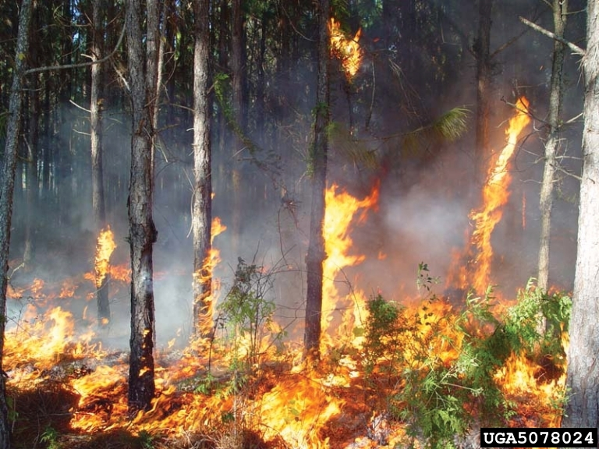
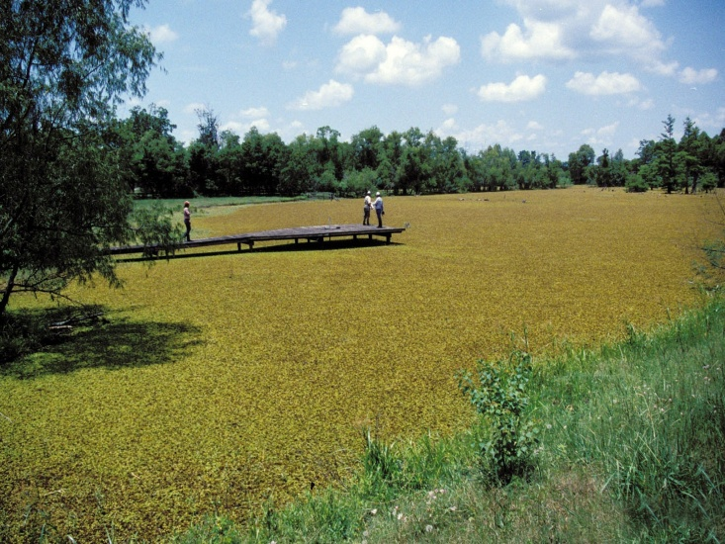
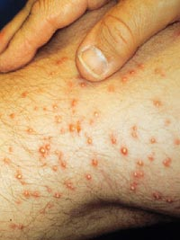
Invasive Species: Background Federal Definition
An invasive species is defined as a species that is non-native (or alien) to the ecosystem under consideration and whose introduction causes or is likely to cause economic or environmental harm or harm to human health. (Executive Order 13112).
USGS
USDA
Harm: Economic
Pesticide application
Harm: Environmental
Increases wildfire intensity
Harm: Social/Recreation
Sport fishing compromised
Harm: Human Health
Fire ant bites
Notes:
Many of these examples could easily fit into more than one category. For instance, waterways cogged by invasive plants in certainly an economic cost to fishing companies, and industries using pipes for water disposal. But waterways clogged by invasive plants growing on the surface can also cause an ecological disaster by blocking life-giving sunlight for submerged plants. Clogged waterways can also cause social costs by making recreational rivers and lakes unusable for boating, fishing, and swimming. (NISIC, 2007 [http://alic.arid.arizona.edu/invasive/sub1/p4.shtml]}

Slide 4
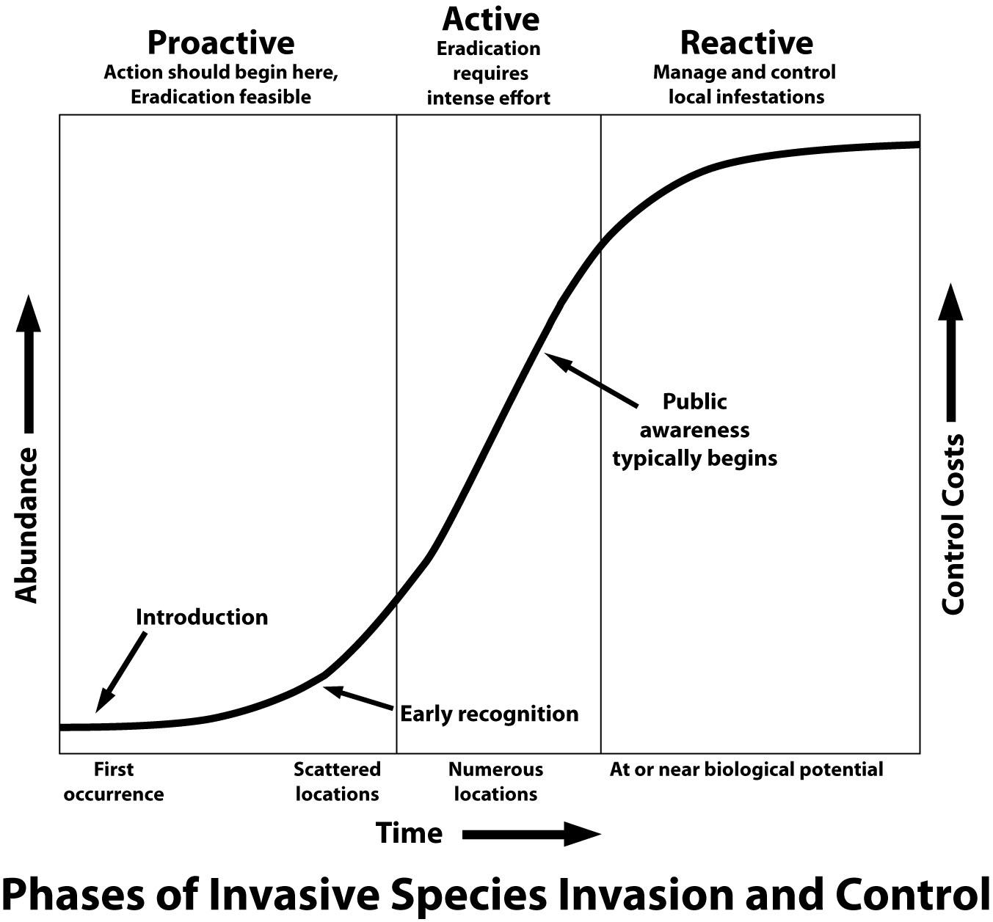
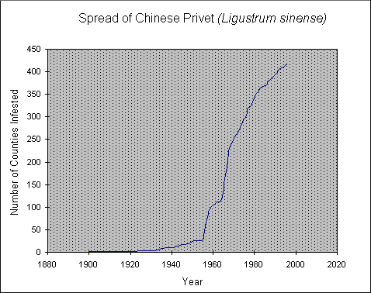
Invasive Species: Background
Are All Exotic’s Invasive?
Not All Exotics Are Invasive
98% U.S. agricultural crops are non-native
Remember: Must Cause Harm
How Exotics Become Invasive
Become naturalized
“How” Example: Ornamental Plants
1
1
When Do We Notice?
“The Lag Phase” may be decades
1
¹The University of Georgia - Center for Invasive Species and Ecosystem Health, 2011
Notes:
Just to be clear, not all exotics are invasive. Exotic or non-native species are considered to be invasive only when they cause harm. Of our agricultural crops 98% are not native to the regions where they are grown. Predicting which plants will become invasive is difficult. Scientists are still trying to discover why a plant can suddenly become an invasive problem after many years. The two lists here show that many of the characteristics we prize in an ornamental plant are very similar to the characteristics which increase the likelihood of a non-native plant becoming an invasive problem.
If a non-native plant is used over a long period of time, it stands a better chance of naturalizing. Extensive use in landscaping also increases the likelihood that a plant will naturalize, which is the first step to becoming an invasive problem. Many invasives start on disturbed soils and habitat disturbances such as construction, grading, plowing and mowing which can increase the vulnerability of any habitat to invasive species. Areas such as rights-of-way, fencerows, old fields, ditches and roadsides all have a high rate of disturbance.
Some non-native plants were used here for many years before they became an invasive problem. This phenomenon has been termed “The Lag Phase”. This refers to the period of time after a plant has been introduced, escapes, and naturalizes but before the population reaches the point at which it begins to increase rapidly. It may take decades before a plant becomes an invasive problem. This is one reason it is important to track populations of non-native plants which have escaped and naturalized, even though they may not actually be invasive at this time. Tracking non-native plant populations is especially important for species which have been shown to be an invasive problem in other regions, states or countries.
The graph shown above represents the lag phase of Chinese privet in the South. Control measures would have been more effective and much less costly had they been started in 1960 as the privet began its rapid spread. Early Detection & Rapid Response programs attempt to identify problem species in the early stages of infestation, so that control measures can be taken before their populations become so large that control is difficult or impossible.
(The University of Georgia - Center for Invasive Species and Ecosystem Health, 2011)
Lag Times
One common feature of invasions is a lag time between initial colonization and the onset of rapid population growth and range expansion (Mack 1985, Kowarik 1995). This lag time is often interpreted as an ecological phenomenon (the lag phase in an exponential population growth curve). Lag times are also expected if evolutionary change is an important part of the colonization process. This process could include the evolution of adaptations to the new habitat, the evolution of invasive life- history characteristics, or the purging of genetic load responsible for inbreeding depression. It appears likely that in many cases there are genetic constraints on the probability of a successful invasion, and the lag times of successful invasives could be a result of the time required for adaptive evolution to overcome these genetic constraints (Ellstrand & Schierenbeck 2000, Mack et al. 2000).
Multiple introductions are often correlated with the eventual success of non- native species’ establishment and invasiveness (Barrett & Husband 1990). Indeed, North America’s most successful invasive birds, the European starling (Sturnus vulgaris) and the house sparrow (Passer domesticus), both became invasive only after repeated introductions (Ehrlich 1989). Migration may be critical not only as a source of continuing propagule pressure, but also as an important source of genetic variation to the colonizing population, if multiple invasions provide the genetic variation necessary for adaptive evolution. Multiple introductions can create in- vasive populations that are much more genetically diverse than any single source population when the invasive species is highly structured in its native range. Differ- ent colonizing populations of the same species are likely to be genetically divergent with different levels of genetic variation and therefore have different capacities to promote invasiveness; characteristics that promote invasiveness might evolve in some populations but not others. Gene flow between populations could result in the spread of invasive genotypes. Alternatively, gene flow between populations that swamps out locally beneficial alleles could prevent evolution of invasiveness (e.g., Kirkpatrick & Barton 1997).

Slide 5
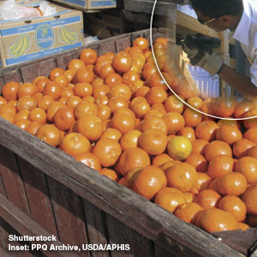
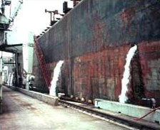
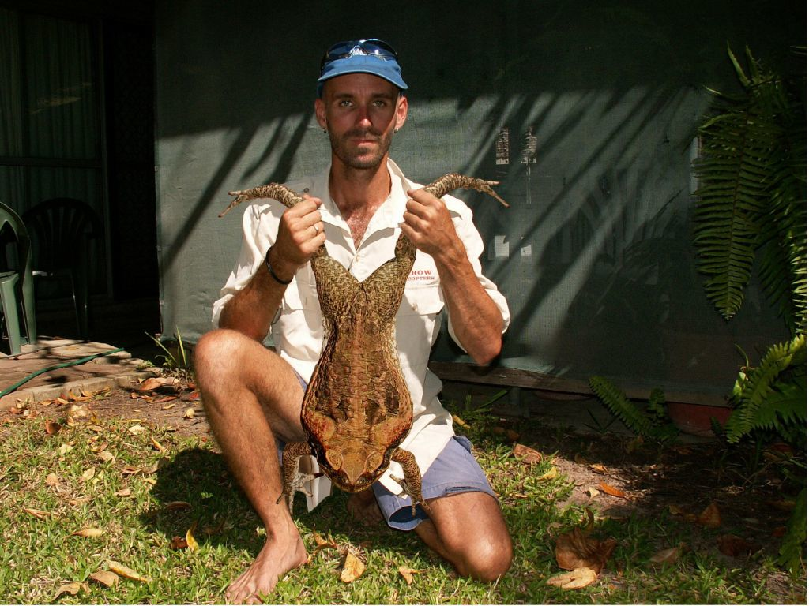
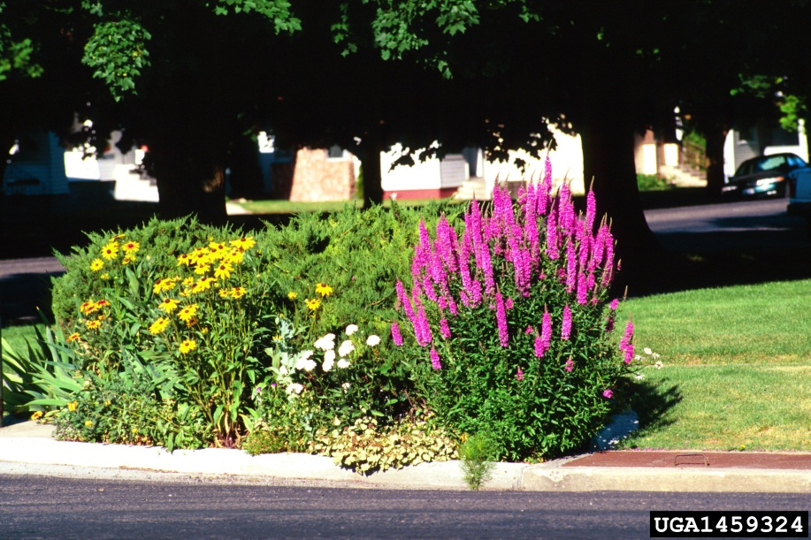
Invasive Species: Introduction
Into the U.S.
Accidental
Produce
Nursery stocks
Ship ballasts
Packing materials & shipping containers
Recreational travelers
Purposeful
Biological Controls
Ornamentals
Agriculture
Pets/Aquariums
1
2
2
¹L. David Smith, Smith College, MA ²www.larvalsubjects.files.wordpress.com/2010/05/cane_toad.jpg
Notes:
Some species were introduced accidently in packing material, as crop contaminants, in shipping containers or from the cargo holds of ships. But many invasive plants have been brought here deliberately. Only a small portion of non-native species are invasive. We rely on non-native plants for food, for their beauty as ornamentals in our gardens, for their usefulness in feeding wildlife, and enhancing our environment. (The University of Georgia - Center for Invasive Species and Ecosystem Health, 2011)

Slide 6

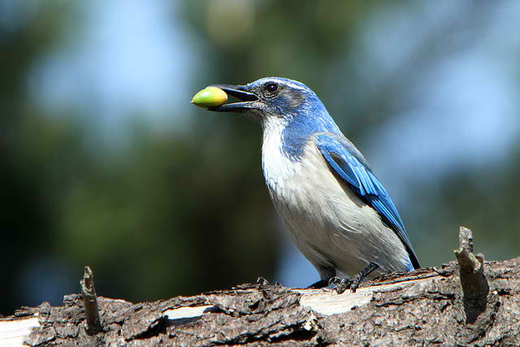
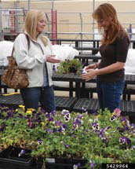
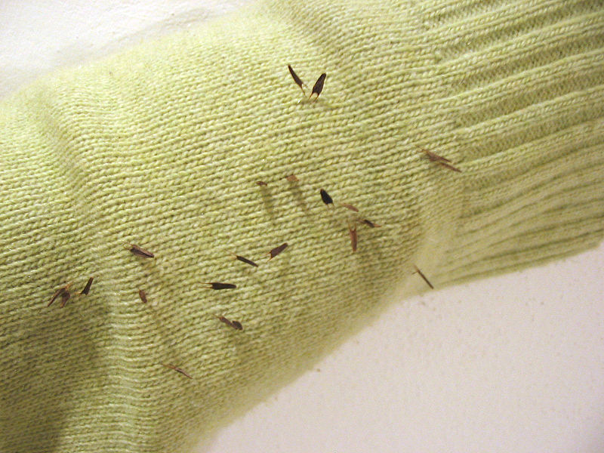
Invasive Species: Spread
Within the U.S.
Natural
The Elements
Flight
Wildlife
Humans
Ornamental planting
Erosion control
Mowing practices
Vehicles
Firewood
Boots and gear
1
2
2
3
¹National Health Museum, 2009 ²Alan Vernon, Fliker ³Aelwyn Fliker 2007

Slide 7
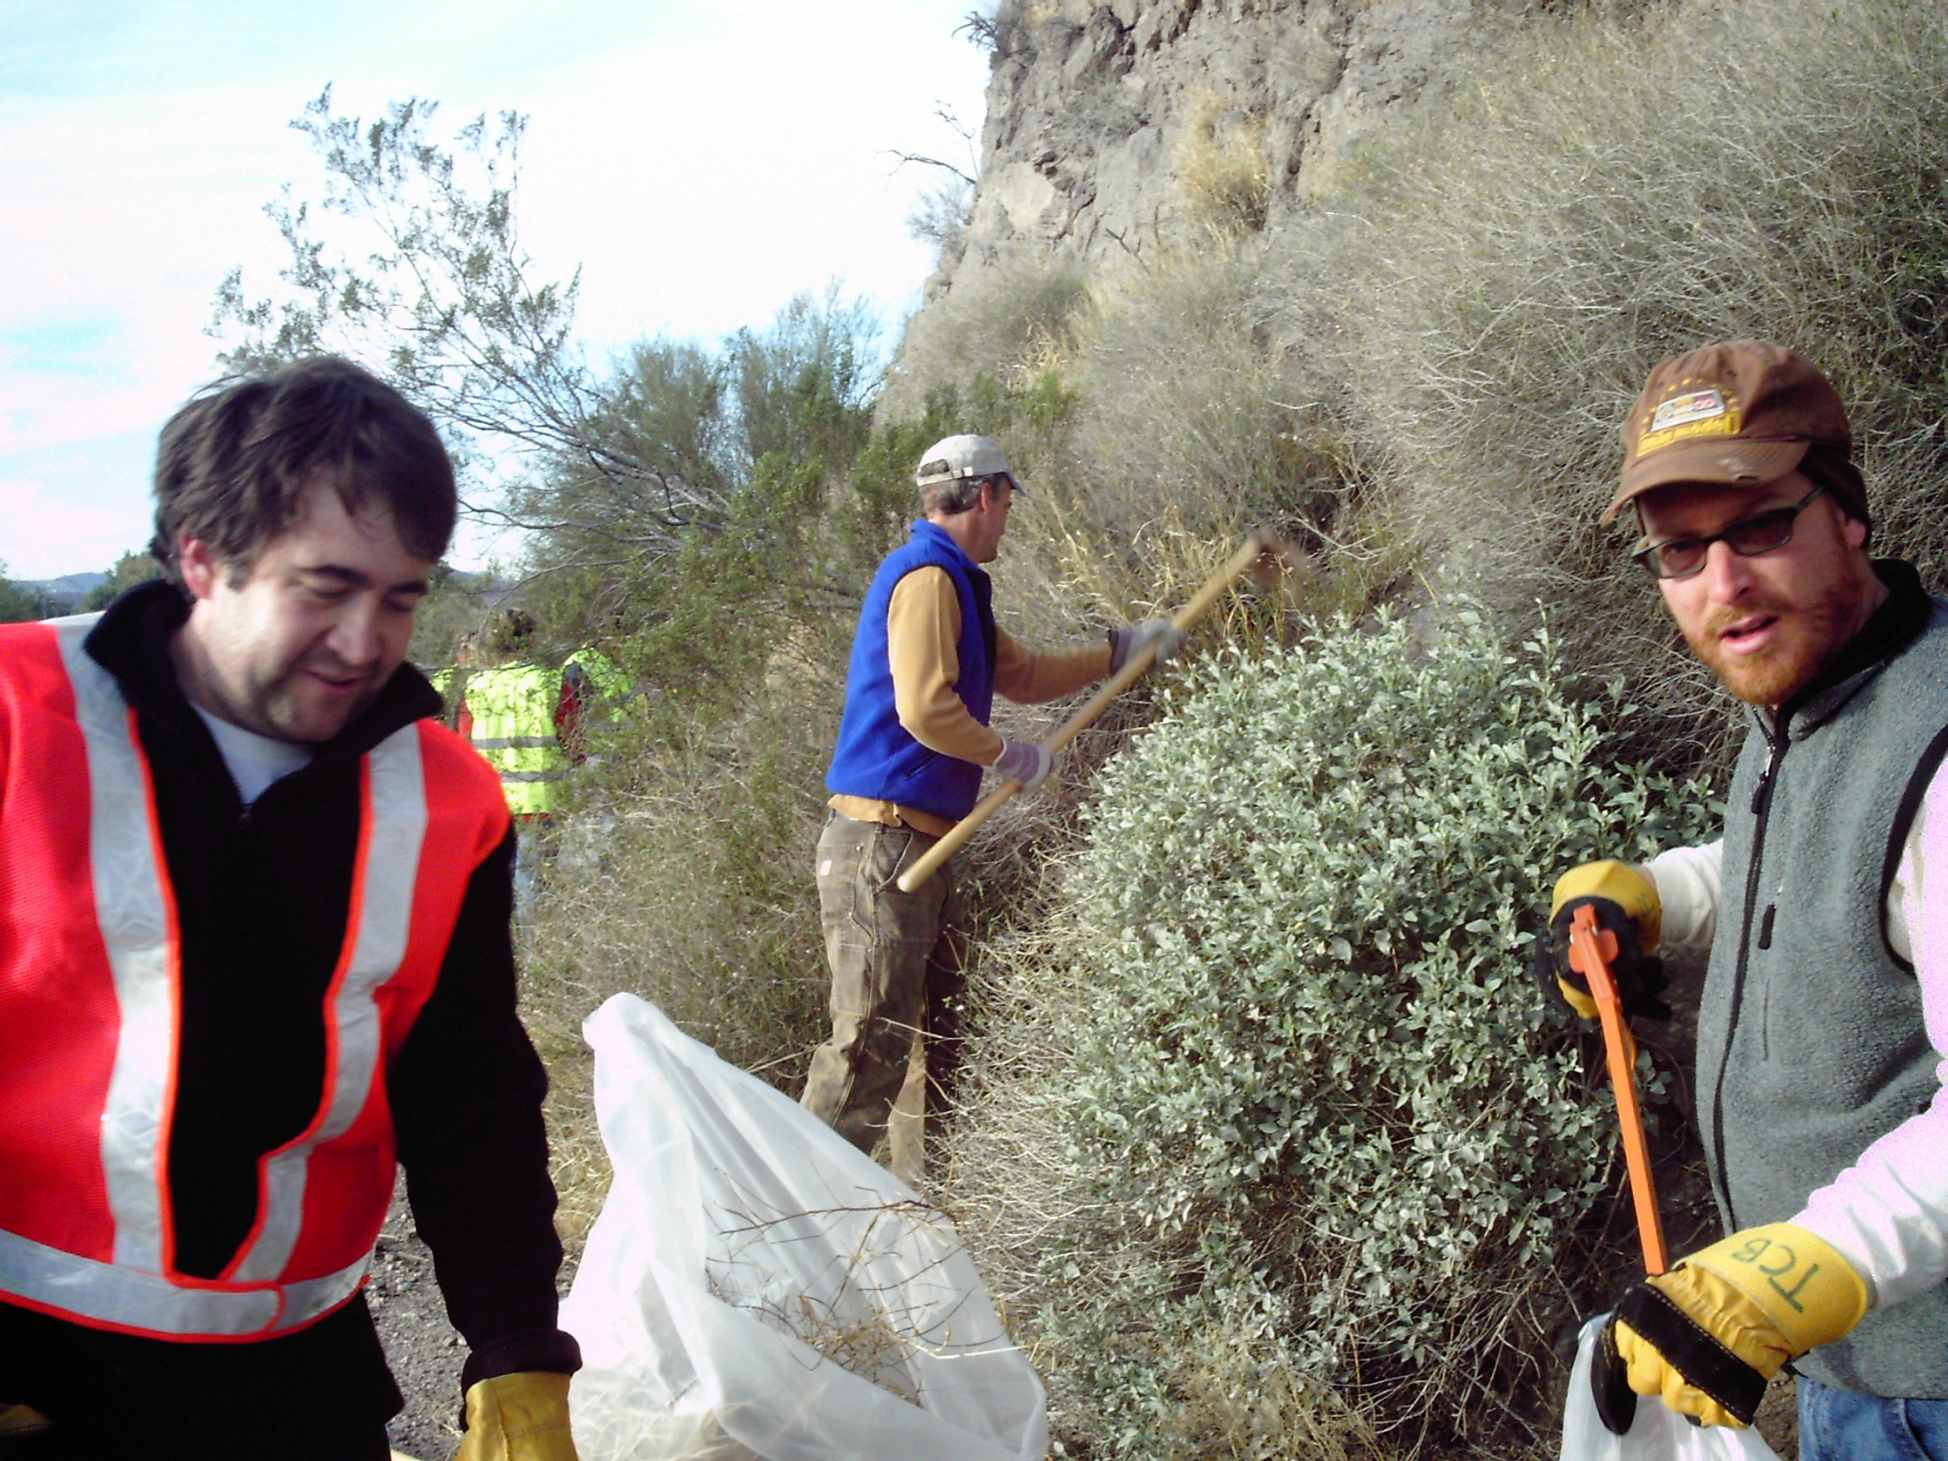

Notes:
One Ecosystem’s trash……

Slide 8
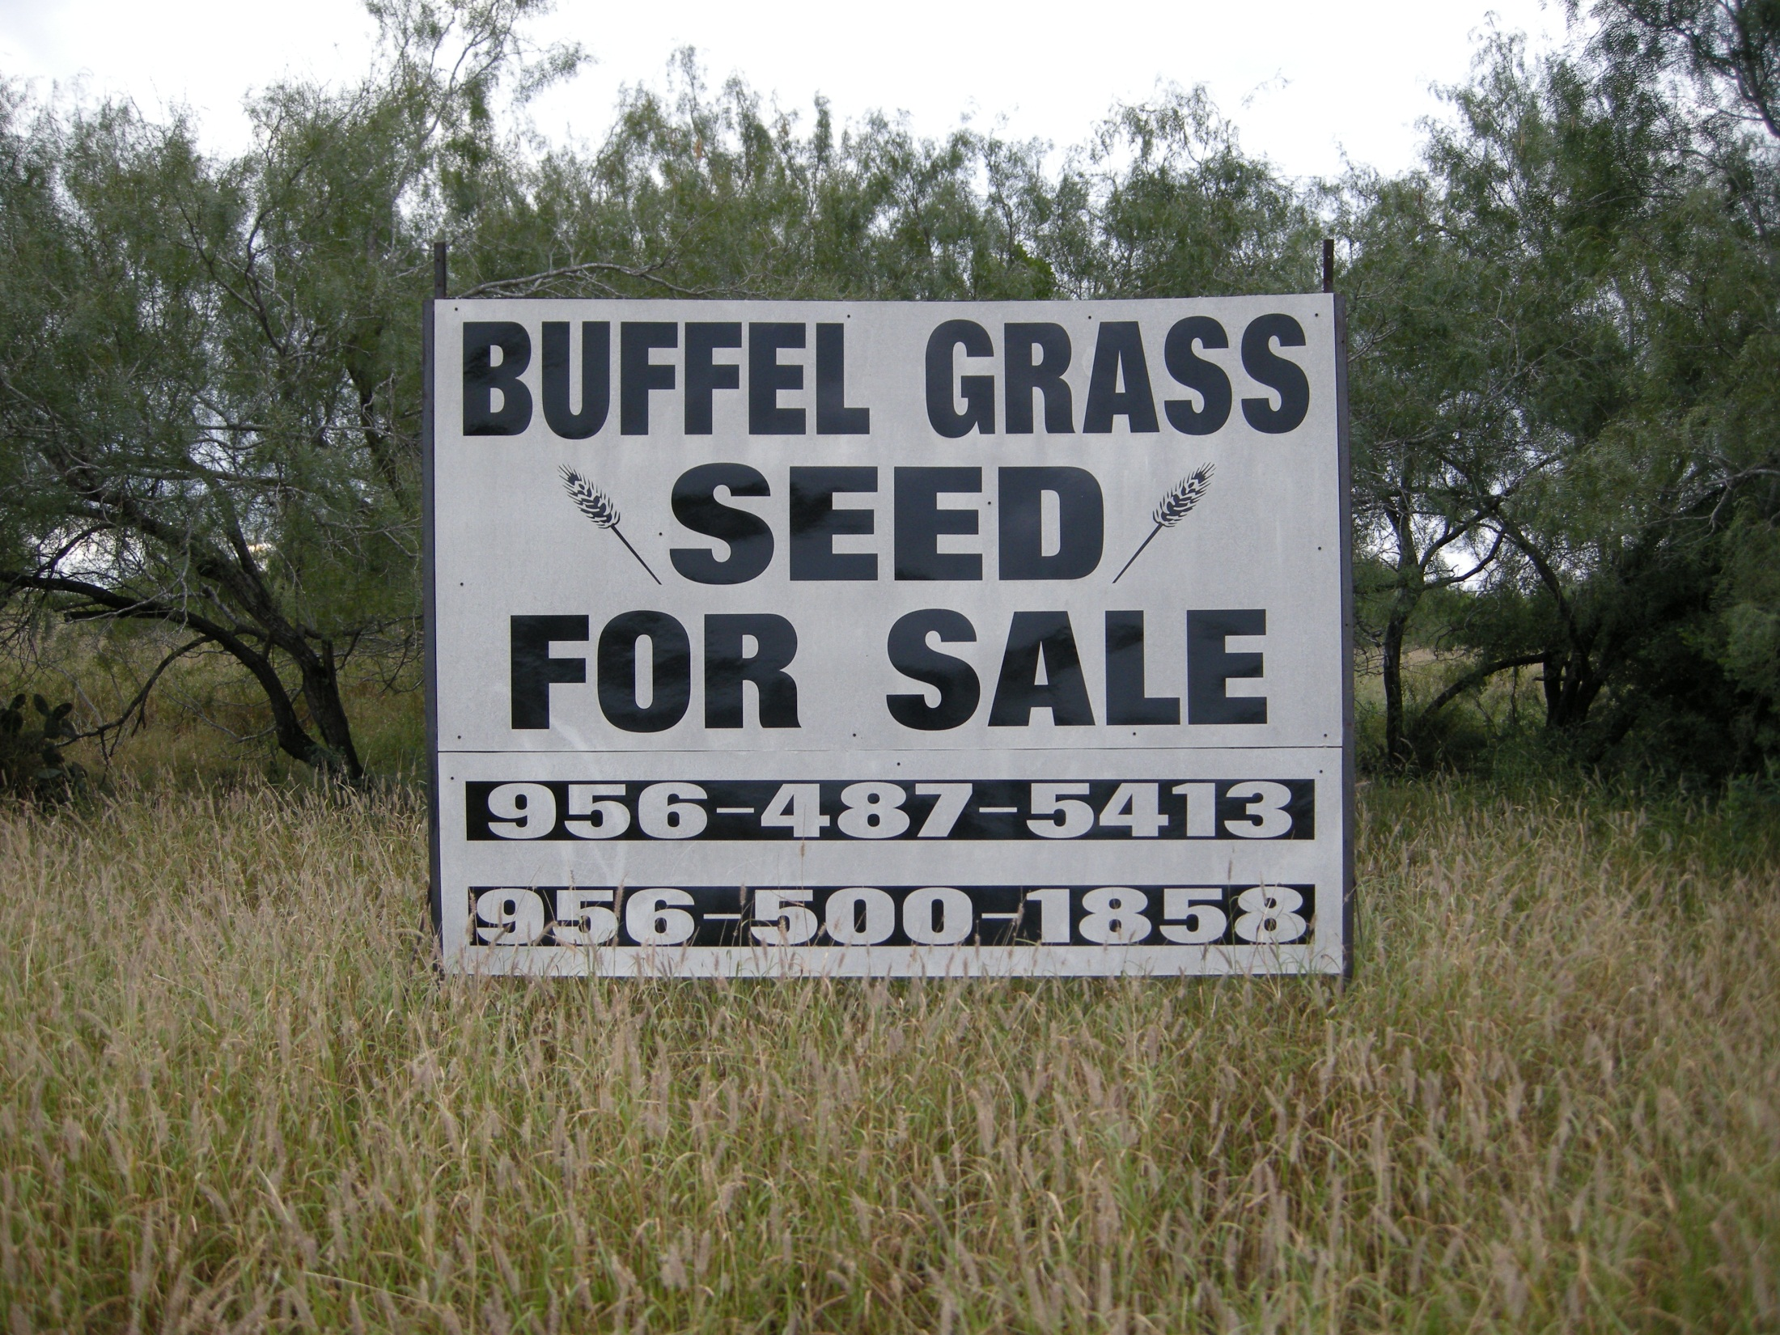
Notes:
Is another Ecosystems treasure.

Slide 9
Invasive Species: Damages
Economic
50,000 non-native species in the U.S. costs over $138 billion annually:
Examples:
Agricultural Losses: 65% of crop losses ($21 billion) attributed to non-native plant pathogens¹
Urban Pest Management: Pigeons cost over $1 billon/year in control and damages¹
Aquatic Nuisances: Zebra mussels cause $100 million/year in damages to pipes and filtration systems¹
Insect Damage and Control: Fire ants cause $500 million/year in livestock, wildlife, and public health damages and control efforts in TEXAS alone²
Feral Animals: cats kill approximately 465 million birds/year and cost an estimated $14 billion/year¹
2
2
¹National Invasive Species Information Center, 2006 ²Pimentel et al., 2000
Notes:
Some statistics
Approximately 50,000 non-native species are estimated to have been introduced into the U.S.
Invasive species are estimated to cost about $138 billion in environmental damage and losses each year.
Non-native plants are invading about 1.7 million acres of U.S. wildlife habitat each year.
Examples:
Yellow starthistle, an invasive plant, now dominates almost 10 million acres of once productive grazing land in northern California.
Pigeons, considered the most serious introduced bird pests, are estimated to cost over $1 billion annually for control and damage to property.
It is estimated that fire ants, an introduced insect species, have caused a 34% decrease in the nesting success of swallows, a ground-nesting bird.
An introduced mollusk, the zebra mussel, reduces food and oxygen for native fauna; it also causes $100 million annually in damage to water pipes and filtration systems, and in control costs.
Approximately 65% of the crop losses attributed to plant pathogens (primarily fungi), or $21 billion, is attributed to non-native species.
Economists and other researchers have used several methods in an attempt to estimate the costs of invasive species. Presented below are some examples:
Plants – It is estimated that there are over 25,000 non-indigenous plants have escaped cultivation and become established in U.S. ecosystems. In the 1990s, such weeds cost the U.S. economy about $20 billion for herbicides, mechanical control, and other management practices. Costs to control weeds for major crops and animal health were as high as $15 billion. Most of the rest of the cost was for weed management on golf courses, forests, aquatic areas, and other non-crop sites. The value of losses for these sites is generally not calculated, so it is not part of the $20 billion figure.
Fish – Invasive fish are estimated to cost about $6 billion annually in the U.S. (although this estimate varies considerably depending on whether the value of introduced fish to the sport fishing industry is included or not). As of 1997, there were 138 species of non-indigenous fish established in the country, most found in states with mild climates like Hawaii, California, and Florida. Invasive fish negatively change aquatic ecosystems by, for example, increasing the water’s turbidity or reducing native vegetation. In addition, exotic fish sometimes hybridize with natives, diluting the genetic integrity of both involved species.
Birds – About 10% of the bird species in the U.S. were introduced into the country. About 95% of these bird additions are considered detrimental because they damage property and crops, and spread disease; but introduced species can be beneficial…like chickens! The common pigeon (Columba livia) is probably the most notorious invasive bird because of its sheer numbers. This bird dirties structures, feeds on valuable crops, and carries and spreads over 50 known diseases. It has been estimated that pigeon control alone costs over $1 billion annually.
Mammals – Several species of domestic animals including pets and livestock have escaped into the wild and become invasive. These include dogs, burros, pigs, and deer, and are responsible for problems like habitat destruction and eating native plants to the point of extinction. Invasive mammals also destroy populations of native animals. For example, feral cats are responsible for the death of millions of birds and countless amphibians and small mammals. The most numerous invasive mammals are no doubt rodents, primarily rats and mice. While many rodent species are native, several dangerous and detrimental species were imported from all over the world. Some estimates as of 2004 published by the USDA for cost of invasive mammals include:
Horses (Equus caballus) and burros (Equus asinus) introduced into western states cost about $22 million annually
Feral pigs (Sus scrofa) cause damage nationwide of about $800 million/year
Feral dogs (Canis lupus) cause about $9-10 million in losses to cattle and sheep each year
Feral cats (Felis silvestris) kill about 465 million birds per year at an estimated cost of $14 billion
Nutria (Myocastor coypus) cost over $6 million per year in damage to sugarcane
Rat (Rattus rattus) destruction of stored grains in the U.S. averages more than $19 billion per year
Mollusks – These invertebrates are aquatic organisms that often arrive in the U.S. in ship ballast water. Two particularly important offenders are the zebra mussel (Dreissena polymorpha) and the Asian clam (Corbicula fluminea), which clog waterways and decrease populations of native aquatic species. The zebra mussel is expected to invade most bodies of fresh water in the U.S. by about 2020, and is already estimated to cost $5 billion/year for control and repairs due to infestations. Control of the Asian clam is estimated to cost $1 billion annually. On the west coast, a new invader to San Francisco Bay is the shipworm (Teredo navalis), a mollusk estimated to cost $200 million annually for control and containment.
Insects and other arthropods – By far the largest group of invasive species, approximately 4,500 arthropods have been introduced into the U.S. Invasive insects are known to wipe out entire populations of native species, for example, the balsam woolly adelgid (Adelges piceae), is estimated to have destroyed up to 95% of the Fraser fir (Abies fraseri) in the southern Appalachians. The adelgid also infects the more valuable balsam fir (Abies balsamea), which grows in the northeastern U.S. Both trees are valued as Christmas trees and monetary losses to the industry have been substantial. The southern part of the country has been particularly hard hit by invasive insects that are not only expensive to control but also cause huge financial losses by their infestations. The red imported fire ant (Solenopsis invicta) kills livestock and these costs, along with control expenses, are estimated to be $1 billion/year. In addition, the introduced Formosan termite (Coptotermes formosanus) inflicts structural damages that, coupled with efforts to control the pest, incur costs of nearly $1 billion annually.

Slide 10
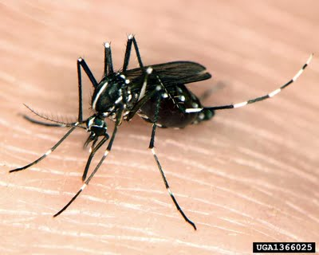
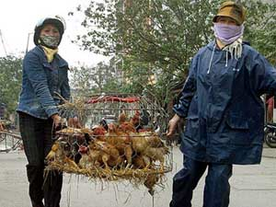
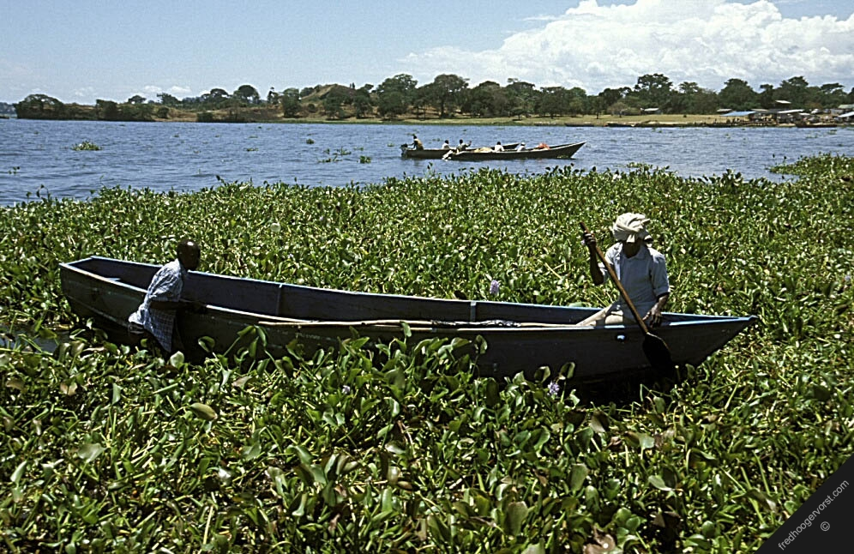
Invasive Species: Damages
Human Health & Social/Recreational
Human Health
Allergies
Pollens
Insect bites/stings
Injury/disease Examples:
SARS
“Bird flu”
Pesticide and herbicide application
Social/Recreational
Sport fishing & boating
Aesthetics & Outdoor activities
International travel
West Nile Virus and non-native mosquitoes
Trapping & “bird flu” testing
2
2
Canoeing in water hyacinth
2
3
¹alic.arid.arizona.edu/invasive/sub9/p2.shtml ²www.fredhoogervorst.com/photo/08485/

Slide 11
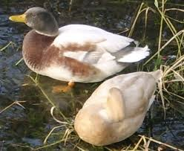
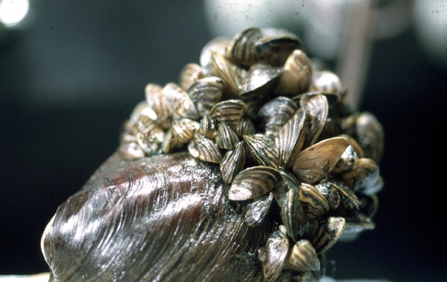
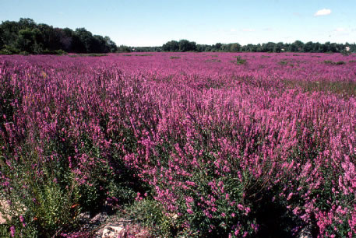
Invasive Species: Damages
Environmental
Hybrid mallards
Genetic & Individual Impacts:
Hybridize with native species
Changes in morphology
Changes in behavior
Population Impacts:
Competition
Predation
Physical
Community Impacts:
Species composition
Extinction
Ecosystem Impacts:
Fire
Soil health
Hydrology
Water yield
Erosion
Nutrient cycling
Biodiversity
1
2
Zebra mussels attached to a treeridge clam
Purple loosestrife dominates this open field
2
3
¹messybeast.com/genetics/hybrid -birds.htm ²forestryimaages.org ³gettinginthegroove.com

Slide 12
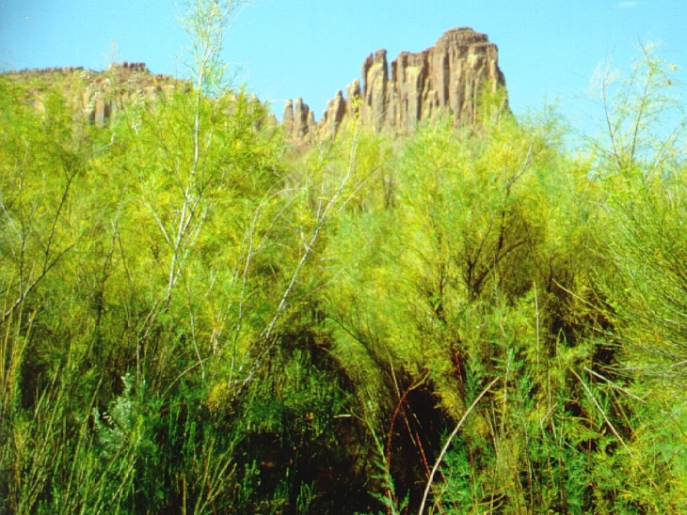
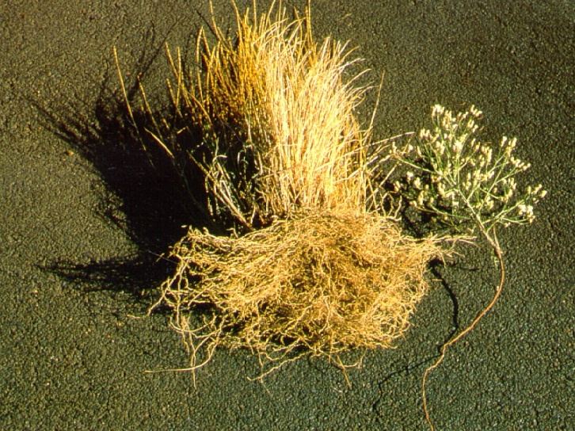
Invasive Species: Damages
Environmental: Ecosystem Function Disruption Examples
FIRE REGIMES
HYDROLOGY
EROSION
AQUATIC NUTRIENTS
Japanese Climbing Fern (Lygodium japonicum)
Tamarisk (Tamarix spp.)
Knapweed (Centaurea maculosa)
Giant salvinia (Salvinia molesta)
Notes:
Even in fire-adapted communities, non-native invaders may alter the intensity and frequency of fire to the detriment of native species. Cogongrass (Imperata cylindrica), shown here completely dominating the understory of a forest plantation, has done just this in longleaf pine-wiregrass communities along the eastern Gulf Coast.
Dense infestations of tamarisk as shown here along a small ephemeral stream in southeastern Utah, can also block flood flows, sharply altering patterns of erosion and deposition. Bailey et al. (2001) found that tamarisk leaf litter degrades more rapidly than that of native riparian trees and that this was associated with a two-fold decrease in aquatic macroinvertebrate richness and a four-fold decrease in abundance. Research conducted by University of Minnesota graduate student Ted Kennedy at Ash Meadows National Wildlife Refuge in Nevada has also shown that tamarisk infestations reduce diversity and biomass of native fishes (personal communication).
In many areas of the Pacific Northwest knapweeds (Centaurea spp.) have invaded and displaced native bunchgrasses. Here, a comparison of the roots of a native wheatgrass and the invasive non-native spotted knapweed (Centaurea maculosa, right) demonstrates a striking difference between the fibrous, soil-holding roots of the former and the thin taproot of the latter.
Invasive aquatic plants can sharply reduce light levels and dissolved oxygen concentrations in the waters they occupy. Giant salvinia (Salvinia molesta) is another floating aquatic plant which severely impacts water bodies at sites around the world. Native to southeastern Brazil, it is shown here completely covering a pond in Texas. Infestations are now known from other US sites - Hawai'i, California, Arizona, Louisiana, Alabama, Georgia, Florida, Mississippi, and North and South Carolina. (Photograph provided for this presentation by www.invasive.org.)

Slide 13
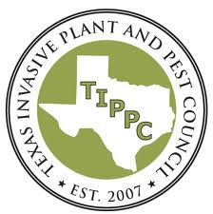




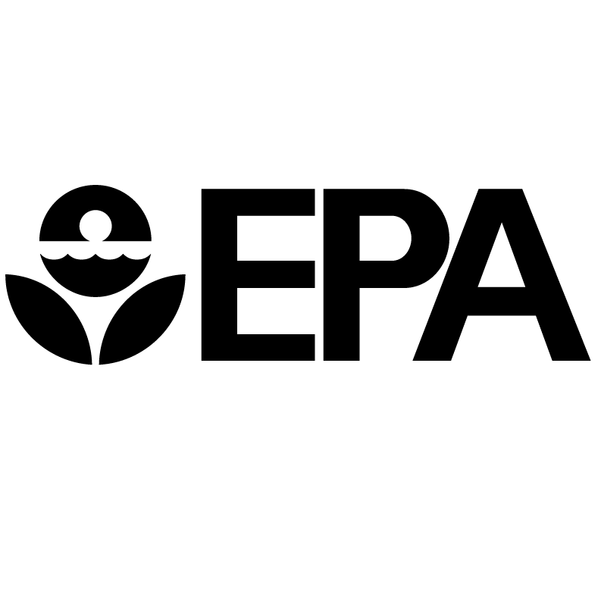

Invasive Species: Response
Committees and Agencies
Administrative Committees: Examples
National Invasive Species Council
Federal Interagency Weed Committee
Texas Invasive Plant and Pest Council
Texas Invasive Species Coordinating Committee
Agencies:
Department of Agriculture (USDA)
Animal and Plant Health inspection Service (APHIS)
Natural Resources Conservation Service (NRCS)
Research, Education, and Economics (REE)
Forest Service (FS)
Department of Commerce
Department of Interior
Many more…..
2
2
Notes:
In 1999, President Clinton issued Executive Order 13112 which created an interagency, the National Invasive Species Council, to better coordinate Federal agencies response to invasive species. The Council helps coordinate the activities for several departments and agencies involved in the control of invasive species. In addition, the Federal Interagency Weed Committee was formed to coordinate invasive plant control and eradication activities.
Many federal, state, and local governmental agencies and some private organizations have taken on the task of educating the public about invasive species and the problems they create. This has triggered a groundswell of interest by private citizens and has increased participation in activities that control the introduction and spread of invasive species. As people in general become aware of the magnitude of this problem, they are more likely to support the funding of invasive species control and eradication efforts.
Department of Agriculture (USDA)
The USDA has a significant role in national conservation efforts. In this capacity it administrates several agencies related to invasive species management:
Animal and Plant Health inspection Service (APHIS) – APHIS provides leadership in ensuring the health and care of animals and plants. The agency improves agricultural productivity and competitiveness and contributes to the national economy and the public health.
Natural Resources Conservation Service (NRCS) – NRCS provides leadership in a partnership effort to help people conserve, maintain and improve our natural resources and environment.
Research, Education, and Economics (REE) – The REE mission area of USDA is dedicated to the creation of a safe, sustainable, competitive U.S. food and fiber system and strong, communities, families, and youth through integrated research, analysis, and education. Through the following member agencies, REE provides research, analysis, and data to benefit consumers and promote agricultural prosperity and sustainable agricultural practices.
Cooperative State Research, Education, and Extension Service (CSREES) – Charged with advancing knowledge for agriculture, the environment, human health and well-being, and communities by supporting research, education, and extension programs in the Land-Grant University System and other partner organizations. CSREES doesn't perform actual research, education, and extension but rather helps fund it at the state and local level and provides program leadership in these areas. The agency is actively engaged in the battle against invasive species through leadership in the implementation of the National Invasive Species Management Plan and funding from Section 406 Pest Management Programs and others in the National Research Initiative (NRI). CSREES also has established the National Animal and Plant Diagnostic Laboratory Networks, provides annual Hatch Act funding of Agricultural Experiment Station projects, and administers special grants related to invasive species.
Agricultural Research Service (ARS) – ARS is the U.S. Department of Agriculture's chief scientific research agency. Their task is to find solutions to agricultural problems that affect Americans. ARS conducts research on a variety of topics, including invasive species, to develop and transfer solutions to agricultural problems of high national priority and provide information access and dissemination to ensure safe food, optimal nutrition, a competitive and sustainable agricultural economy, healthy natural resources, and economic opportunities for in rural areas. The Exotic and Invasive Weeds Research Unit is responsible for developing methods for managing invasive plant species in rangeland, riparian, and aquatic ecosystems by developing improved weed management systems that are efficient and environmentally safe. ARS also conducts research on how to manage pathogens that pose a risk to agriculture
Economics Research Service (ERS) – ERS conducts research on invasive species economic issues related to managing invasive pests in increasingly global agricultural markets. Trade is essential to the U.S. agricultural sector, with earnings from U.S. exports accounting for as much as 30 percent of total farm receipts. Increased movement of people and products across international borders creates new risks of introducing invasive species that can damage food and fiber production. The ERS research program focuses on national decision-making concerning invasive species of agricultural significance or affecting, or affected by, USDA programs. USDA currently manages programs affecting the entry and spread of agricultural invasive species which can potentially cause economic losses to consumers, producers and other stakeholders.
National Agricultural Statistics Service (NASS) – NASS provides a central location for accessing a variety of information related to agriculture.
Forest Service (FS) – FS sustains the health, diversity and productivity of the Nation's forests and grasslands to meet the needs of present and future generations, including a large program to prevent the introduction and spread of invasive species in forested regions.
Department of Commerce – Through the National Oceanic and Atmospheric Administration (NOAA), the Department of Commerce directs environmental stewardship, long-term economic development and responsible use of America’s coastal, ocean and Great Lakes resources and the Sea Grant. Sea Grant is a nationwide network of 30 university-based programs that engages in conducting scientific research, education, training, and extension projects designed to foster science-based decisions about the use and conservation of our aquatic resources, including incursions by invasive plants, aquatic animals, and pathogens. In addition, Commerce coordinates U.S. policies with NAFTA and WTO efforts to minimize global movement of invasive species.
Department of Interior (DOI) – DOI is the nation’s principal conservation agency charged with protecting much of America’s land, providing access to natural resources, offering recreation opportunities, providing wise stewardship of energy and mineral resources, fostering sound use of land and water resources, and conserving and protecting fish and wildlife. Some of its land management agencies that deal with invasive species are;
Healthy forests Initiative: The result of the Healthy Forests Restoration Act of 2003, this initiative provides the resources to help reduce the risk of catastrophic fire form built up fuel in our nation’s forests.
The Bureau of Indian Affairs (BIA) is responsible for the administration and management of 55.7 million acres of land held in trust by the United States for American Indians, Indian tribes, and Alaska Natives. The agency develops forestlands, leases assets on these lands, directs agricultural programs, provides educational programs, protects water and land rights, and develops and maintaining infrastructure and economic development.
The Bureau of Land Management (BLM) manages 264 million acres of public lands located primarily in the 12 Western States, including Alaska. The agency manages an additional 300 million acres of below ground mineral estate located throughout the country. These lands were valued for the commodities extracted from them, and for their recreational opportunities and the natural, historical, and cultural resources they contain.
The Bureau of Reclamation (BOR) mission is to manage, develop, and protect water and related resources in the interest of the American public. Established in 1902, Reclamation is the largest wholesale water supplier in the country, and manages 457 dams; its 348 reservoirs have more than 90 million recreation visits annually.
National Park Service (NPS) preserves the natural and cultural resources and values of the national park system for the enjoyment, education, and inspiration of this and future generations. NPS comprises 388 areas covering more than 84 million acres in 49 States, the District of Columbia, and U.S. territories. The agency cooperates with partners to extend the benefits of natural and cultural resource conservation and outdoor recreation throughout this country and the world.
The U.S. Fish and Wildlife Service (FWS) is the only agency of the U.S. Government whose primary responsibility is fish, wildlife, and plant conservation. The Service helps protect a healthy environment for people, fish and wildlife, and helps Americans conserve and enjoy the outdoors and our living treasures. Its major responsibilities are for migratory birds, endangered species, certain marine mammals, and freshwater and anadromous fish.
The U.S. Geological Survey (USGS) collects, monitors, analyzes, and provides scientific understanding about natural resource conditions, issues, and problems. USGS carries out studies on a national scale and sustains long-term monitoring and assessment of natural resources including issue relating to invasive species. The mandate of USGS is to provide information to decision makers at all levels of government and citizens so they can address pressing societal issues.
Department of Defense (DOD): The primary role of DOD regarding invasive species is to keep military installations functional and free of impairment from these species. They are to effectively monitor and control invasion by non-native nuisance plants and other organisms.
Environmental Protection Agency (EPA) directs the Office of Wetlands, Oceans and Watersheds, whose mandate is to protect these resources from hazardous materials, including invasive species.
Department of Health and Human Services (HHS) serves the American public by protecting the health of citizens and providing essential human services. In this role, HHS administrates the following agencies:
The Centers for Disease Control and Prevention (CDC) is the principal U.S. agency for protecting the health and safety of all Americans and for providing essential human services, especially for those people who are least able to help themselves. This includes monitoring non-indigenous infectious diseases.
Department of Homeland Security administrates the Customs and Border Protection Agency, which is responsible for protecting U.S. borders to prevent terrorists and terrorist weapons from entering the country, while facilitating the flow of legitimate trade and travel. This includes oversight of the movement of invasive species, especially those potentially used as biological weapons like anthrax and smallpox.
National Aeronautics and Space Administration (NASA) facilitates efforts against invasive species by providing decision-support tools in the form of Earth observations and predictive models from space research. The agency provides map for monitoring land cover, develops systems to generate predictive maps for invasive species locations, and participates in the development of an on-line Invasive Species Forecasting System to make this information readily available.
Office of the U.S. Trade Representative (USTR) provides trade policy leadership regarding U.S. policies on the movement of invasive species around the world, and integrates theses with policies from international agreements with organizations such as WTO and NAFTA.
Department of State directs the Bureau of Economic and Business Affairs (EB) which participates in directing U.S. trade and other interests around the world.
Department of Transportation (DOT) directs efforts to prevent the introduction and spread of invasive species while ensuring transportation safety and the protection and enhancement of the natural environment affected by transportation. The department participates in interagency committees such as the Aquatic Nuisance Species Task Force, the Federal Interagency Committee for Management of Noxious and Exotic Weeds, the Native Plants Conservation Initiative, the Interagency Ecosystem Management Task Force, and the Interagency Working Group on Endangered Species. DOT also coordinates with other federal agencies and with state, local, and tribal governments
U.S. Agency for International Development (USAID) works in agricultural development to support efforts to increase productivity around the world. A major impediment to this goal is infestation of invasive species.
(NISIC, 2007 [http://alic.arid.arizona.edu/invasive/sub1/p4.shtml]}

Slide 14

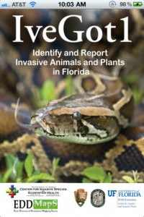
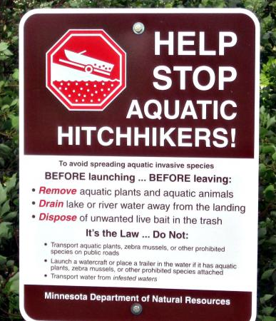
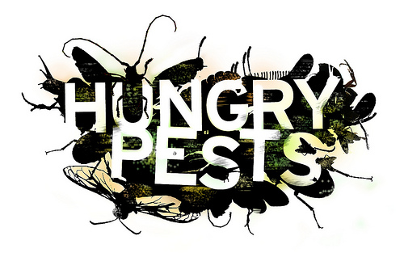
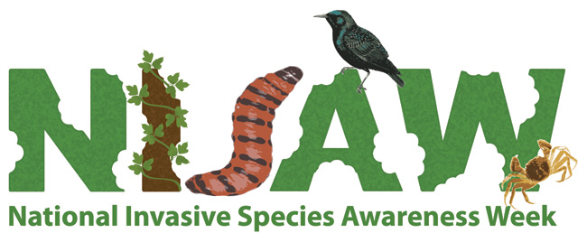
Invasive Species: Response
Action & Outreach
Action:
Regulation
Import and export restrictions (USDA-APHIS)
Inspections and surveillance
Example: Texas Department of Agriculture Noxious Plants List
Research
Species biology
Ecological impacts
Control methods
Biological controls
Control and Management
Monitoring
Restoration
Outreach:
Early detection and reporting
Educational programming
2
Notes:
The leading invasive species threats to American agriculture are insects, weeds, and pathogens. The best method for combating the effects of these invasive organisms is to prevent their initial entry into the country. But, once they have entered the U.S., aggressive strategies are needed to control their establishment and spread.
The U.S. government, through the Department of Agriculture (USDA), established the Animal and Plant Health inspection Service (APHIS) primarily to protect and promote agricultural health as one of its primary responsibilities. APHIS is currently challenged in protecting these interests because of the growing amount of global agricultural trade. The agency operates the Plant Protection and Quarantine (PPQ) programs and, through which it oversees the following activities:
Exotic pest and disease exclusion: responsible for preventing the entry and establishment of exotic pests and diseases through activities such as issuing permits for importing plants and animals, conducting port-of-entry inspections, and alerting trading partners of the organisms that seemingly pose the greatest risks;
Pest detection: surveillance of intrastate and international trade involving plants and animals through partnerships with other federal, state, and local agencies, and in cooperation with North America Free Trade Agreement (NAFTA); and
Pest management programs: provide information and assistance on methods of pest control and non-indigenous organisms that become established in the U.S.
With international trade valued at over $50 billion, APHIS has become involved in promoting plant and animal health in other countries. The agency also serves a role in wildlife damage management, animal welfare, human health and safety, and ecosystem protection from invasive pests and pathogens.
(NISIC, 2007 [http://alic.arid.arizona.edu/invasive/sub1/p4.shtml]}

Slide 15
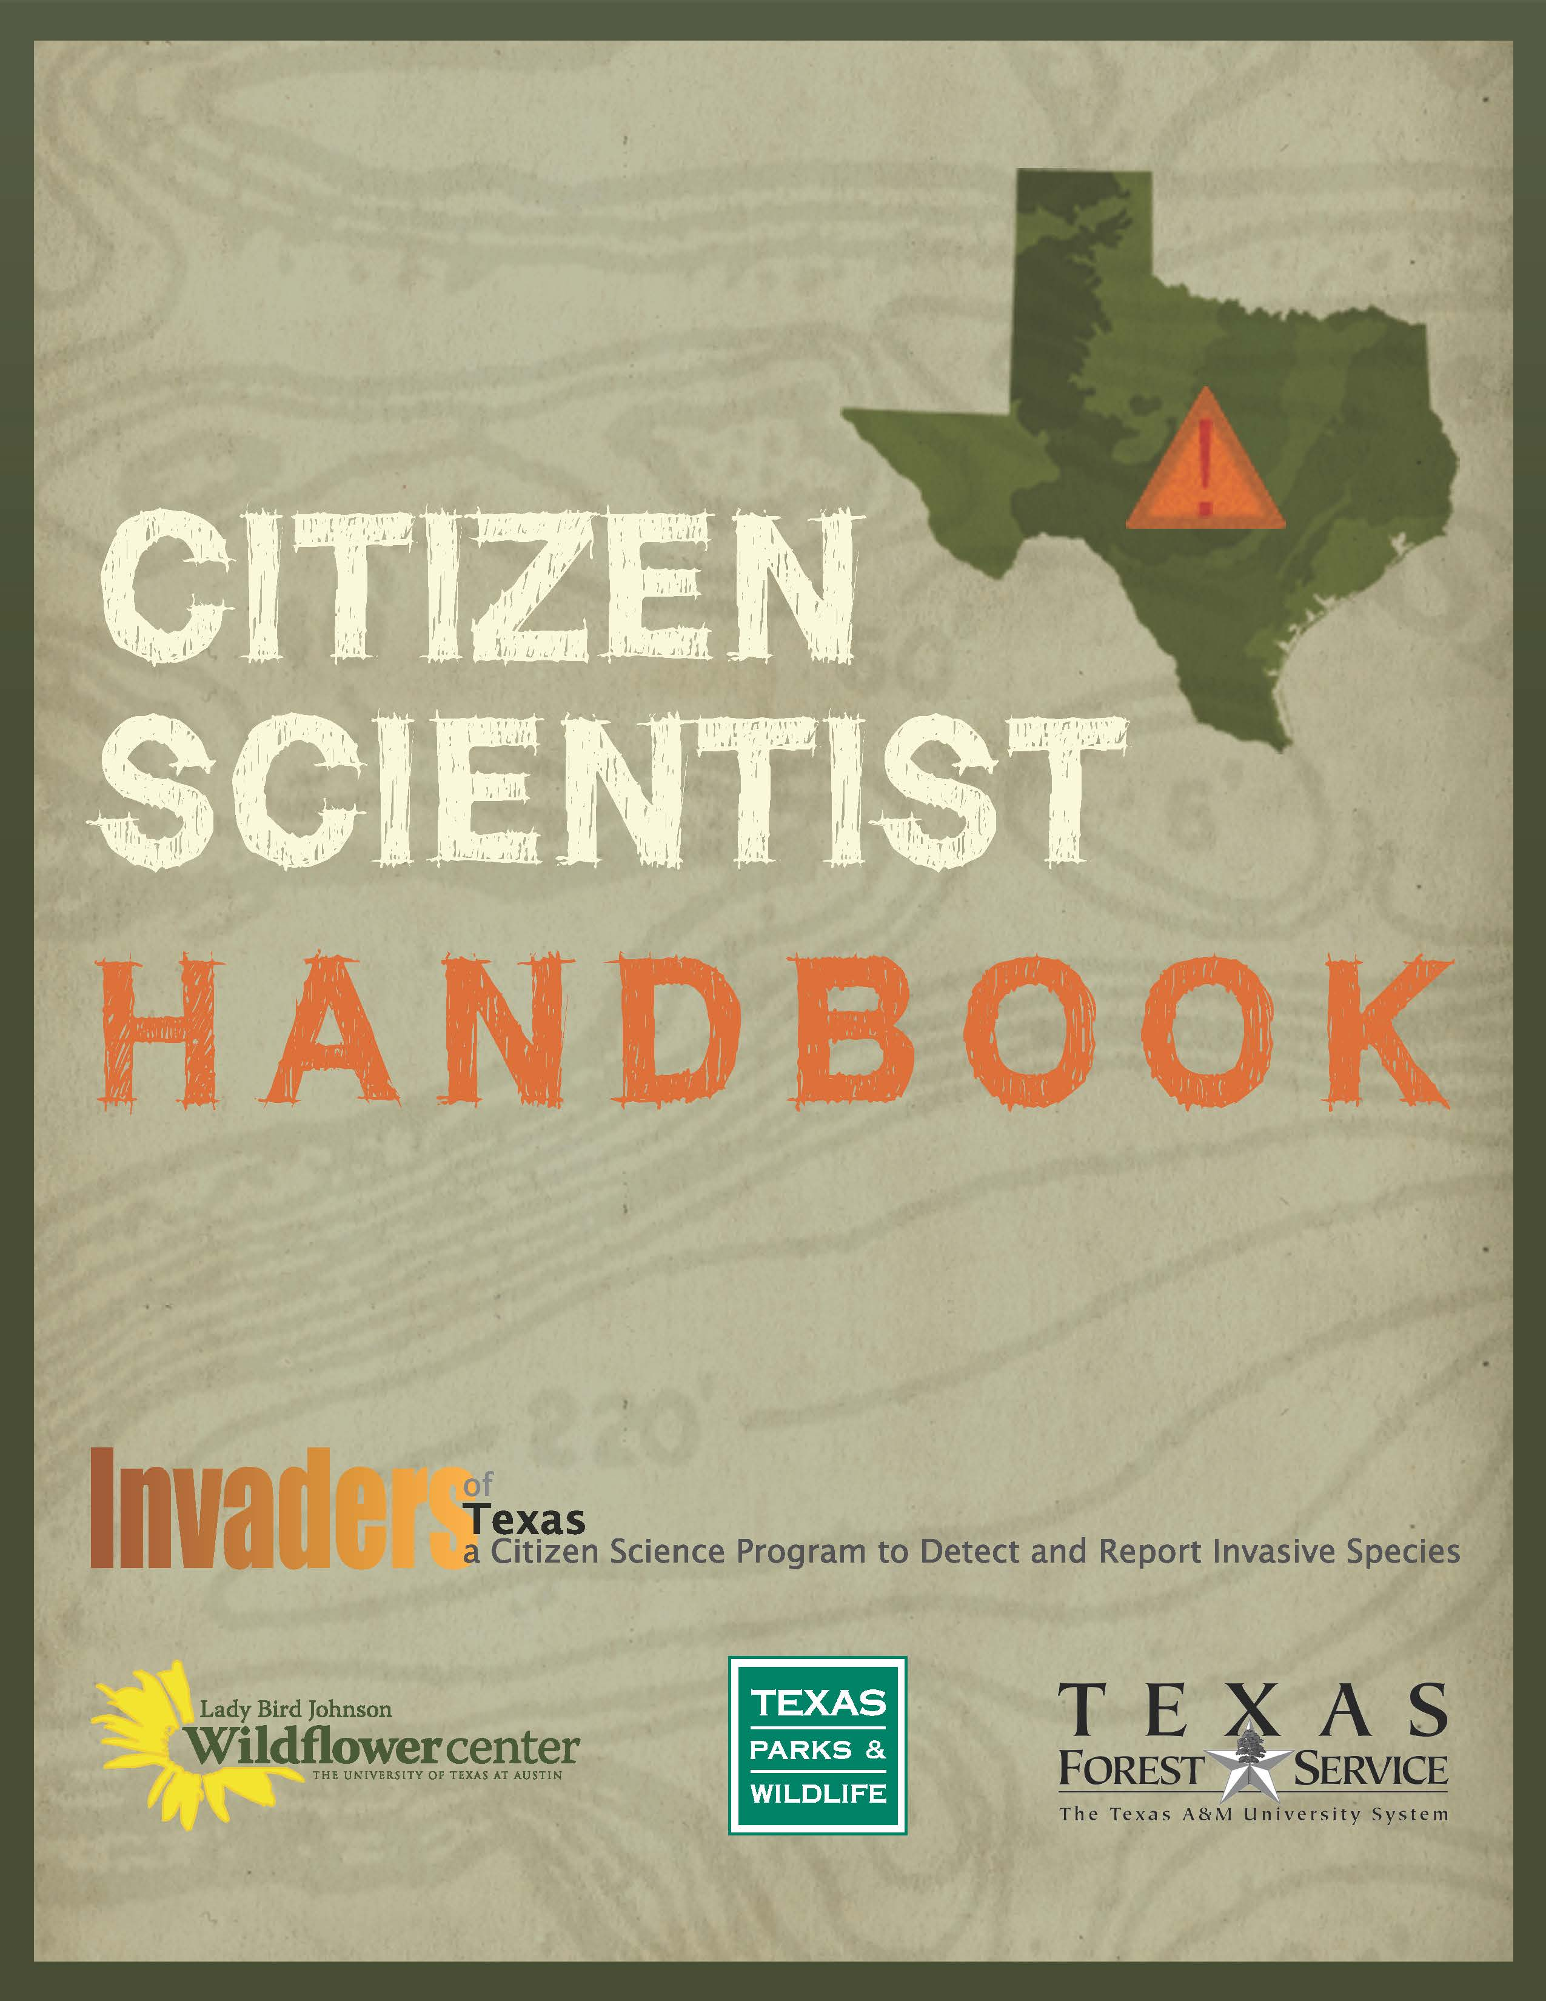
The Wildflower Center:
Invasive Species Initiatives
Texas Invasive Plant and Pest Council (TIPPC)
Biennial Statewide Invasive Species Conferences
Public Awareness Campaigns
City of Austin Invasive Species Management Plan
Texasinvasives.org
Invaders of Texas Citizen Scientist Program
Sentinel Pest Network
Eradicator Calculator
Notes:
Those of us who care deeply about native plants and habitats understand how important they are to our sense of place. But even as we are working to protect our plant heritage from land development and other pressures, native flora across the country – in our backyards, along our roadways, on our farms and ranches, in our parks and natural areas – are facing a less obvious but equally serious threat from non-native invasive plants. Here are just a few of the problems caused by Invasive species:
After habitat destruction, invasive species are the second greatest threat to biodiversity. Invasives threaten the survival of native plants and animals, interfere with ecosystem functions, and hybridize with native species resulting in negative genetic impacts.
Invasive species impede industry, threaten agriculture, endanger human health, and are becoming increasingly harder to control as a result of rapid global commercialization and human travel.
Invasive species are a significant threat to almost half of the native species currently listed as federally endangered.
The costs to prevent, monitor and control invasive species combined with the costs to crop damage, fisheries, forests, and other resources cost the U.S. $137 billion annually.
The Lady Bird Johnson Wildflower Center takes a multi-pronged approach to addressing the harm caused by invasive plants, combining public outreach, research, monitoring, and the appropriate control and eradication of invasive plants.

Slide 16
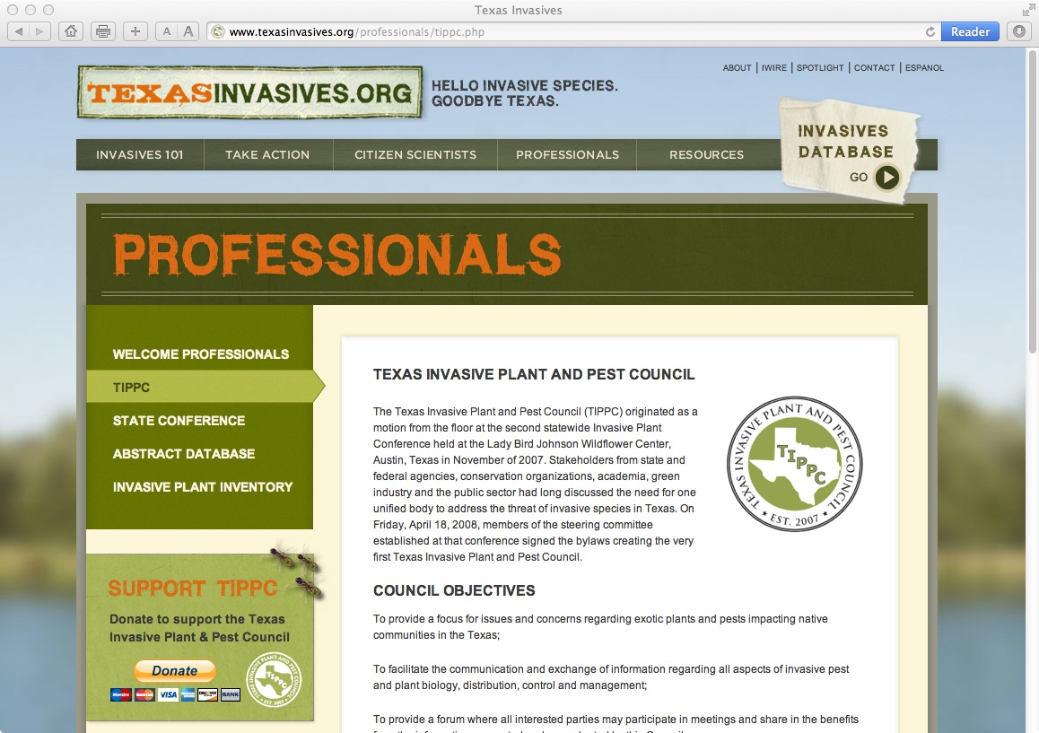
Notes:
Texas Invasive Plant and Pest Council – Established in 2008, the non-profit Texas Invasive Plant and Pest Council (TIPPC) promotes awareness of invasive plant and pest impacts in Texas; provides a forum for the exchange of scientific, educational and technical information; and supports research and restoration activities that reduce impacts of invasive species in Texas. TIPPC has 170 members and is a member of NAEPPC. Dr. Damon Waitt is the founder and past president of TIPPC. In addition to a biennial conference, TIPPC is engaged in performing Weed Risk Assessments and economic analyses in an effort to improve the state’s regulatory list of noxious and invasive plants species.
The Texas Invasive Plant Conference is a professional level meeting, held every two years, including keynotes, concurrent sessions, posters, and symposia. The conference is designed to serve scientists, land managers, state and federal agencies, local governments, and other professionals interested in invasive plant research and policy in Texas. The first and second statewide conferences were organized and hosted by the Wildflower Center in 2005 and 2007; then handed over to TIPPC in 2009 and 2011.

Slide 17
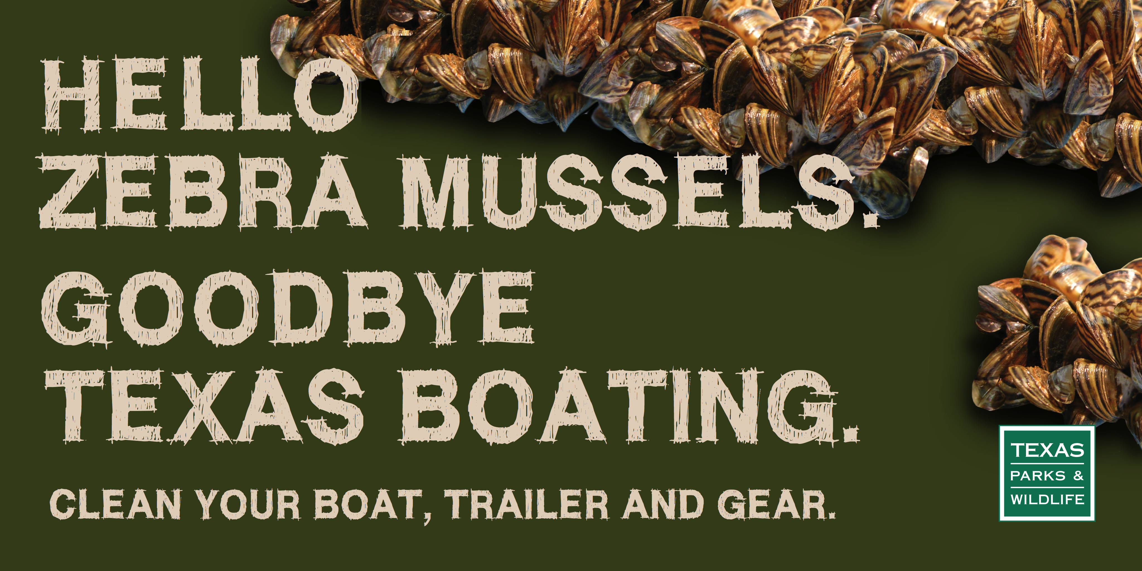
Public Awareness Campaigns

Slide 18
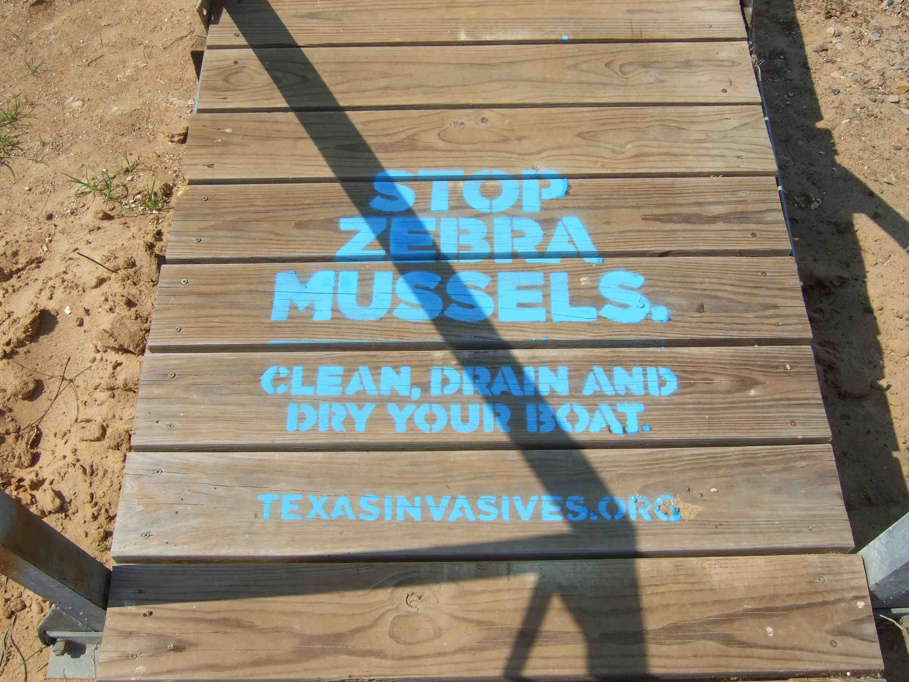

Slide 19
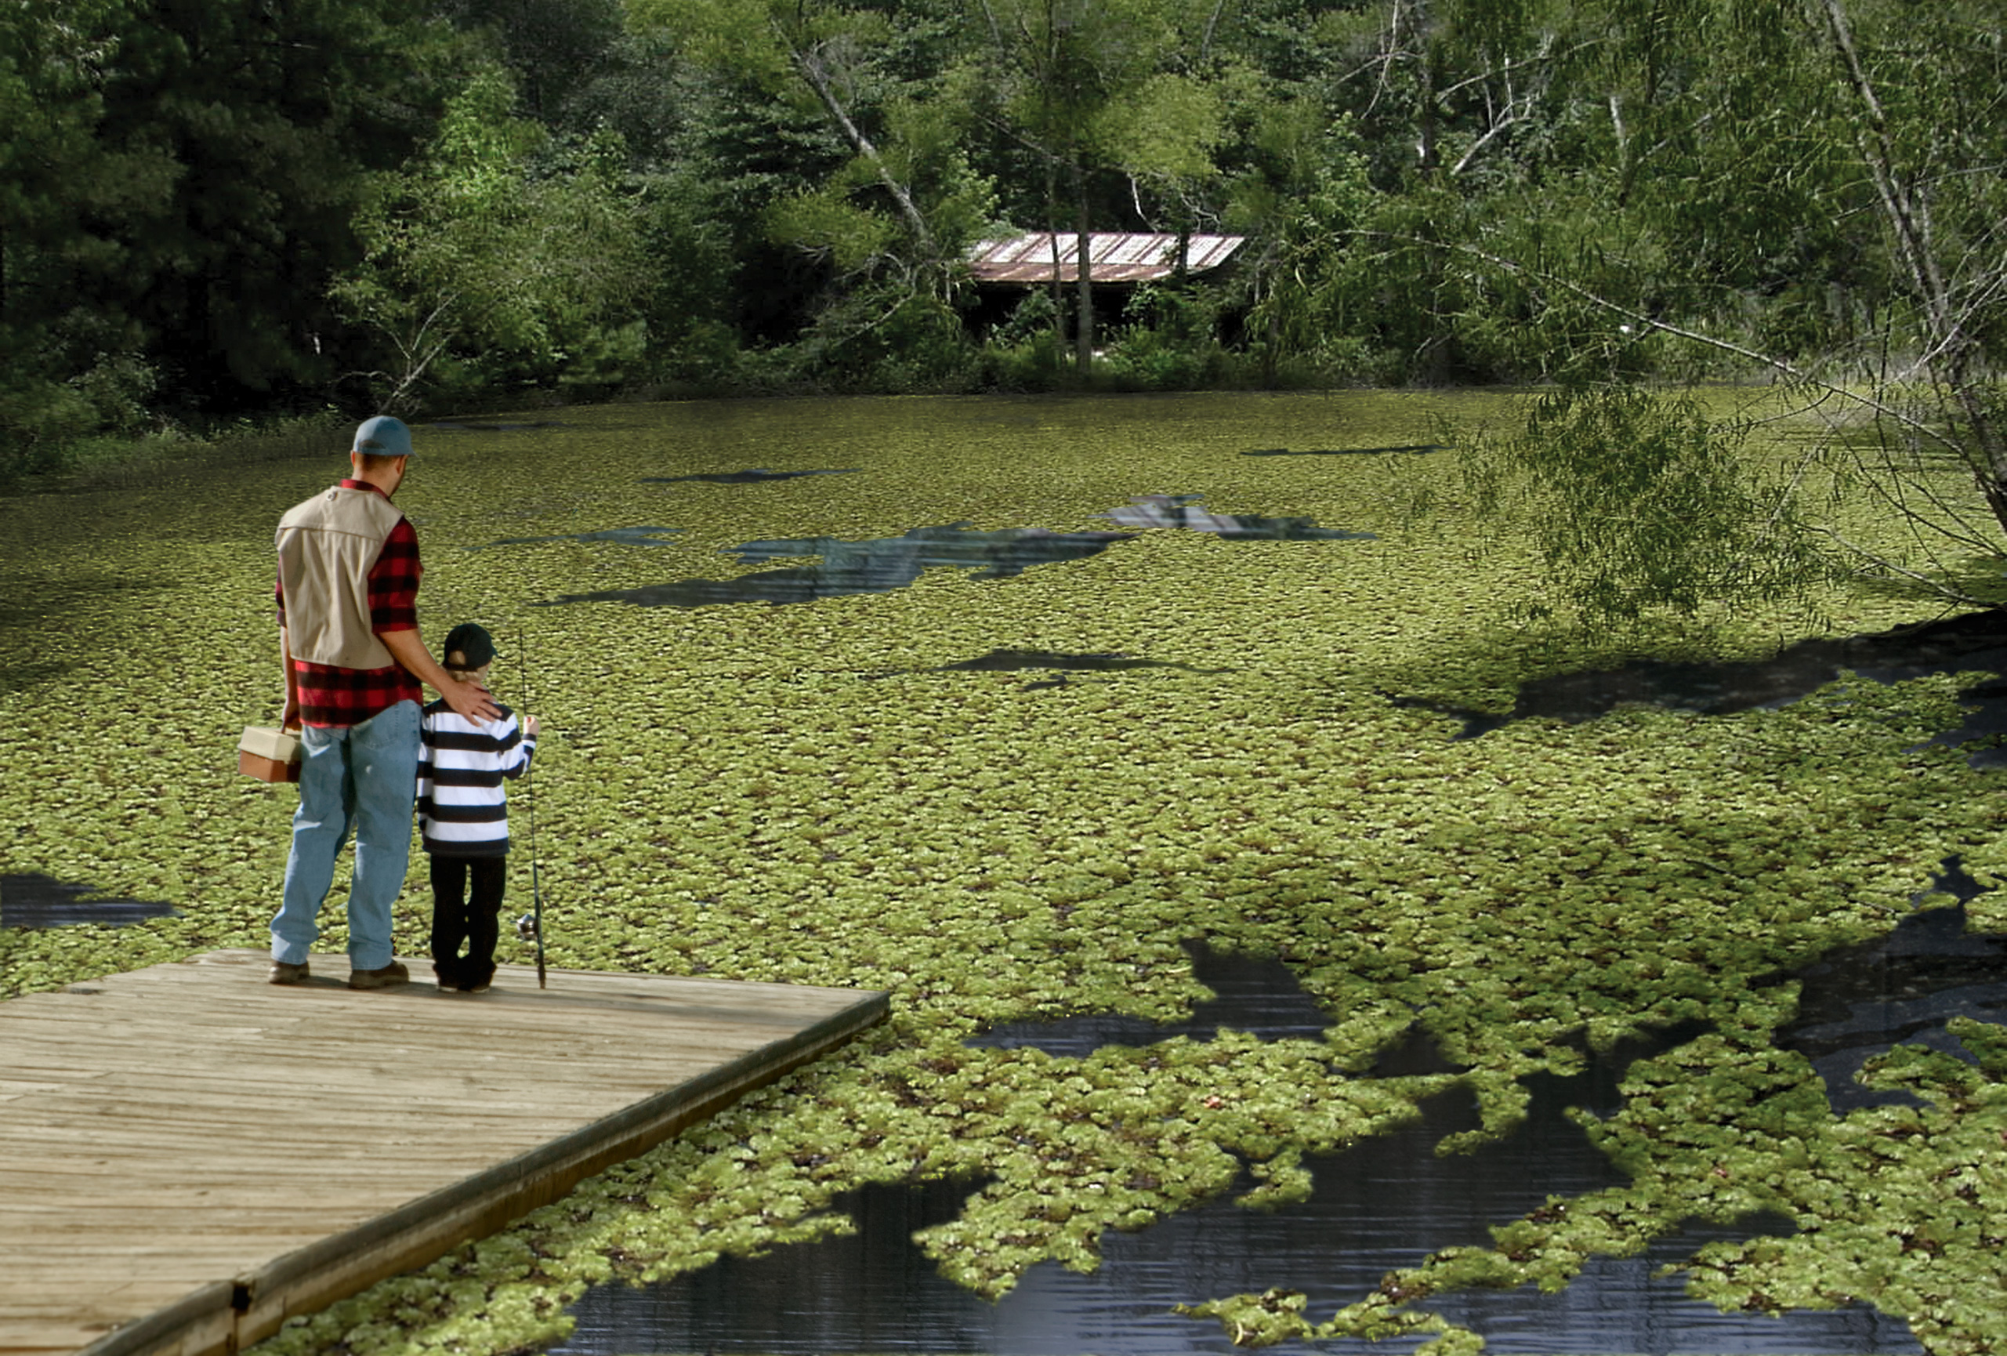

Slide 20
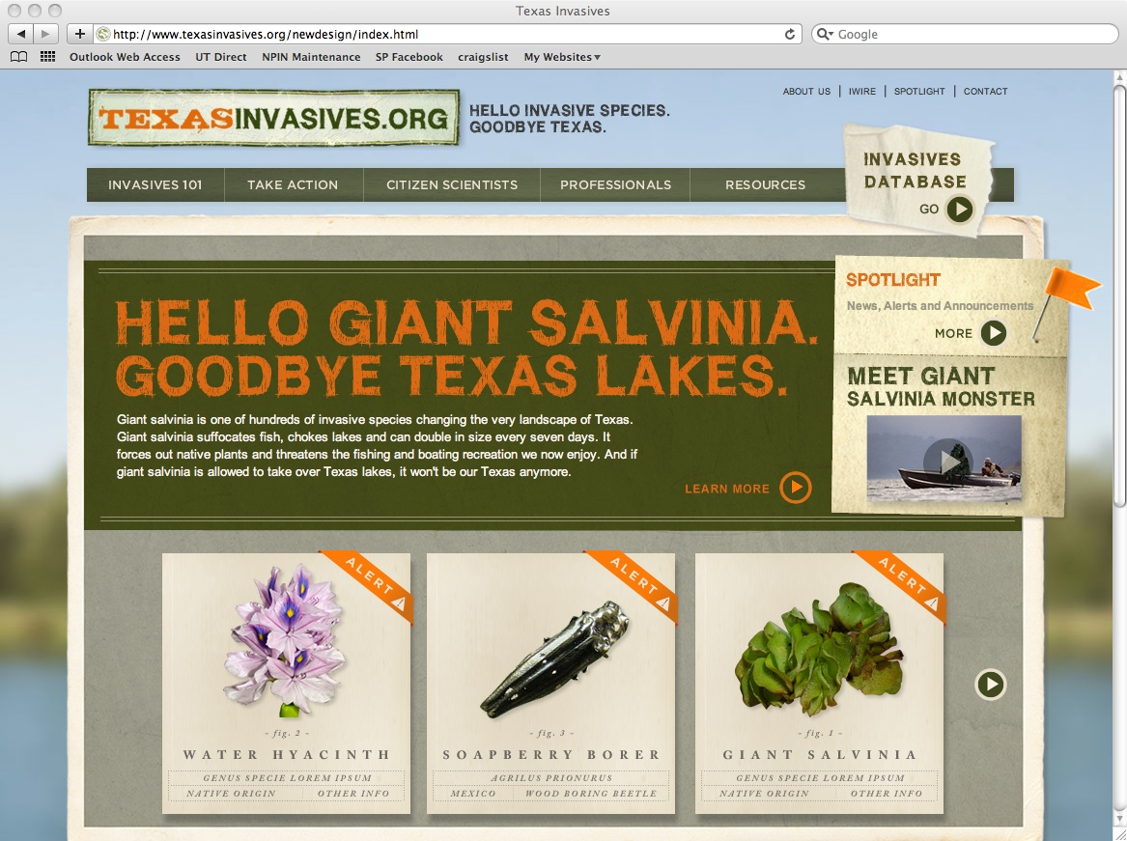
Notes:
Serves as the invasive species information clearinghouse for Texas.

Slide 21
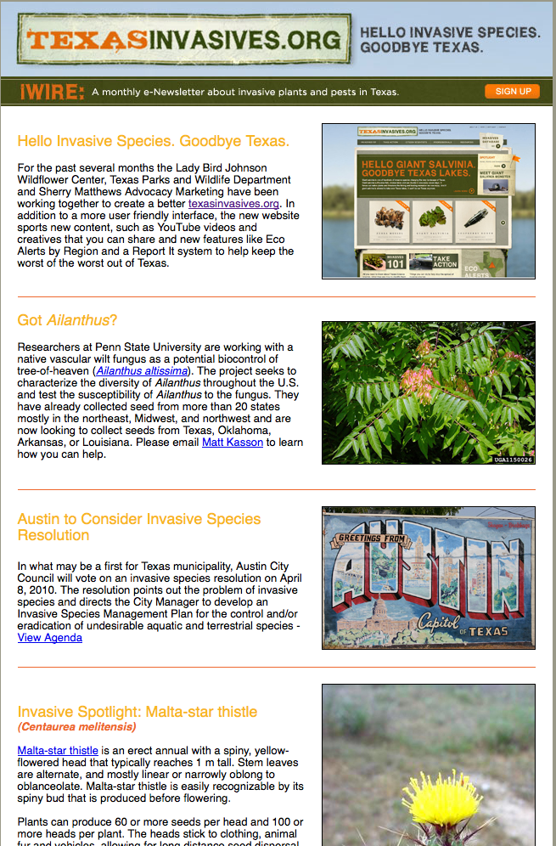
Texasinvasives.org
A “One-Stop-Shop” for information
Professionals
TIPPC
Control and Management
Invasive Plant Inventory
Resources
Publications
Partner links
News Releases
Citizen Scientists
Invaders of Texas
Sentinel Pest Network
iWire: monthly e-newsletter
Invasives Database
Notes:
www.texasinvasives.org was created by the Lady Bird Johnson Wildflower Center in partnership with the Texas A&M Forest Service, Texas Parks and Wildlife Department and other stakeholders to serve as the invasive species information clearinghouse for the state of Texas. The website is managed by the Wildflower Center and is the home of TIPPC, the biennial conference, the Invaders of Texas Program, invasive species databases and factsheets, publications and other resources. The website has evolved into the centralized clearinghouse for invasive species information in Texas as illustrated by the site visitation statistics below.
Category 2009 2010 2011 2012
Visits 44,166 70,200 100,563 156,165
Uniq. Vis 33,952 54,314 78,680 126,739
Page Views 200,771 361,053 484,176 601,922
iWire – The iWire is an electronic, monthly newsletter created by the Wildflower Center tofacilitate communication about invasive plants and pests in Texas. Each issue of iWire includesnews items, updates on activities of the Texas Invasive Plant and Pest Council, information about the Invaders of Texas Citizen Science program, a calendar of upcoming events and a spotlight on an invasive species of interest in Texas. There are currently 2,233 iWire subscribers.

Slide 22
Texasinvasives.org
Invasives Database: Species Information
Illustrated Descriptions
Ecological Information
Distribution & Habitat
Biology & Spread
History of Introduction
Ecological Threats
Control & Management
Native Look-a-likes
References

Slide 23
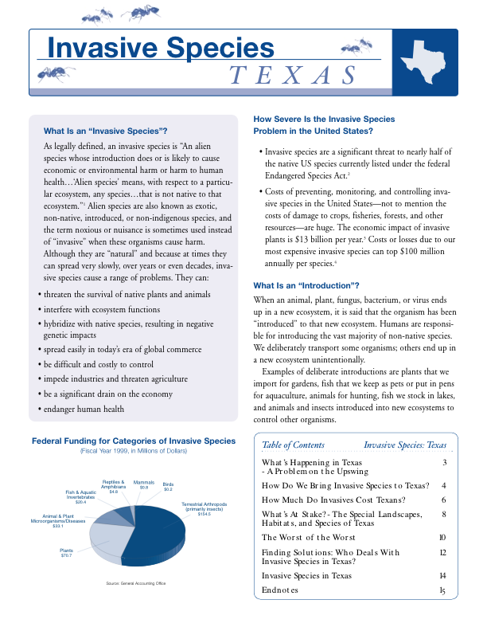
Invasive Species in Texas:
Rauschuber C. 2002. List Appendix to Invasive Species - Texas
How Many Invasives are in Texas?
67 terrestrial plants
12 aquatic/wetland plants
10 mammals
4 birds
7 fishes
11 insects
11 mollusks and crustaceans
The Worst of the Worst:
Saltcedar (Tamarix spp.)
Hydrilla (Hydrilla verticillata)
Giant Salvinia (Salvinia molesta)
Nutria (Myocaster coypus)
Red Imported Fire Ant (Solenopsis invicta)
Channeled Applesnail (Pomacea canaliculata)
2
2

Slide 24
Invasive Species in Texas: Plants
Texas Department of Agriculture Noxious Plant List
TITLE 4.AGRICULTURE. Part 1. TEXAS DEPARTMENT OF AGRICULTURE. Chapter 19. QUARANTINES AND NOXIOUS PLANTS §19.300.Noxious Plant List. N= 35 species Botanical Name - Common Name Alternanthera philoxeroides - alligatorweed Cardiospermum halicacabum - balloonvine Schinus terebinthifolius - Brazilian peppertree Orobanche ramosa - broomrape Alhagi camelorum - camelthorn Triadica sebiferum - Chinese tallow tree Cyperus entrerianus - deeprooted sedge Carthamus lanatus - distaff thistle Myriophyllum spicatum - Eurasian watermilfoil Spirodela oligorrhiza - giant duckweed Arundo donax - giant reed Calystegia sepium - hedge bindweed Hydrilla verticillata – hydrilla | Botanical Name - Common Name Rottboellia cochinchinensis – itchgrass Cuscuta japonica - Japanese dodder Pueraria montana var. lobata - kudzu Lagarosiphon major - lagarosiphon Melaleuca quinquenervia - paperbark Lythrum salicaria - purple loosestrife Eichhornia azurea - rooted waterhyacinth Tamarix spp. – salt cedar Salvinia spp. - salvinia Nassella trichotoma - serrated tussock Panicum repens - torpedograss Solanum viarum - tropical soda apple Ipomoea aquatica - water spinach Cryptocoryne beckettii - water trumpet Eichhornia crassipes - waterhyacinth Pistia stratiotes – waterlettuce CHINABERRY – Melia azedarach JAPANESE CLIMBING FERN – Lygodium japonicum
Texas Parks & Wildlife Department Invasive, Prohibited & Exotic Aquatic Plants List
Notes:
Only reguletory list. No other list is regulatory only educational, including www.texasinvasvies.org. Notice not a lot of wildland weeds, only ag weeds.
Sec. 71.153. Local Regulation: - A political subdivision may not adopt an ordinance or rule that restricts the planting, sale, or distribution of noxious or invasive plant species.This section does not limit the preparation and distribution of educational materials relating to plants of local concern.
Sec. 71.154. Disclaimer Required (2011) - “This plant list is only a recommendation and has no legal effect in the state of Texas. It is lawful to sell, distribute, import, or possess a plant on this list unless the Texas Department of Agriculture labels the plant as noxious or invasive on the department's plant list.”

Slide 25
Invasive Species in Texas: Plants
TPWD Invasive, Prohibited & Exotic Aquatic Plants List
TITLE 31. NATURAL RESOURCES AND CONSERVATION. Part 2. TEXAS PARKS AND WILDLIFE DEPARTMENT. Chapter 57. FISHERIES. SUBCHAPTER A. HARMFUL OR POTENTIALLY HARMFUL FISH, SHELLFISH, AND AQUATIC PLANTS §57.111. Definitions. N= 19 species Botanical Name - Common Name Alternanthera philoxeroides - alligatorweed Limnophila sessiflora - ambulia Schinus terebinthifolius - Brazilian peppertree Ottelia alismoides - duck-lettuce Landolita punctata - giant or dotted duckweed Myriophyllum spicatum - Eurasian watermilfoil Sparganium erectum - exotic bur-reed Monochoria vaginalis - heartshaped false pickerelweed Hydrilla verticillata - hydrilla Lagarosiphon major – lagarosiphon Monochoria hastata - narrowleaf false pickerelweed Melaleuca quinquenervia - paperbark Lythrum salicaria - purple loosestrife | Botanical Name - Common Name Salvinia sp. – salvinia Panicum repens - torpedograss Eichhornia crassipes and azurea - floating and rooted Waterhyacinths Pistia stratiotes – waterlettuce Ipomoea aquatica - water spinach Solanum tampicense - wetland nightshade
Texas Department of Agriculture Noxious Plant List

Slide 26

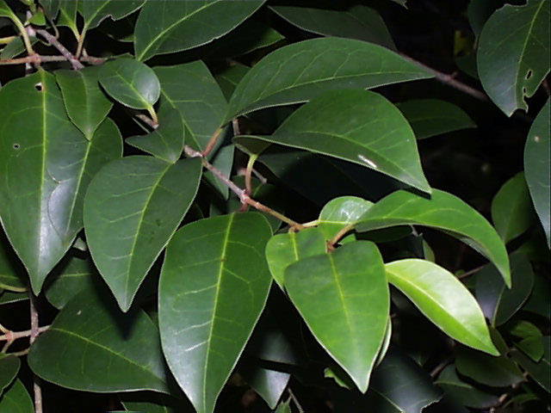
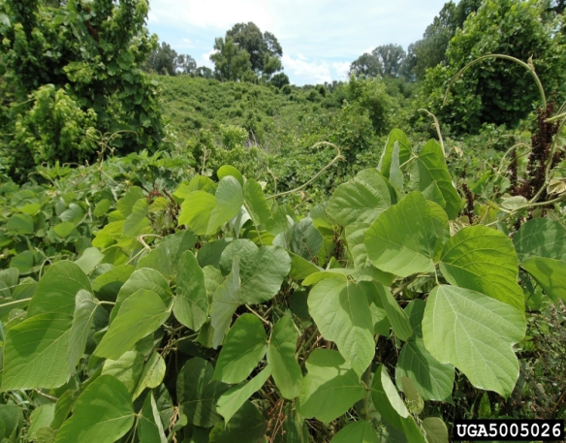
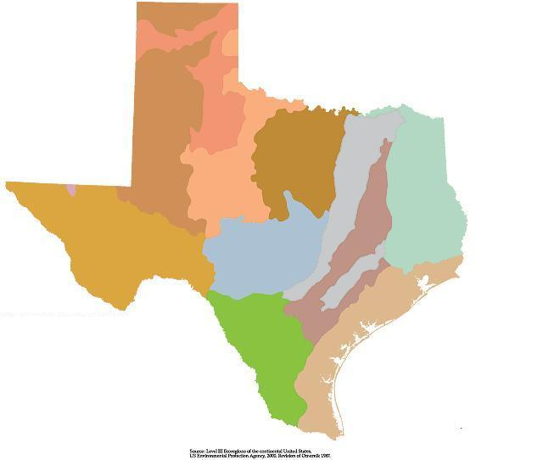
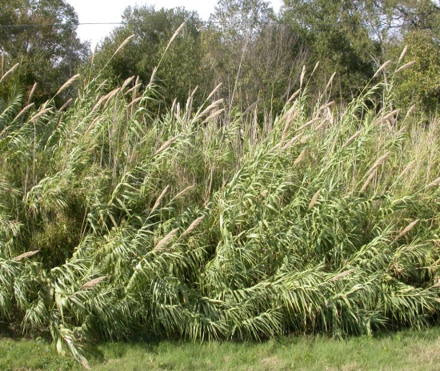
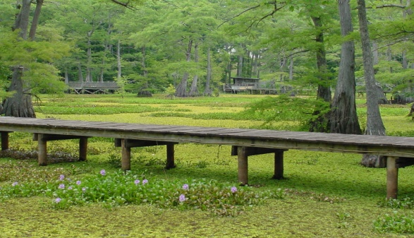
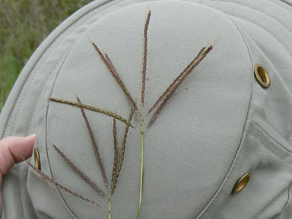
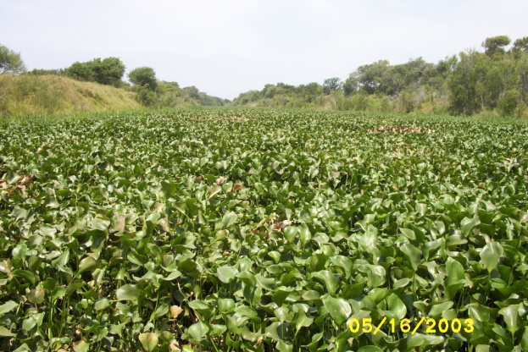
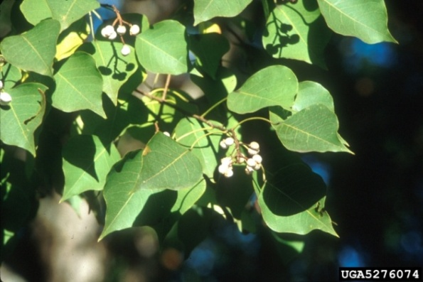
Invasive Species in Texas: Plants
Alerts by EcoRegion
Salt cedar
Privet
Kudzu
Giant reed
Giant salvinia
Water hyacinth
Old whorl bluetem
Chinese tallow tree
Notes:
All different regions of the state have different problems because it is such a diverse state. Its hard to make a list of species for the entire state.
Salt Cedar
Arundo
Old whorl bluestem
Ligustrum
Water hyacinth
Kudzu
Giant Salvinia
Tallow tree

Slide 27
Invasive Species in Texas: Plants
Austin Invasive Species Management Plan: Top 24 Invasive Species
Herbaceous
Giant reed
King Ranch Bluestem
Malta star-thistle
Bermudagrass
Japanese netvein hollyfern
Golden bamboo
Bastard cabbage
Johnsongrass
Vines
Japanese honeysuckle
Catclawvine
Kudzu
Woody
Tree of heaven
Paper mulberry
Chinese parasoltree
Glossy privet
Chinaberry tree
Heavenly (sacred) bamboo
Chinese pistache
Scarlet firethorn
Salt cedar
Chinese tallow tree
Aquatic
Elephant ears
Common water hyacinth*
Hydrilla*
TDA Noxious Plant List (§19.300) species
*TPWD Prohibited Aquatic & Exotic species

Slide 28
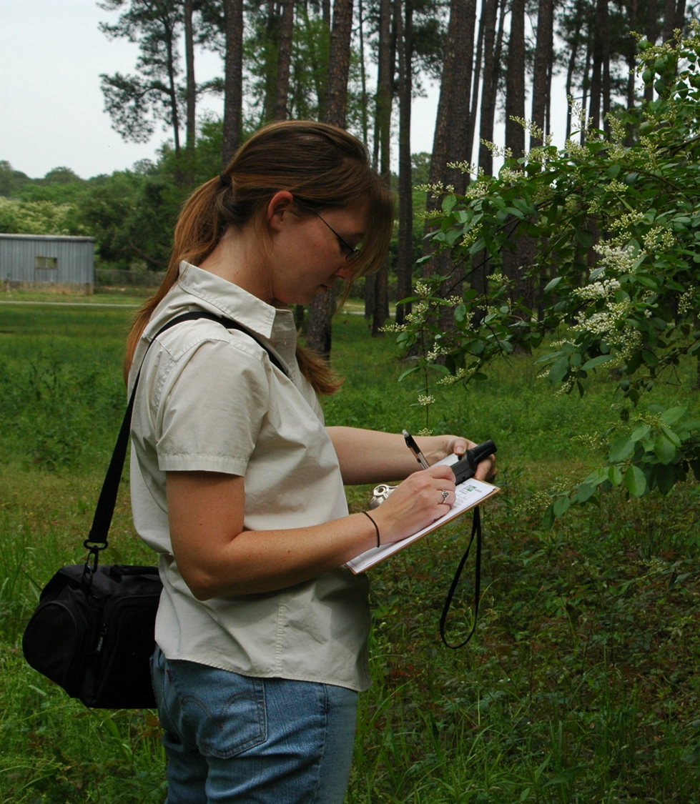
Invaders of Texas: Citizen Science
Detect and Report Invasive Plants
Invaders of Texas
The Invaders of Texas Program is an innovative campaign whereby volunteer "citizen scientists" are trained to detect and report invasive species in their communities.
REPORT IT
Since 2006
Workshops: 79
Satellites: 49
Volunteers: 1,700
Observations: 15,000+
Species Targeted: 161
Notes:
NVADERS: Citizen Scientists Combat Invasive Species
At the national level, the Wildflower Center has joined with The Arizona Sonora Desert Museum to lead a consortium of museums participating in a national scientific education program entitled INVADERS: Citizen Scientists Combat Invasive Species. The INVADERS program involves recruiting, training, and providing materials to volunteers who detect and report invasive species in their communities. These volunteers find, track, describe, photograph, and collect samples of invasive species and report occurrences to their affiliated institution. The early detection data is then delivered to the U.S.G.S. National Institute of Invasive Species Science website for data hosting, analysis and mapping. The anticipated outcomes of this ground breaking program include a national network of volunteers contributing scientific data, increased public awareness of the dangers imposed by invasive species and what steps citizens can take when they encounter them; and reduced spread of invasive species through more timely control and eradication responses from regulatory agencies.

Slide 29
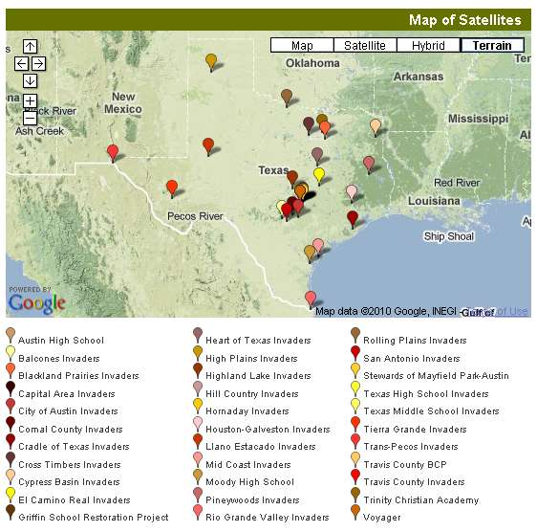

Invaders of Texas: Citizen Scientists
Satellite & Voyagers
Notes:
29
This

Slide 30
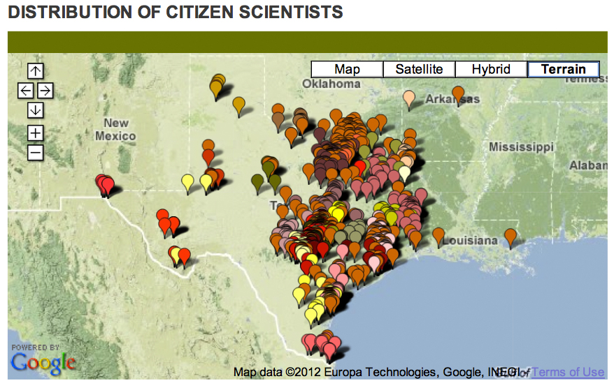
Invaders of Texas: Citizen Scientists
Notes:
30

Slide 31



Invaders of Texas: Citizen Scientists
Data Collection
Field Data Sheet
Data Entry
Notes:
On the left is an example datasheet which you would take out in the field. The paper version is word-for-word to the online submittal form, so data entry is simple and streamlined.

Slide 32

Invaders of Texas: Citizen Scientists
Detection Database
Tracks species observations submitted by volunteers.
Provides the public with full access to citizen science data.
Links to species observation detail page plant detail page and validation information.
Procedure based on Nature Conservancy Weed Information Management System.
Species
Satellite
Observer
Search & Export Data by:

Slide 33


Invaders of Texas: Citizen Scientists
Contribution - Data Mapping
Google Maps
Interactive and searchable by Species or Satellite and linked to individual records.

Slide 34




Example: Arundo donax (giant reed)
Invaders of Texas: Citizen Scientists
Your Contribution - Data Dissemination
USDA/Turner – 60 Counties
Invaders of Texas– 157 Counties
Unique Invaders- 40 Counties
149% more counties observed
Notes:
All of the orange is new county records of Arundo donax contributed by Invaders Citizen Scientists.

Slide 35

Citizen Science: Sentinel Pest Network
Training our Citizen Scientists to Detect & Report Invasive Pests
Objectives:
Train citizens to identify and report pests of regulatory significance
Work with state and federal agency partners to follow up on citizen reports.
Participate in outreach campaigns to disseminate information about pests to the public.
Notes:
Actions:
Training
Online training module
10 workshops (2012)
Collaboration:
Target species: “ Pest Dirty Dozen”
Report It!
Public Outreach
Online materials
Pest Alerts
Pest ID Cards
Fact Sheets
Distribute posters and pamphlets
EAB identification kit

Slide 36


REPORT IT!
Early Detection & Rapid Response
IMPORTANT:
Does not require an Invaders of Texas Citizen Scientist login account!

Slide 37












The “Dirty Dozen” Pest List
Where Are They Now?

Slide 38












“Dirty Dozen” Pest List
COMMON NAME | SCIENTIFIC NAME
Asian Longhorned Beetle | Anoplophora glabripennis
Brown Fir Longhorned Beetle | Callidiellum villosulum
Cactus Moth | Cactoblastis cactorum
Emerald Ash Borer | Agrilus planipennis
Gypsy Moth | Lymantria dispar
Sirex Woodwasp | Sirex noctilio
Cogongrass | Imperata cylindrica
Giant Hogweed | Heracleum mantegazzianum
Onionweed | Asphodelus fistulosus
Tropical Soda Apple | Solanum viarum
Tropical Spiderwort | Commelina benghalensis
Giant African Land Snail | Lissachatina fulica

Slide 39

Eradicator Calculator
Documenting Invasive Species Control
Objectives:
Publicize invasive species management events throughout Texas.
Unified statewide database to track volunteer-based management efforts
Provide data to help quantify the economic impacts of invasive species management
Database information:
(1) Target species
(2) Location
(2) Volunteer hours
(3) Staff hours (if applicable)
(4) Eradication Method
Notes:
Eradicator Calculator – While education, early detection and prevention are program hallmarks, it is important to ensure that volunteer-based invasive species control efforts don't go undocumented. The Eradicator Calculator is a tool to publicize eradication events, track efforts, and quantify the costs associated with the control and management events. It houses important data needed to more accurately determine the economic impacts of controlling invasive species. The calculator went public in 2012 and has tracked $160,000 and nearly 6500 volunteer hours in invasive species control efforts. This feature was designed to ensure that volunteer-based eradication efforts don't go undocumented. It provides a forum to publicize eradication events, track efforts by date and location, and quantify the costs associated with invasive species eradication.
Volunteer groups led by state, municipal, nonprofit, and concerned citizens alike can post events and submit post-event details through the Eradicator Calculator. Posting past events helps build the Eradicator Calculator database, which helps track the amount of time and money spent on controlling invasive species.

Slide 40
Eradicator Calculator
Texasinvasives.org/action: iEradicate
Event Calendar
Mapping System
Notes:
Eradicator Calculator – While education, early detection and prevention are program hallmarks, it is important to ensure that volunteer-based invasive species control efforts don't go undocumented. The Eradicator Calculator is a tool to publicize eradication events, track efforts, and quantify the costs associated with the control and management events. It houses important data needed to more accurately determine the economic impacts of controlling invasive species. The calculator went public in 2012 and has tracked $160,000 and nearly 6500 volunteer hours in invasive species control efforts. This feature was designed to ensure that volunteer-based eradication efforts don't go undocumented. It provides a forum to publicize eradication events, track efforts by date and location, and quantify the costs associated with invasive species eradication.
Volunteer groups led by state, municipal, nonprofit, and concerned citizens alike can post events and submit post-event details through the Eradicator Calculator. Posting past events helps build the Eradicator Calculator database, which helps track the amount of time and money spent on controlling invasive species.

Slide 41

How To Take Action: Garden Smart
Plantwise: Plant with Native Species
Native Plant Database
(+ 6,800)
Regional Recommended Species
Image Gallery
Mr. Smarty Plants Q&A's
How To Articles
National Suppliers Directory
National Organizations Directory
Notes:
Native Plant Information Network
Goal is to…
Assemble and disseminate information that will encourage the sustainable use and conservation of native plants and landscapes.
Educate North America about the environmental necessity, economic value and natural beauty of native plants.
Preventing Invasive Plants BMP’s:
Plant non-invasive plants.When gardening, plant species that are not listed on the Federal noxious weed list for your state, and find out what plants are causing problems in parks or natural areas in your region to make sure you know what species to avoid. Visit USDA Plants Noxious Weeds List for your state.
2. Use non-invasive alternatives.Ask a local nursery about non-invasive plant alternatives. Native plants often have similar characteristics as invasives without the damaging ecological side effects.
3. Watch out for invasive plant hitchhikers.Check clothes, belongings, and vehicles for seeds and pieces of plants. Many invasive plants are spread to new places when they become attached to these things and then drop off somewhere new.
4. Have a care if you share.Many invasive plants move around because they are attractive garden plants. Do not share cuttings, seedlings or plants that are invasive with neighbors and friends.
5. Use only seed mixes that are invasive plant free.Some invasive plants were introduced because they were contaminants in wildflower and grass seed mixes. Check the ingredient lists of seed mixes to make sure that invasive plants are not included. Try to purchase seed mixes from reputable manufacturers that guarantee the purity and content of their seed. Take your regional native plant list with you when you buy the mix. To learn more about native plants in your area, visit www.wildflower.org and select ﾒexplore plantsﾓ to explore your states native plants.
6. Use weed-free soil and mulch mixSome invasive plants are introduced because they were contaminants in landfill soil and mulch mixes. Try to purchase seed mixes from reputable manufacturers that guarantee the purity or weed-free content of their soil and mulch mixes. (Look for a tag that says ﾒCertified weed free.ﾓ)
7. Be especially careful with aquatic plants.Donﾕt just dump them!! Invasive aquatic plants were often introduced as attractive water garden and aquarium decorations. Visit www.habittitude.net to learn more about invasive aquatic plants and conservation of aquatic resources. See Habittatitude
8. Keep an eye on new sprouts and volunteers.Invasive plants can come from anywhere and spread very quickly. Some invasive plants make attractive additions to our gardens but can spread very quickly by producing lots of seedlings. Control your invasive garden plants by hand-pulling or mowing unwanted seedlings to prevent them from growing to maturity. (Regular mowing or use of barriers.) Be aware of what is coming up in your yard, and take care to control these new invasives.
9. Dispose of invasive plants carefully.When pruning or removing parts of or whole invasive plants consider whether there are any seeds, fruits or cuttings that could resprout. Try freezing seeds, fruits and cuttings or burning them if it is permitted in your area, as this will make them nonviable. Or consider pruning or removing invasive plants before they produce fruit or seeds. (When removing the plant either burn, bag or freeze before you dispose.)
10. If you canﾕt part with your invasive plant, remember ﾐ contain it, control it, or cage it. Please be responsible.If you have a plant in your garden that has invasive tendencies, take special steps to keep it in your garden like inserting root barriers, trimming regularly, or harvesting fruits or seeds before they are spread.

Slide 42

Let’s Talk About It: Summary
Invasive Species are a Cause for Concern because:
Introduced species cause economic, environmental, or human health damage:
Cost U.S. estimated $138 Billion Annually¹
42% of U.S. native threatened or endangered species are at risk due to invasive species.²
Spreading exponentially
Into U.S.: Global commercialization
Within U.S.:
Contaminated nursery stocks
Firewood
Vehicles and gear
How to Take Action:
Educate yourself: Texasinvasives.org
Control the spread:
Follow agency guidelines
Plant with native species
Wash vehicles and gear
Don’t move firewood
Volunteer: Invaders of Texas
¹Pimentel et al., 2000. ²TNC 1996, Wilcove et al. 1998

Slide 43

Invaders Resources:
Links to Remember
Invaders of Texas – Create Account: texasinvasives.org/workshop/
TX Invaders APP Download:
iPhone: https://itunes.apple.com/app/texas-invaders/id572419215?mt=8
Android:https://play.google.com/store/apps/details?id=com.bugwood.texasinvasives
Program Contact: Jessica Strickland
jstrickland@wildflower.org
512.232.0107

Slide 44

Closer
Thanks to Our Project Partners
CITY OF AUSTIN
USDA APHIS
USDA FOREST SERVICE FOREST HEALTH PROTECTION
TEXAS A&M FOREST SERVICE
TEXAS PARKS AND WILDLIFE
TEXAS DEPARTMENT OF AGRICULTURE
TEXAS A&M AGRILIFE EXTENSION
TEXAS INVASIVE PLANT AND PEST COUNCIL

Slide 45


