Slide 1
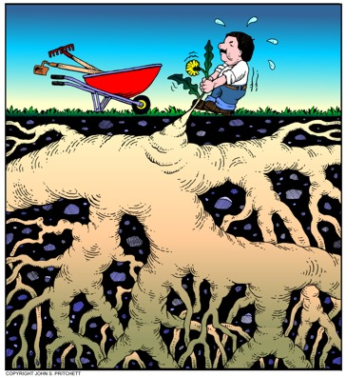
VENIMUS, VIDIMUS, VICIMUS? INVASIVE SPECIES AND THE LADY BIRD JOHNSON WILDFLOWER CENTER
Damon Waitt, Ph. D
Lady Bird Johnson Wildflower Center
at the University of Texas at Austin
Native Plant Society of Texas – Austin Chapter
November 16, 2010
Austin, TX
Notes:
Those of us who care deeply about native plants and habitats understand how important they are to our sense of place. But even as we are working to protect our plant heritage from land development and other pressures, native flora across the country – in our backyards, along our roadways, on our farms and ranches, in our parks and natural areas – are facing a less obvious but equally serious threat from non-native invasive plants. After habitat destruction, invasive species are the second greatest threat to biodiversity. Invasives threaten the survival of native plants and animals, interfere with ecosystem functions, and hybridize with native species resulting in negative genetic impacts. Invasive species also impede industries, threaten agriculture, endanger human health, and are becoming increasingly harder to control as a result of rapid global commercialization and human travel. They are a significant threat to almost half of the native species currently listed as federally endangered. The costs to prevent, monitor and control invasive species combined with the costs to crop damage, fisheries, forests, and other resources cost the U.S. $137 billion annually. The Lady Bird Johnson Wildflower Center takes a multi-pronged approach to addressing the harm caused by invasive plants, combining public outreach, research, monitoring, and the appropriate control and eradication of invasive plants.

Slide 2
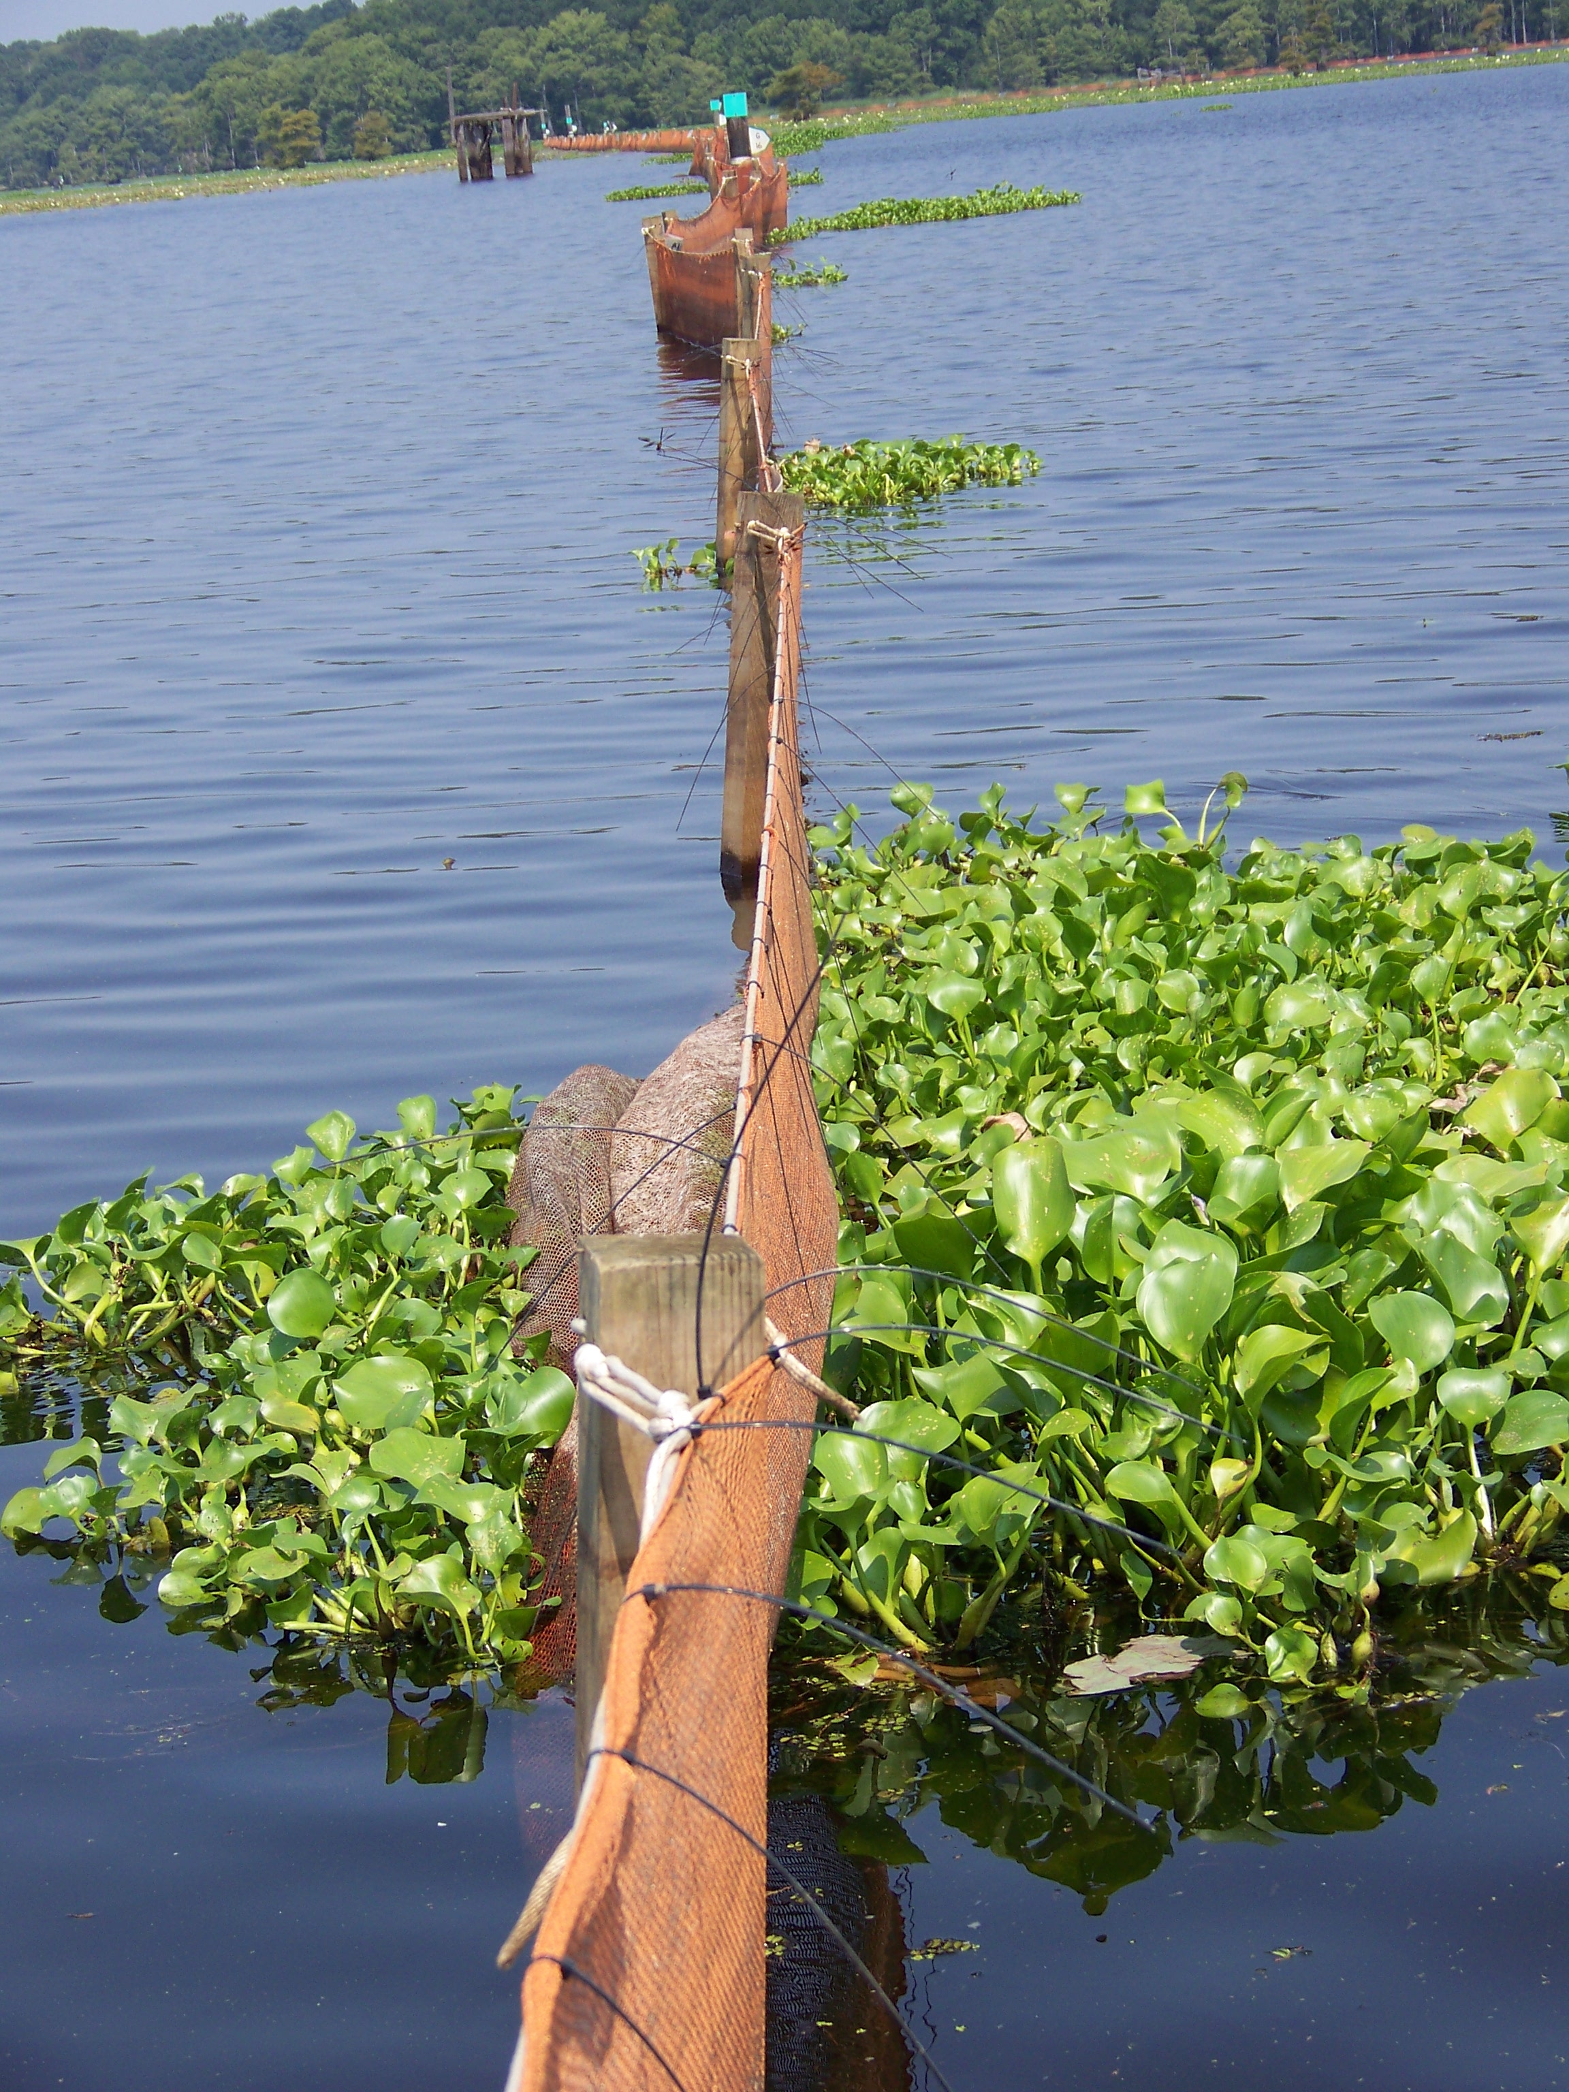
About Our Initiative
A partnership with state and federal agencies, NGOs, the nursery industry and other stakeholders to address invasive species issues in Texas.
Objectives
Facilitate communication among the state's invasive species stakeholders;
Develop a coordinated response to address invasive species issues on a statewide level;
Provide a venue for sharing information about key invasive strategies; and
Raise public awareness of the problems posed by invasive species in Texas.
Notes:
The Pulling Together Initiative
In partnership with state and federal agencies, non-governmental organizations, the nursery industry, and other stakeholders, the Wildflower Center is organizing a new statewide effort to address the issue of non-native invasive plants. The goals of this Pulling Together Initiative are to facilitate communication among the state's invasive plant stakeholders; develop a coordinated response to address invasive plant issues on a statewide level; provide a venue for sharing information about key invasive plant strategies; and raise public awareness of the problems posed by invasive plants in Texas. The Wildflower Center hosted the first statewide conference on invasive plants in November, which included two days of professional meetings and one day of public awareness/educational outreach. In addition, the Wildflower Center has created an informational website to disseminate educational, geospatial, and biological invasive plant information within the state of Texas. For more information on the Pulling Together Initiative, visit www.texasinvasives.org.

Slide 3
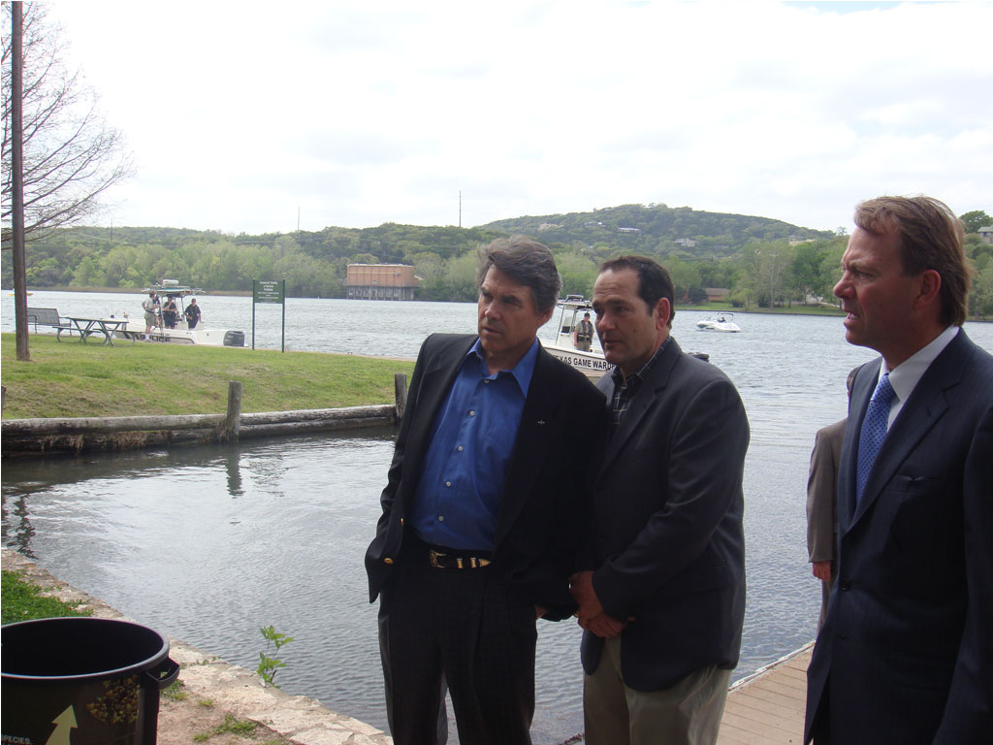
Above and Beyond
Notes:
3

Slide 4
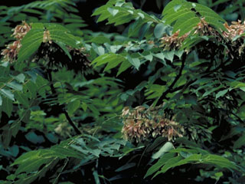
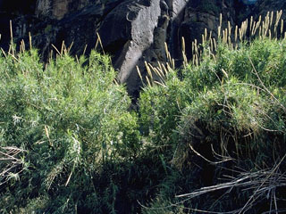
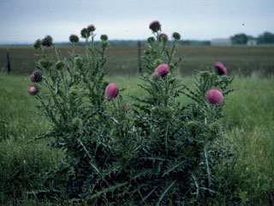
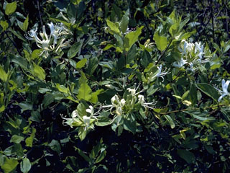
What is an Invasive Species?
An "invasive species" is defined as a species that is non-native (or alien) to the ecosystem under consideration and whose introduction causes or is likely to cause economic or environmental harm or harm to human health.
Executive Order 13112
Ailanthus altissima
Arundo donax
Carduus nutans
Lonicera japonica
Notes:
An invasive species grows/reproduces and spreads rapidly, establishes over large areas, and persists. Species that become invasive succeed due to favorable environmental conditions and lack of natural predators, competitors and diseases that normally regulate their populations.This includes a wide variety of plants, insects and animals from exotic places. As invasive species spread and take over ecosystems, they decrease biodiversity by threatening the survival of native plants and animals. In fact, invasive species are a significant threat to almost half of the native U.S. species currently listed as federally endangered.In addition to negatively impacting ecosystems, invasive species are also costly. It is very expensive to prevent, monitor and control the spread of invasives, not to mention the damage to crops, fisheries, forests, and other resources. Invasives cost the US $137 billion annually. Some of the most harmful species cost in excess of $100 million annually.Sometimes you will see invasive species referred to as exotic, alien, or non-indigenous species. The problem with these names is that they only refer to the non-native part of the definition above. Many exotic or alien species do not cause harm to our economy, our environment, or our health. In fact, the vast majority of "introduced" species do not survive and only about 15% of those that do go on to become "invasive" or harmful.

Slide 5
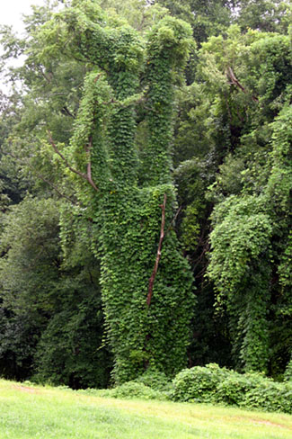
Why are they important?
Invasive species threaten native plants and native plant communities.
After habitat destruction, invasive species are the single largest cause of native plant extinction.
The rate at which new, potentially invasive, species are being introduced is exponentially increasing.
Pueraria montana var. lobata
"On a global basis...the two great destroyers of biodiversity are, first habitat destruction and, second, invasion by exotic species” - E.O. Wilson

Slide 6
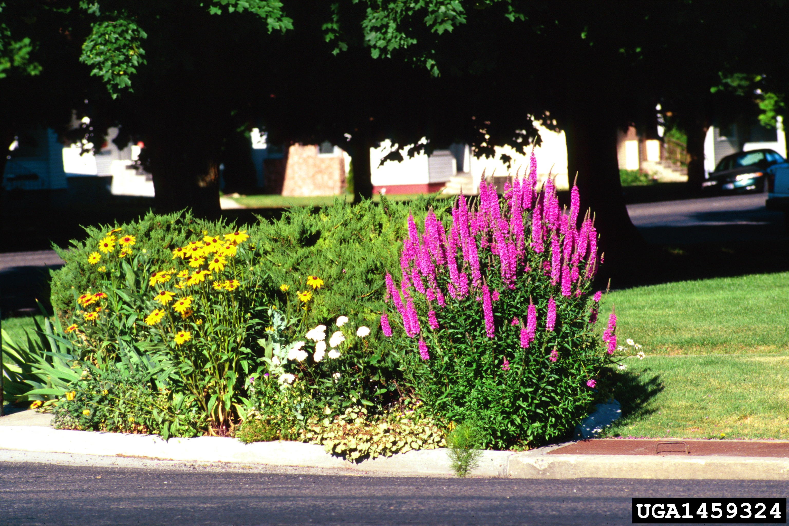
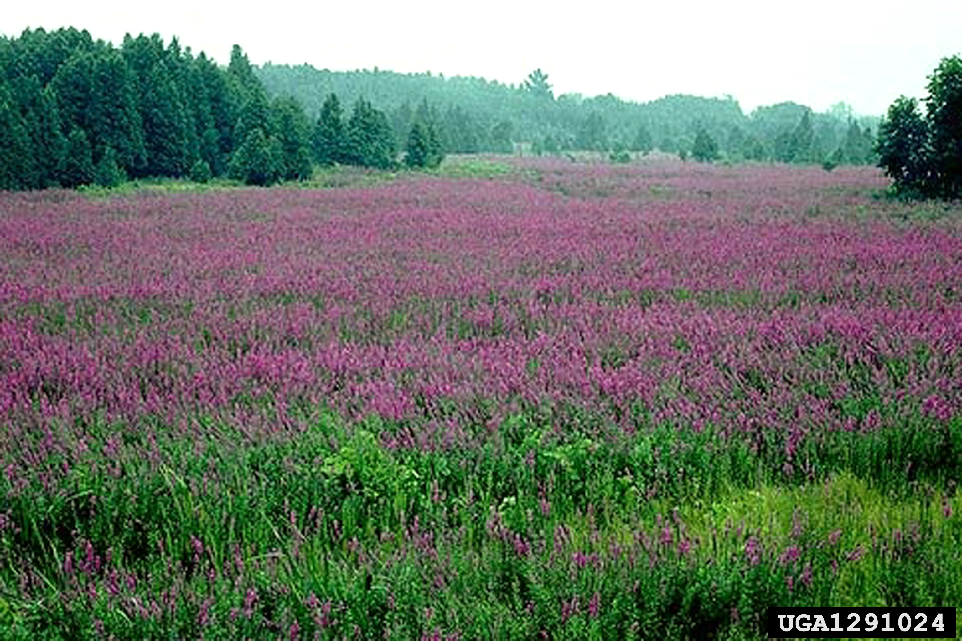
How do they get here?
Spread by humans who do not realize that these plants, animals and insects are destructive.
May happen when people plant garden ornamentals, range forage plants, or plants for erosion control.
Can occur when animals and insects are introduced to control other organisms.
Other species are introduced accidentally on imported nursery stock, fruits, and in ship ballast waters, on vehicles, in packing materials and shipping containers.

Slide 7
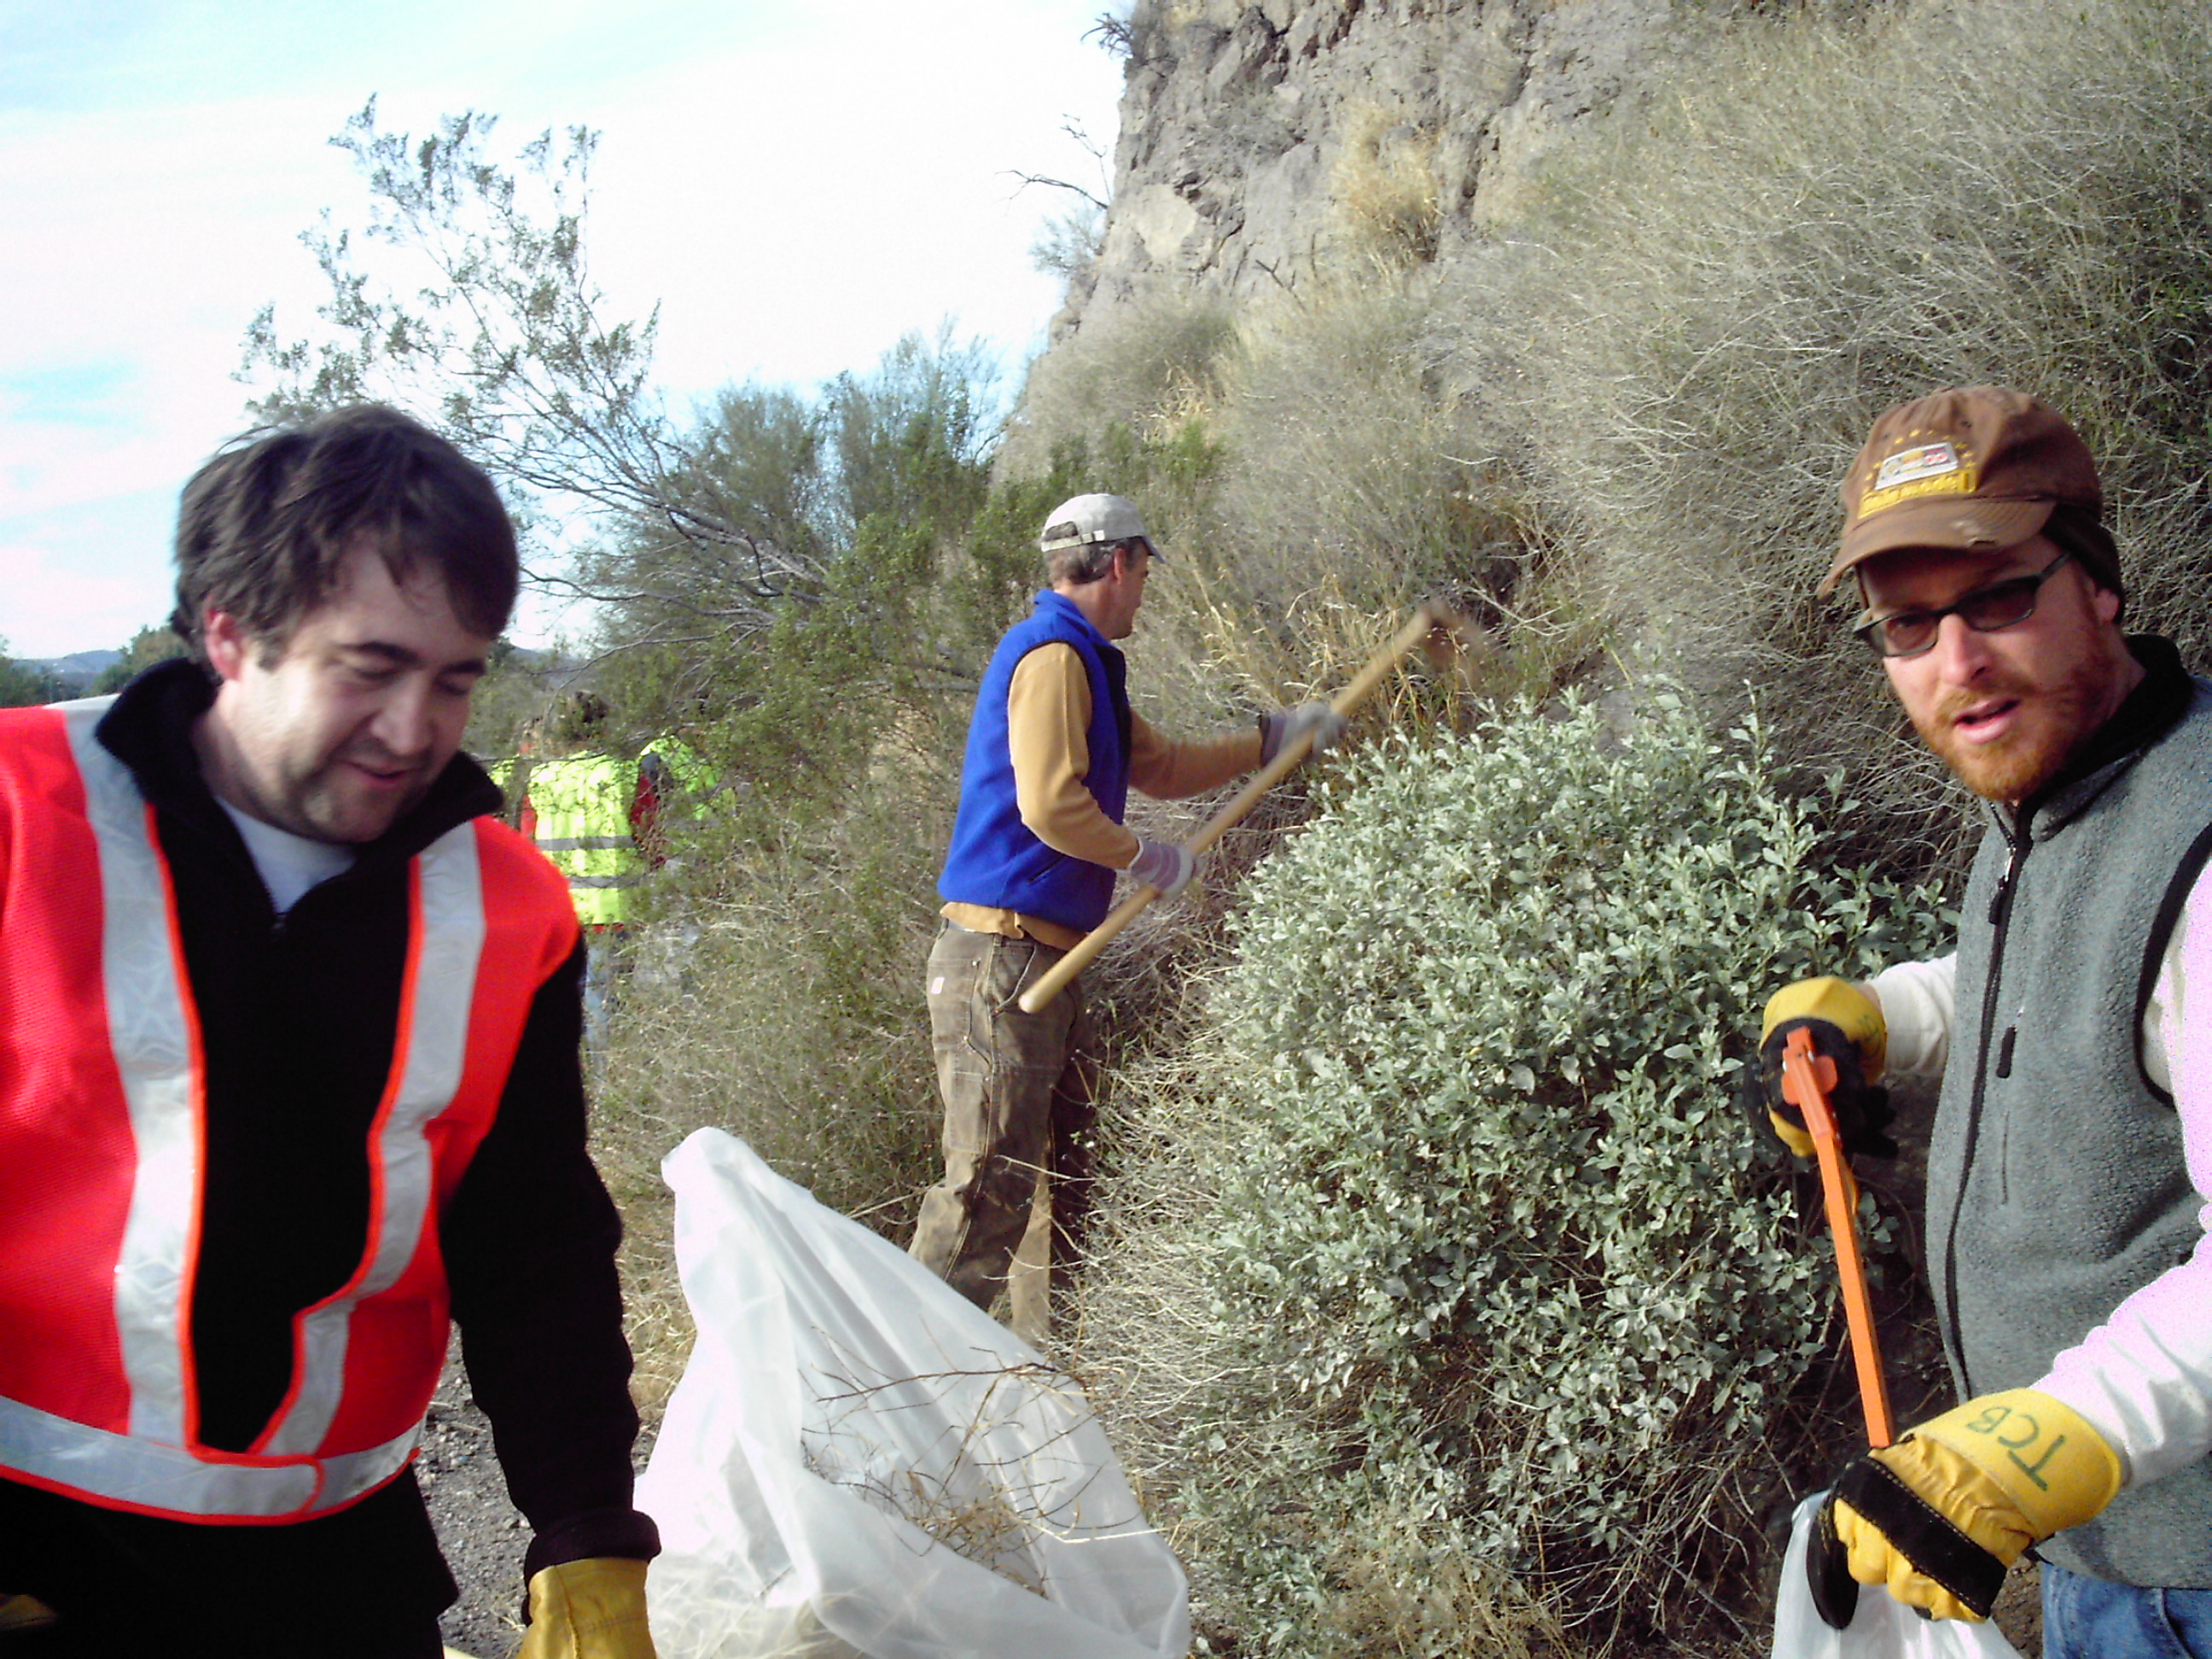

Notes:
One Ecosystem’s trash……

Slide 8
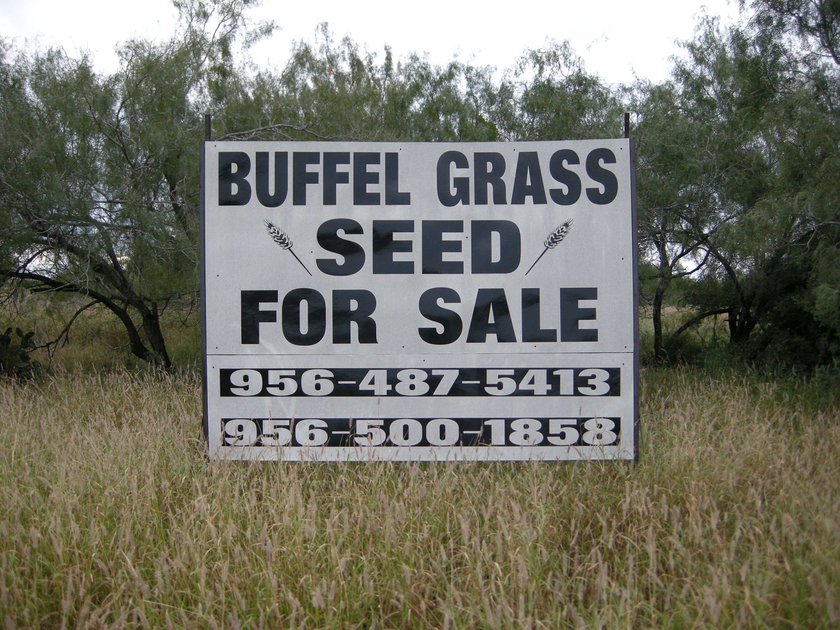
Notes:
Is another Ecosystems treasure.

Slide 9
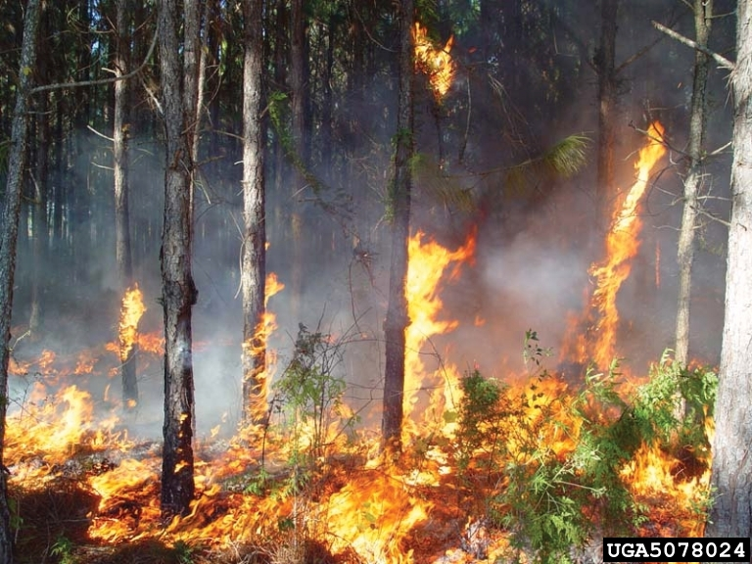
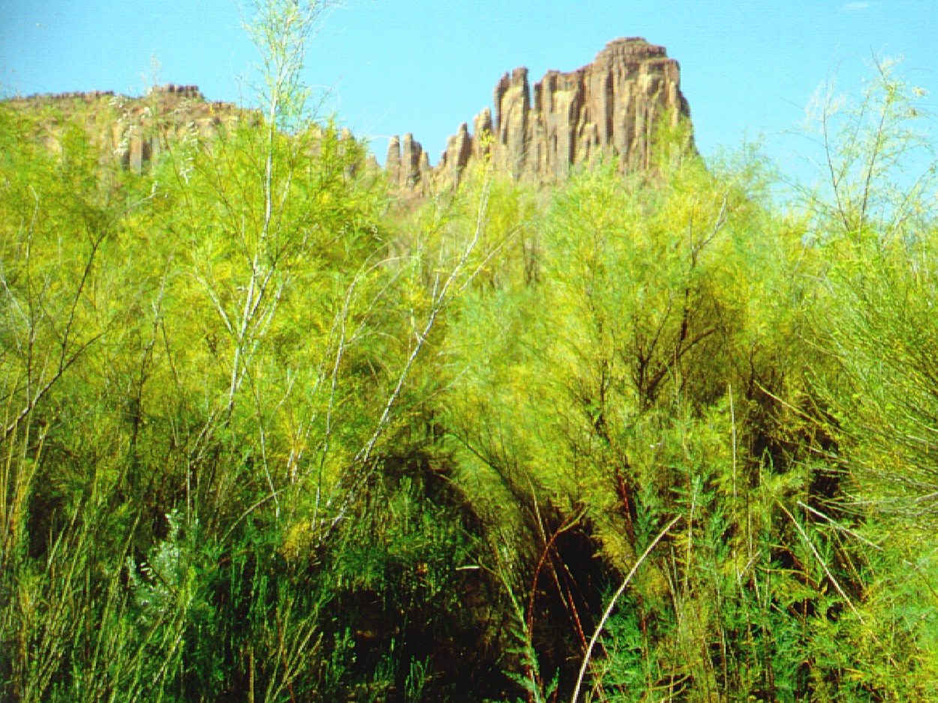
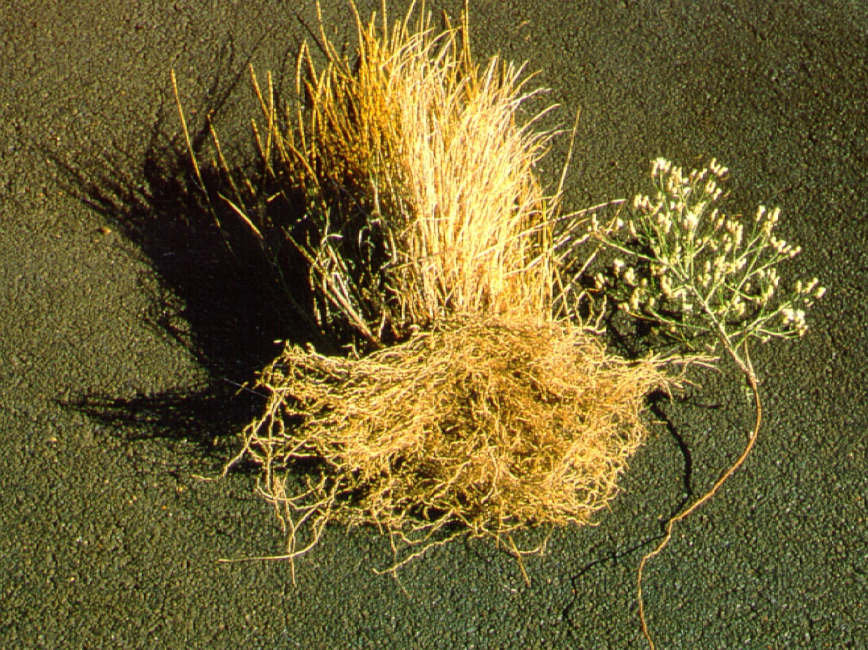
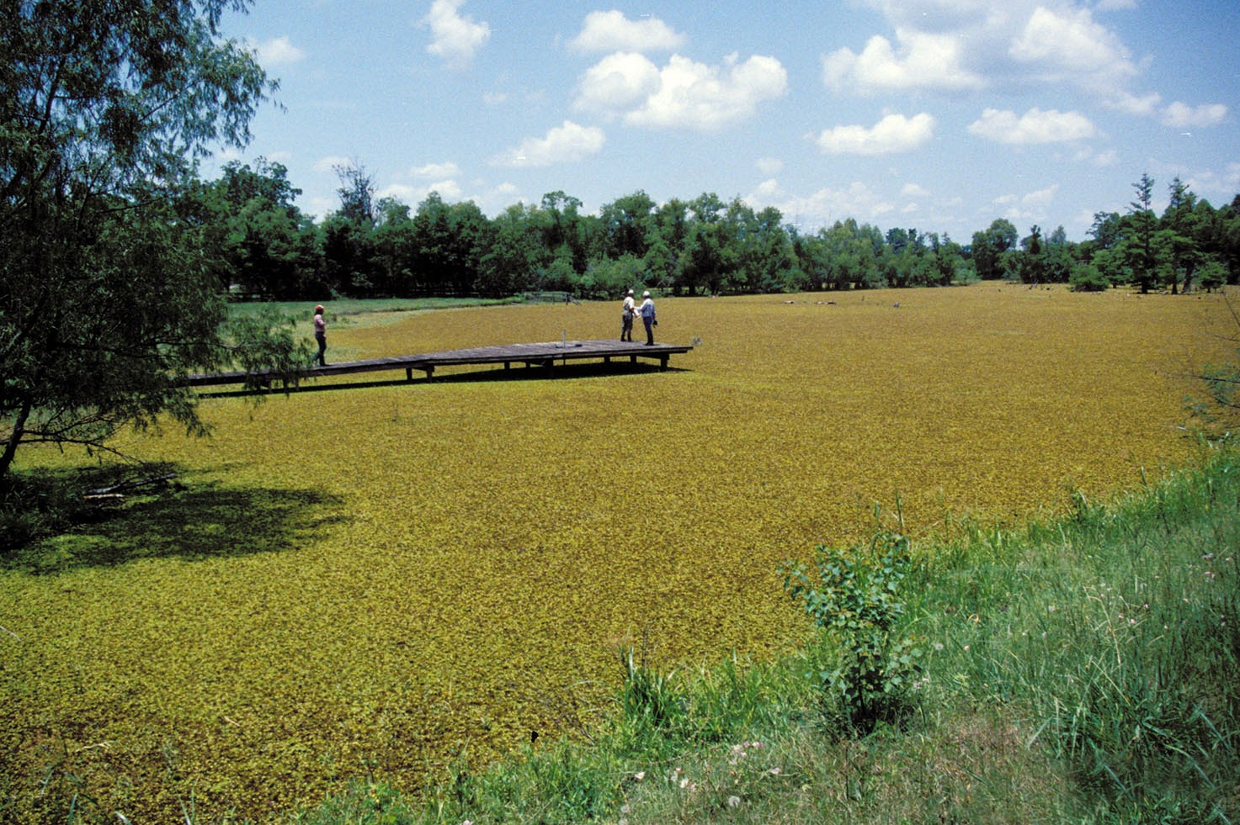
Ecosystem Level Impacts
Alter disturbance regimes (i.e. fire)
Change hydrology
Influence erosion and sedimentation
Change chemistry (i.e. nutrients)
Climbing Fern (Lygodium japonicum)
Tamarisk (Tamarix spp.)
Knapweed (Centaurea maculosa)
Giant salvinia (Salvinia molesta)
Notes:
Even in fire-adapted communities, non-native invaders may alter the intensity and frequency of fire to the detriment of native species. Cogongrass (Imperata cylindrica), shown here completely dominating the understory of a forest plantation, has done just this in longleaf pine-wiregrass communities along the eastern Gulf Coast.
Dense infestations of tamarisk as shown here along a small ephemeral stream in southeastern Utah, can also block flood flows, sharply altering patterns of erosion and deposition. Bailey et al. (2001) found that tamarisk leaf litter degrades more rapidly than that of native riparian trees and that this was associated with a two-fold decrease in aquatic macroinvertebrate richness and a four-fold decrease in abundance. Research conducted by University of Minnesota graduate student Ted Kennedy at Ash Meadows National Wildlife Refuge in Nevada has also shown that tamarisk infestations reduce diversity and biomass of native fishes (personal communication).
In many areas of the Pacific Northwest knapweeds (Centaurea spp.) have invaded and displaced native bunchgrasses. Here, a comparison of the roots of a native wheatgrass and the invasive non-native spotted knapweed (Centaurea maculosa, right) demonstrates a striking difference between the fibrous, soil-holding roots of the former and the thin taproot of the latter.
Invasive aquatic plants can sharply reduce light levels and dissolved oxygen concentrations in the waters they occupy. Giant salvinia (Salvinia molesta) is another floating aquatic plant which severely impacts water bodies at sites around the world. Native to southeastern Brazil, it is shown here completely covering a pond in Texas. Infestations are now known from other US sites - Hawai'i, California, Arizona, Louisiana, Alabama, Georgia, Florida, Mississippi, and North and South Carolina. (Photograph provided for this presentation by www.invasive.org.)

Slide 10
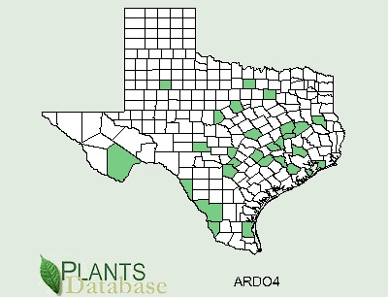
Texas Issues (circa 2005)
1. There is not a definitive source for IS information in Texas.
2. There is a gap in our knowledge about the distribution and biology of IS.
3. There is a need for more communication among the state’s IS stakeholders
4. A coordinated response to address IS on a statewide level has yet to materialize.

Slide 11
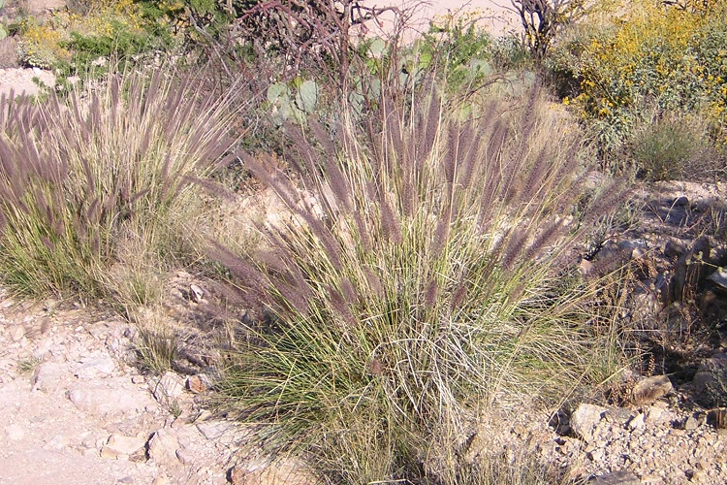
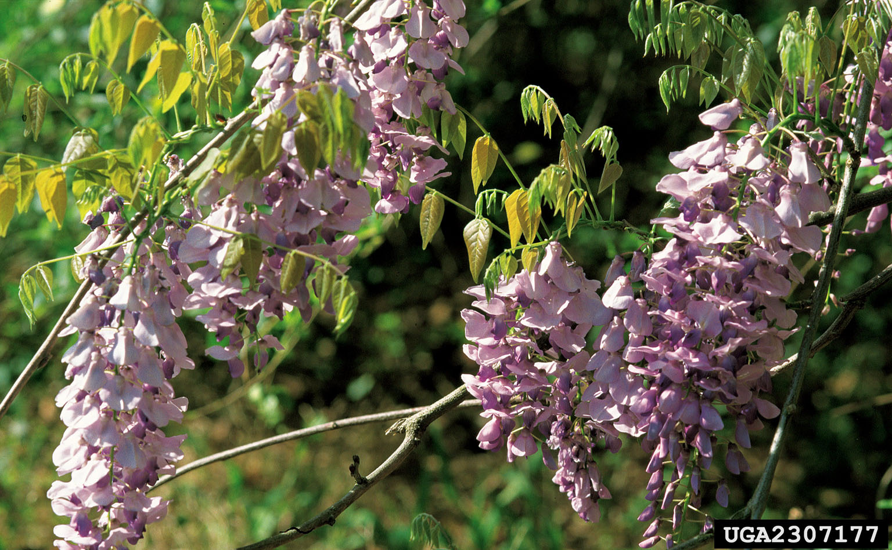
Addressing the Issues
1. Help define the problem through research and information sharing.
2. Raise public awareness through educational outreach.
3. Take action to help stop the spread of invasive plant species.
Pennisetum ciliare - Buffelgrass
Wisteria sinensis - Chinese wisteria

Slide 12
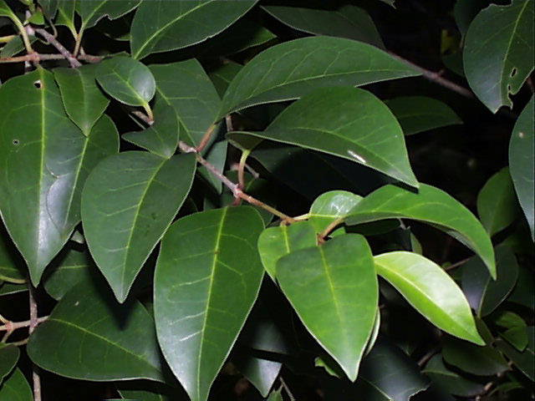

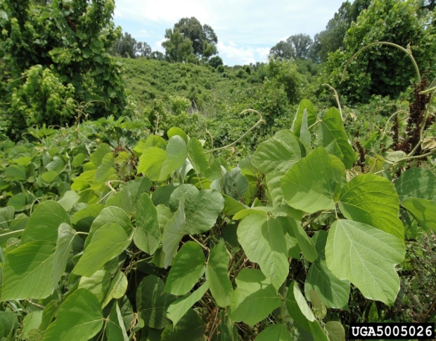
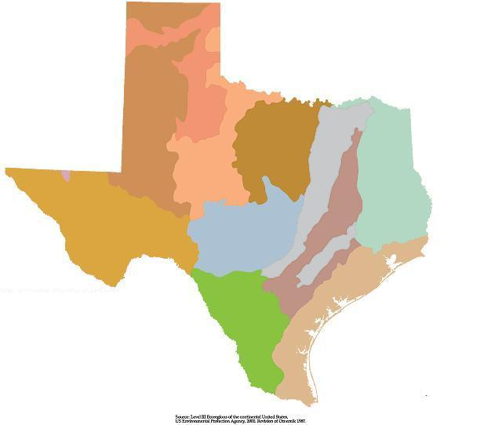
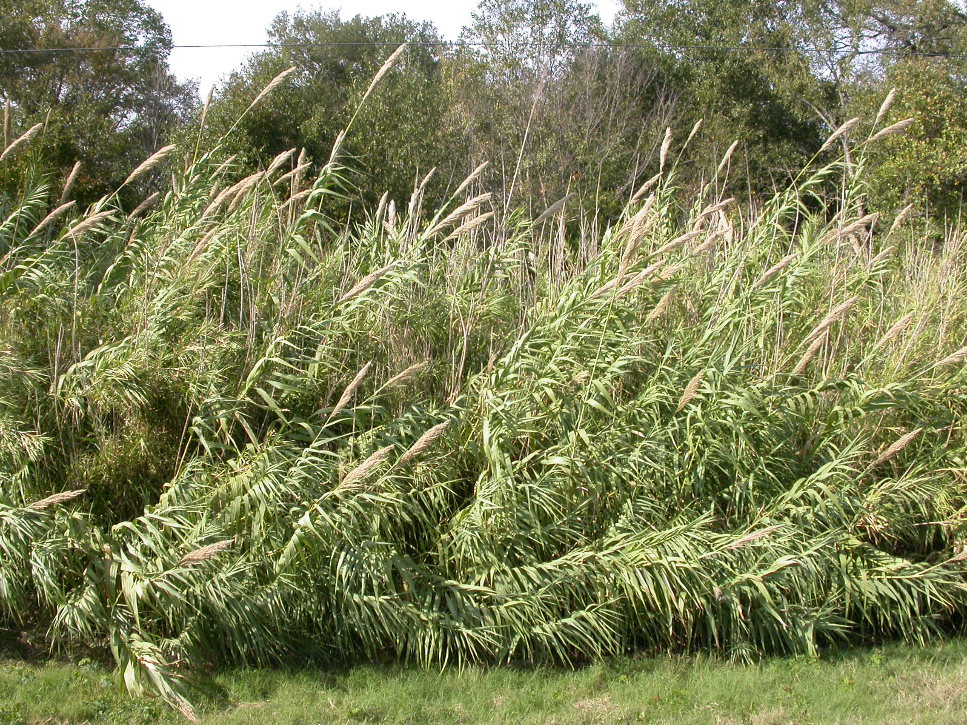
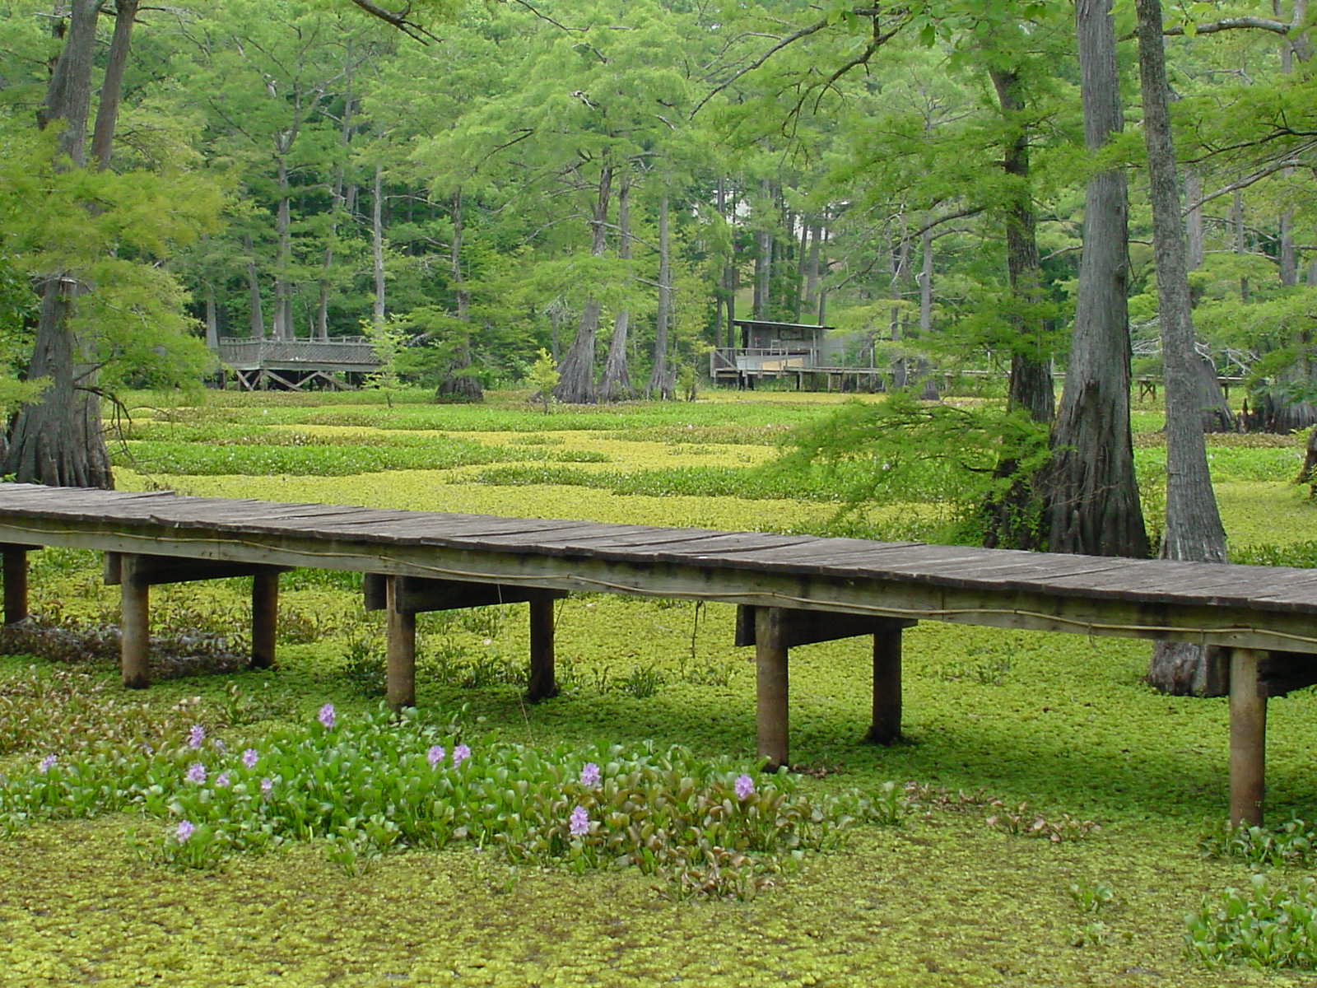
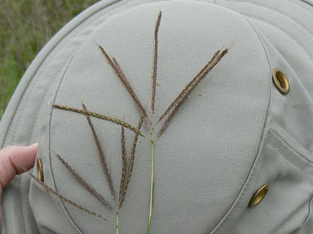
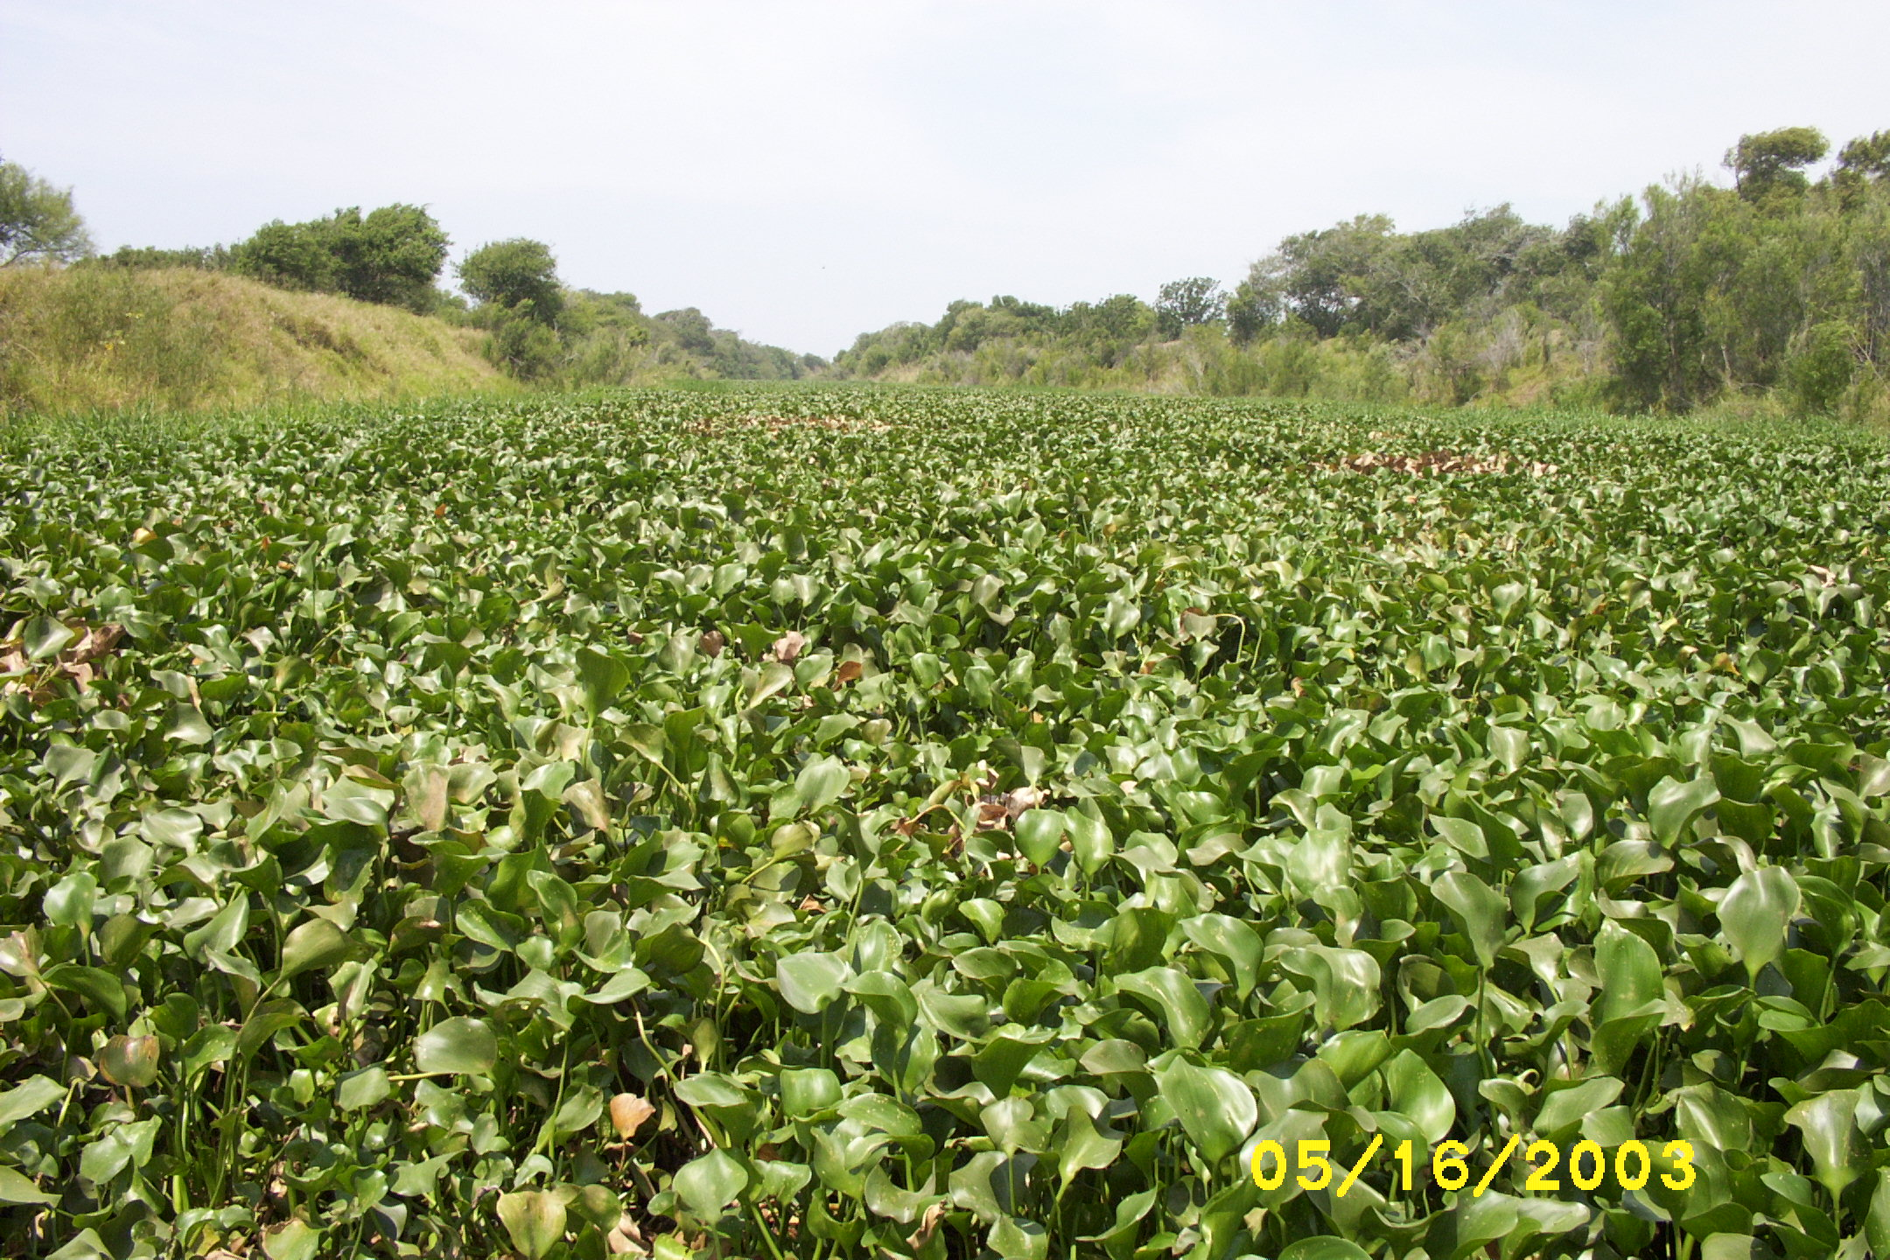
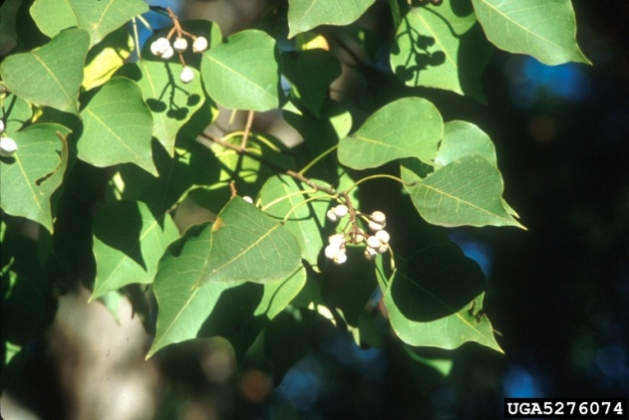
Invaders in Texas

Slide 13
Texas Department of Agriculture N=33 spp.
TITLE 4.AGRICULTURE. Part 1. TEXAS DEPARTMENT OF AGRICULTURE. Chapter 19. QUARANTINES AND NOXIOUS PLANTS §19.300.Noxious Plant List. Botanical Name - Common Name Orobanche ramosa - broomrape Alhagi camelorum - camelthorn Triadica sebiferum - Chinese tallow tree Cyperus entrerianus - deeprooted sedge Carthamus lanatus - distaff thistle Myriophyllum spicatum - Eurasian watermilfoil Spirodela oligorrhiza - giant duckweed Arundo donax - giant reed Calystegia sepium - hedge bindweed Hydrilla verticillata - hydrilla Rottboellia cochinchinensis - itchgrass Cuscuta japonica - Japanese dodder | Botanical Name - Common Name Pueraria montana var. lobata - kudzu Lagarosiphon major - lagarosiphon Melaleuca quinquenervia - paperbark Lythrum salicaria - purple loosestrife Eichhornia azurea - rooted waterhyacinth Tamarix spp. - Saltcedar Salvinia spp. - Salvinia Nassella trichotoma - Serrated tussock Panicum repens - Torpedograss Solanum viarum - Tropical soda apple Ipomoea aquatica - water spinach Cryptocoryne beckettii - water trumpet Eichhornia crassipes - waterhyacinth Pistia stratiotes - waterlettuce Alternanthera philoxeroides - alligatorweed Cardiospermum halicacabum - balloonvine Schinus terebinthifolius - Brazilian peppertree

Slide 14
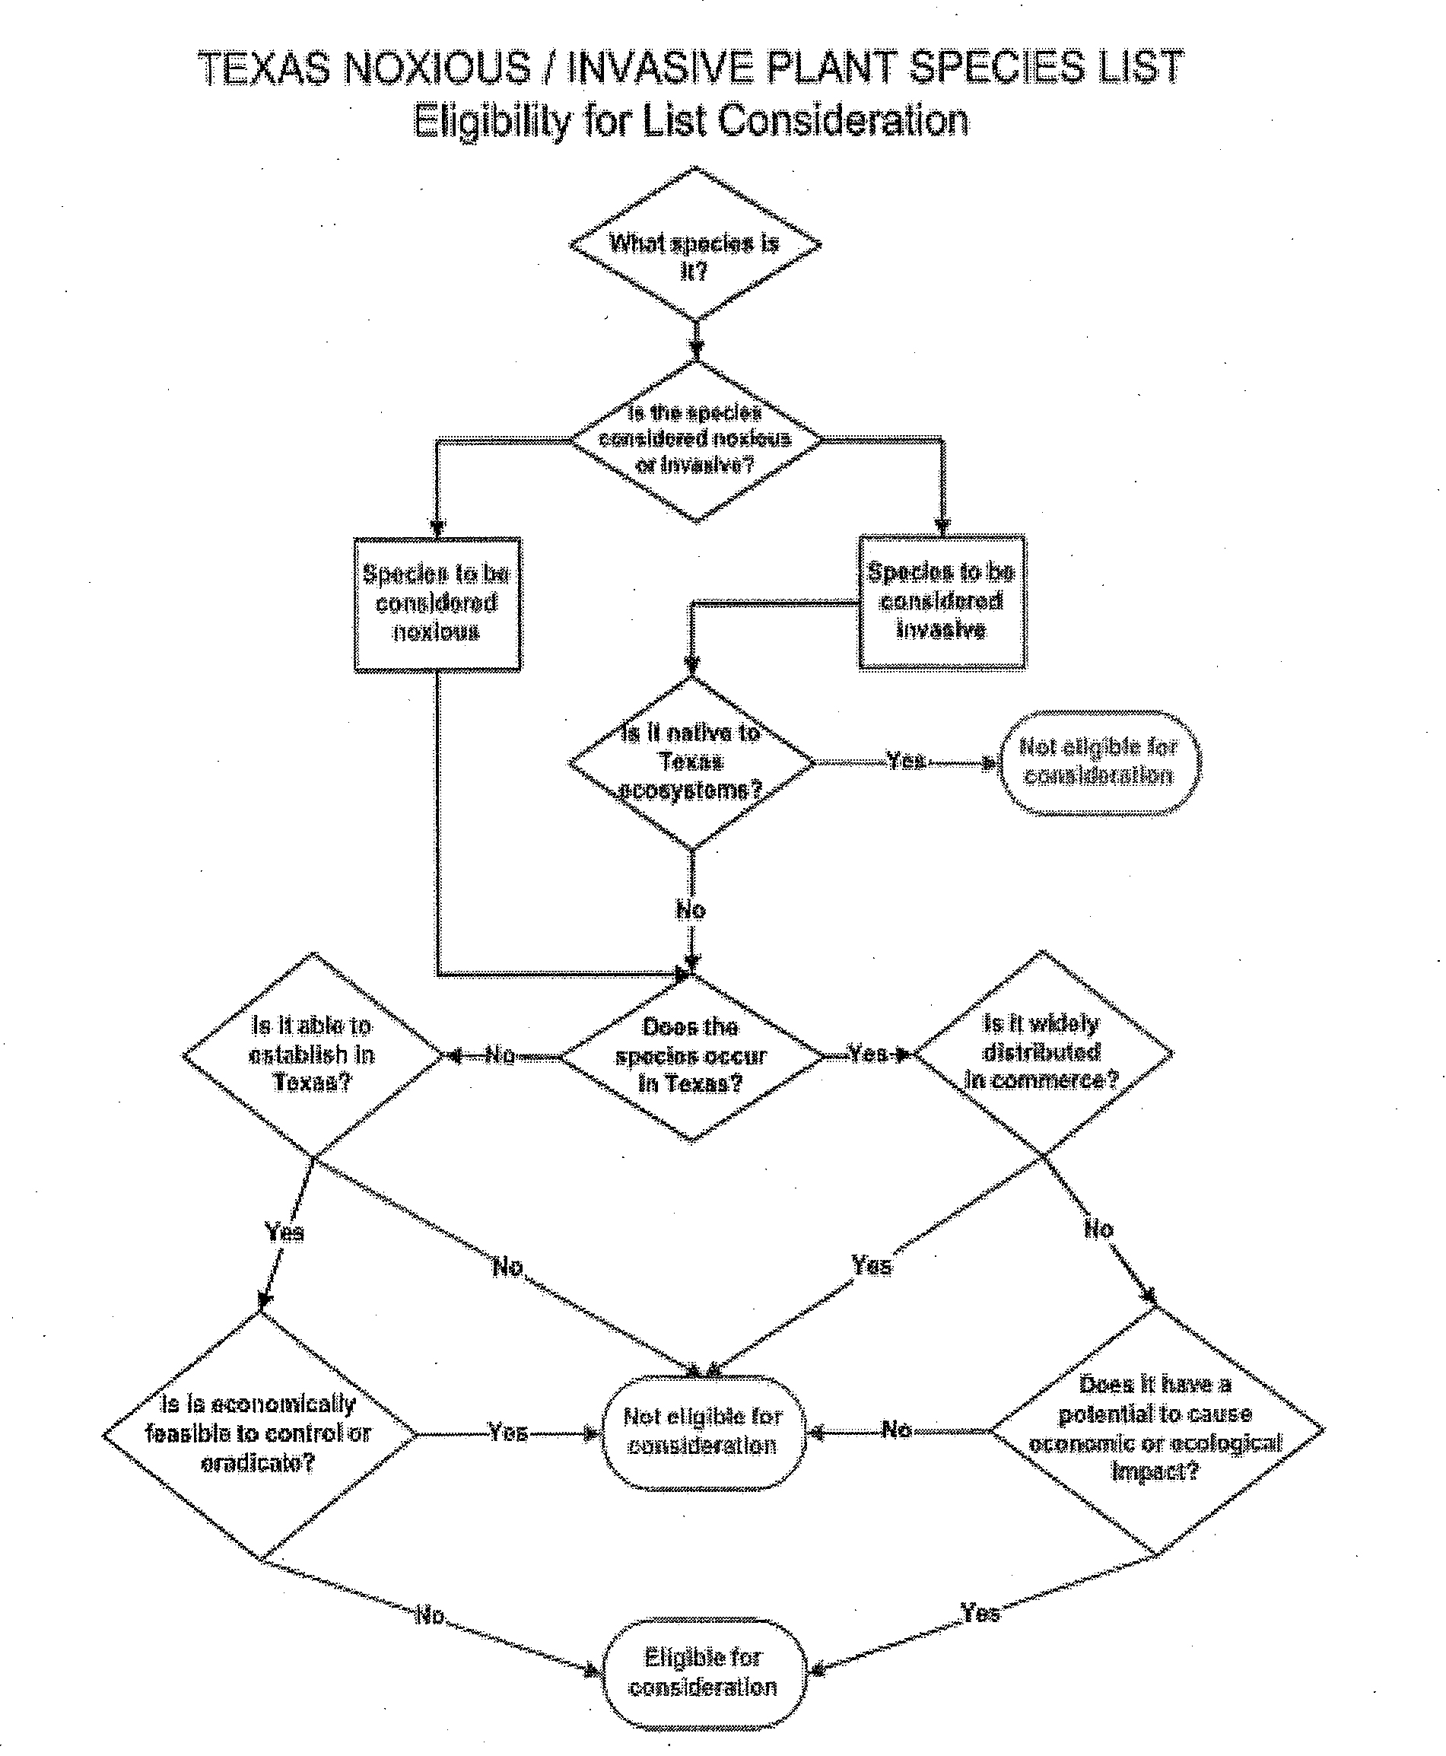

Slide 15
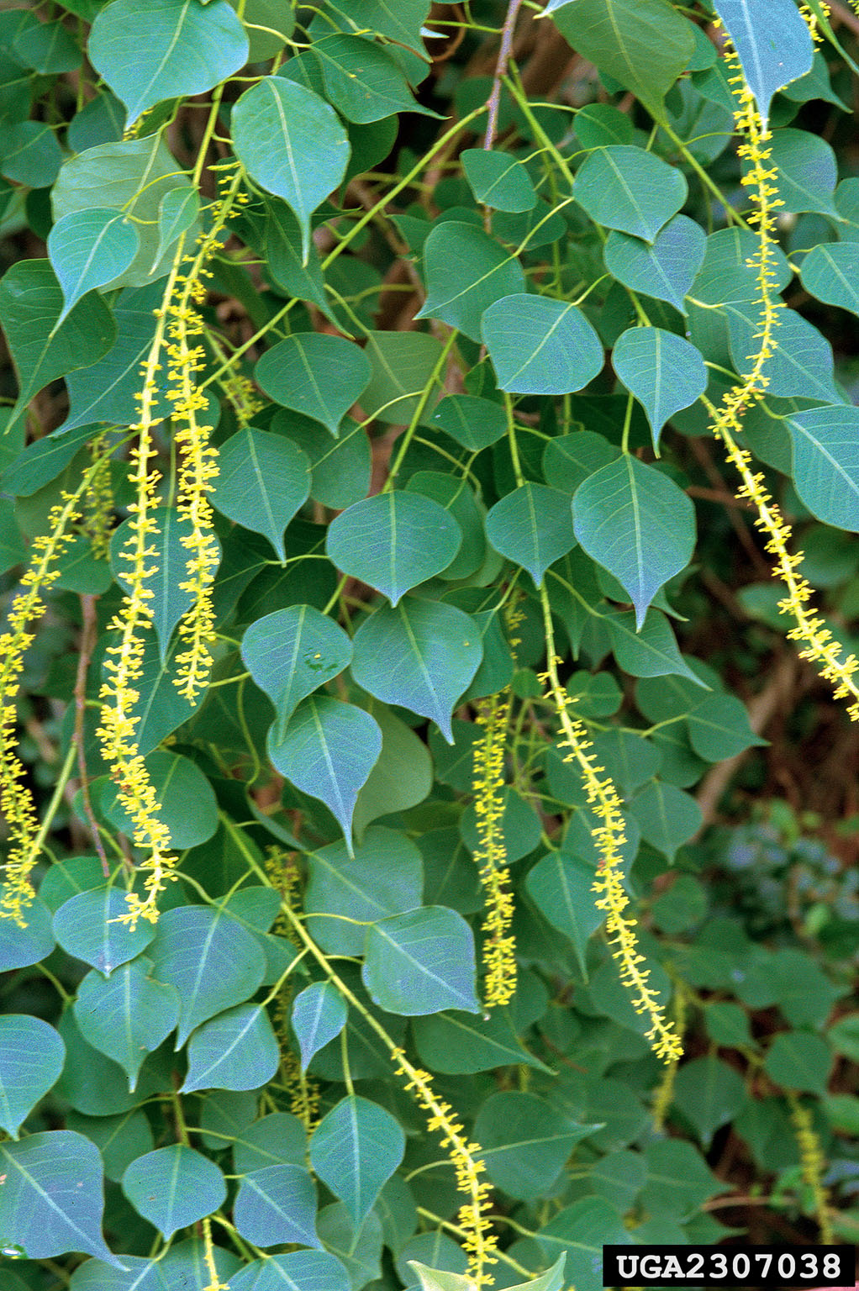
Chinese tallow (Triadica sebifera)
History: Chinese tallow is native to China and Japan. Introduced into the United States in 1776 by Benjamin Franklin. Distributed along the Gulf Coast in the 1900’s by the USDA to establish soap and candle making making industries. Planted as an ornamental because of its colorful autumn foliage.
Biology & Spread: Can reach reproductive age in as little as three years and prolifically produces seeds transported by water and birds. Also propagates via cuttings, stumps, and roots.
Ecological Threat: Chinese tallow will transform native habitats into tallow forests. Fallen tallow leaves contain toxins that create unfavorable soil conditions for native plants. Chinese tallow will outcompete native plant species.
Notes:
30% of Houston’s urban forest canopy

Slide 16
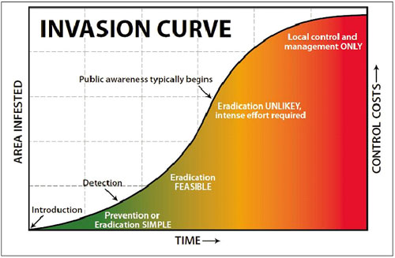
The lag effect

Slide 17
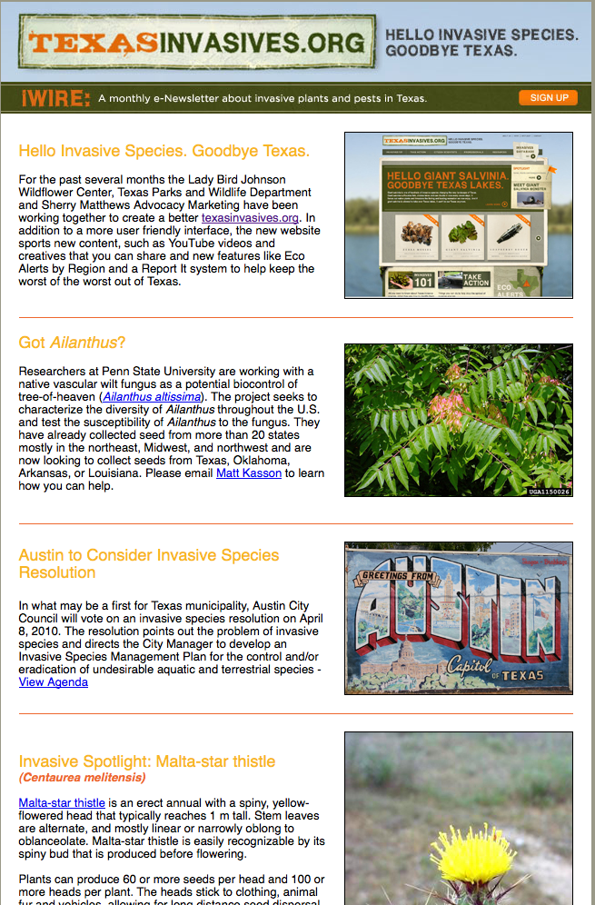
Wildflower Center Activities
www.texasinvasives.org
2005, 2007, 2009 Statewide Invasive Species Conferences.
Texas Invasive Plant and Pest Council.
Be PlantWise Public Awareness Campaign.
Research on specific invasive species.
Invaders of Texas Citizen Science Program.

Slide 18
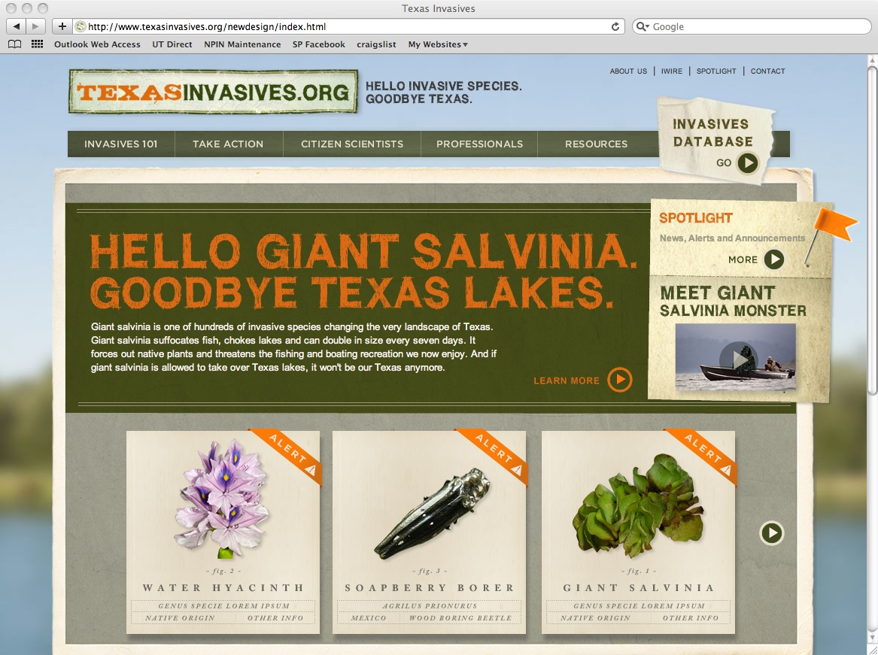
Notes:
Serves as the invasive species information clearinghouse for Texas.

Slide 19
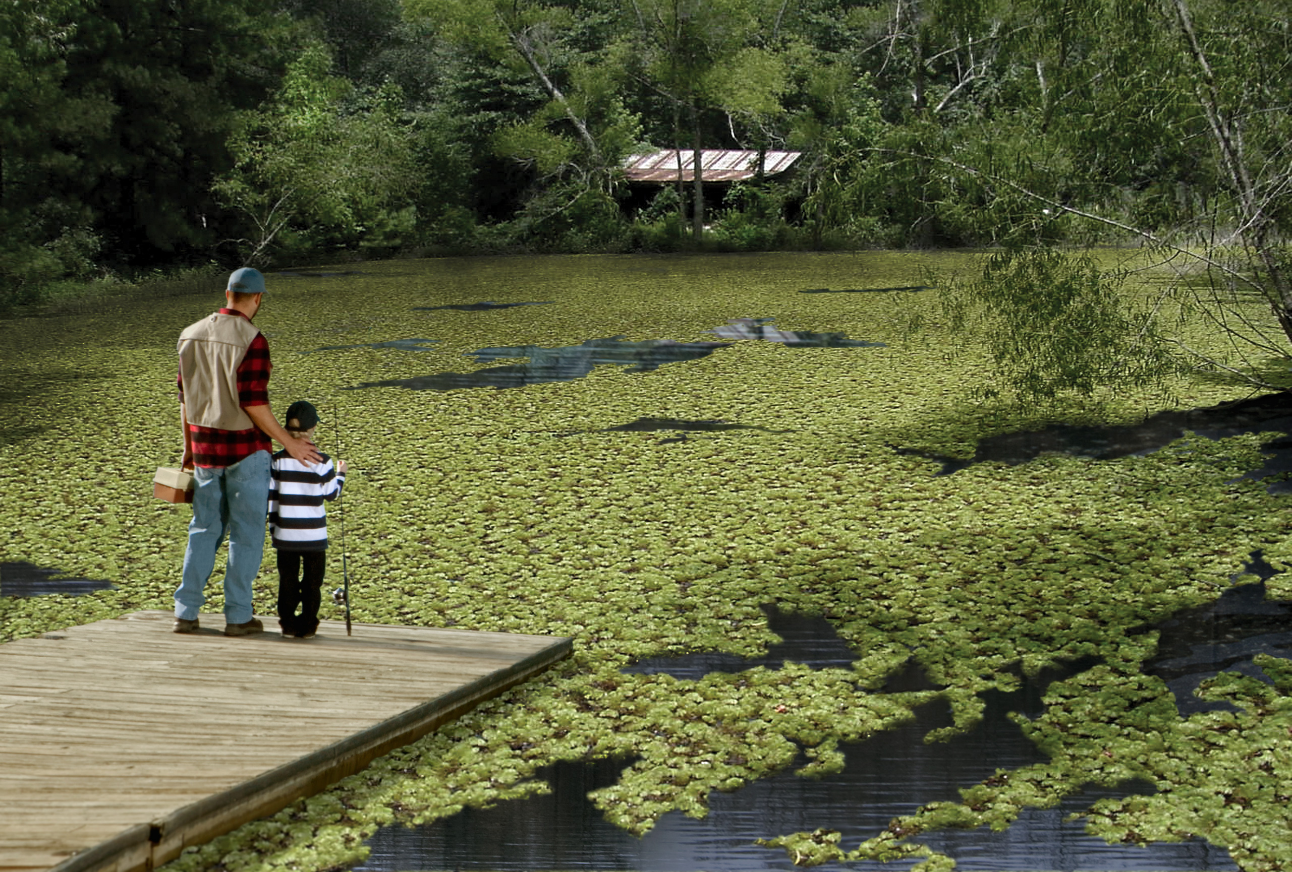



Slide 20


Notes:
Serves as the invasive species information clearinghouse for Texas.

Slide 22
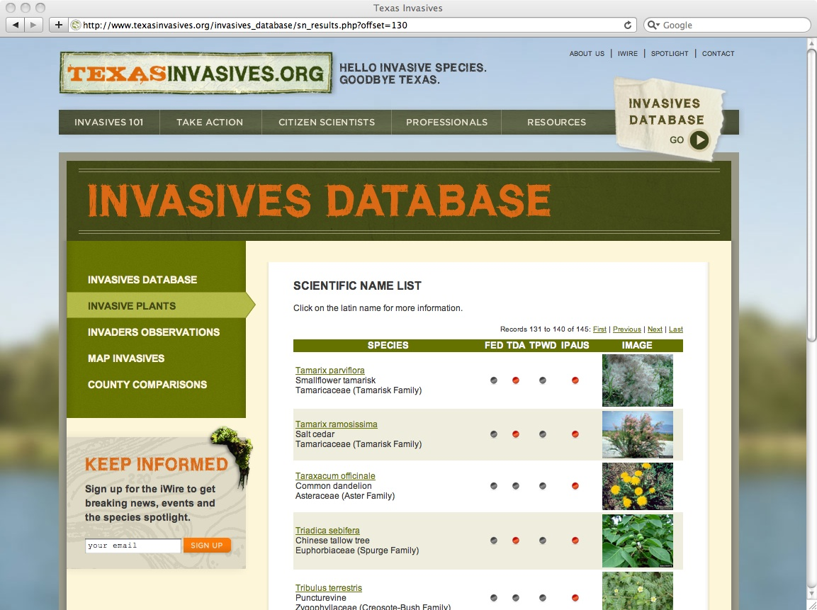
Invasive Plant Database
Notes:
140 Species
Plants known to occur in or around Texas and suspected of invasive problems in natural areas around the United States.
TDA Noxious Weed List - 33
TPWD Prohibited Exotic - 13
\

Slide 23
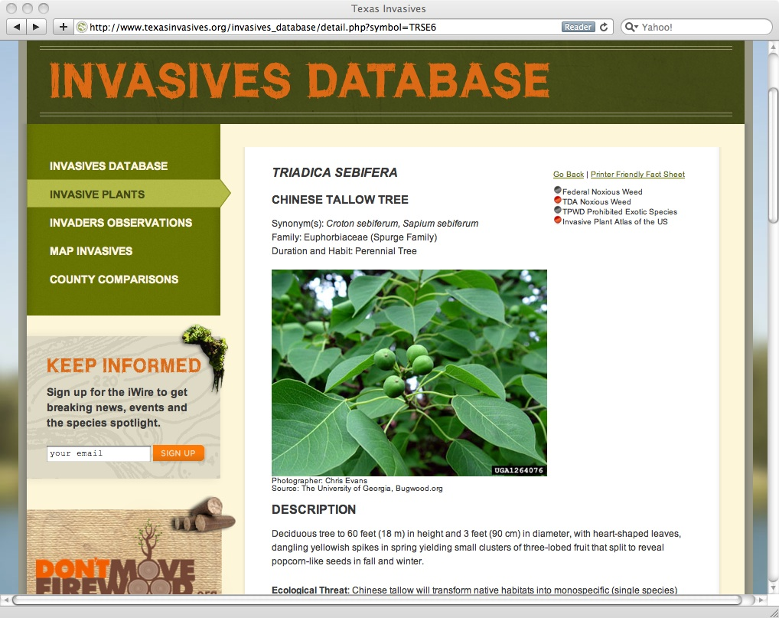
Invasive Plant Database: Detail Page
Illustrated Descriptions
Ecological Information
Distribution & Habitat
Biology & Spread
History of Introduction
Ecological Threats
Control & Management
Native Alternatives
References

Slide 24
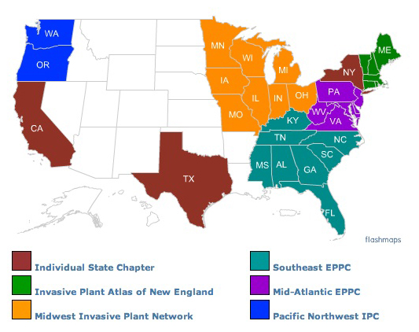
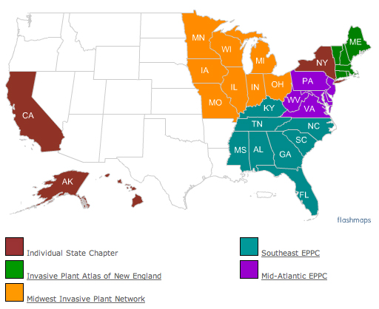
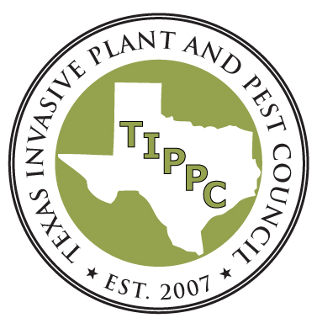
Texas Invasive Plant & Pest Council
Established in 2005 to
Promote understanding and awareness of invasive plant and pest impacts in Texas;
Provide a forum for the exchange of scientific, educational and technical information; and
Support research and restoration activities.

Slide 25
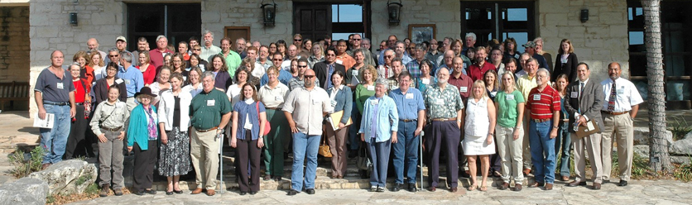
Invasive Plant Conference

Slide 26
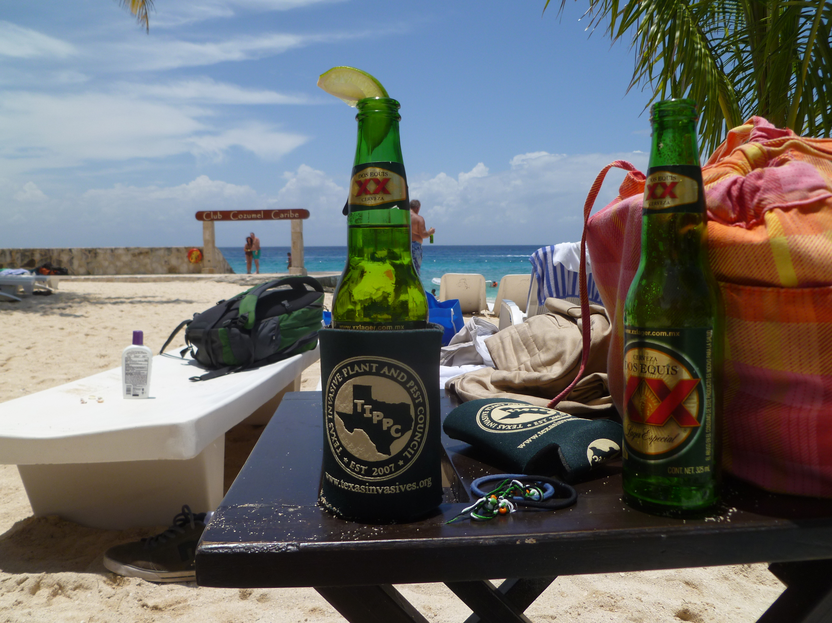
Invasive Plant Conference
November 2005, 2007, 2009

Slide 27
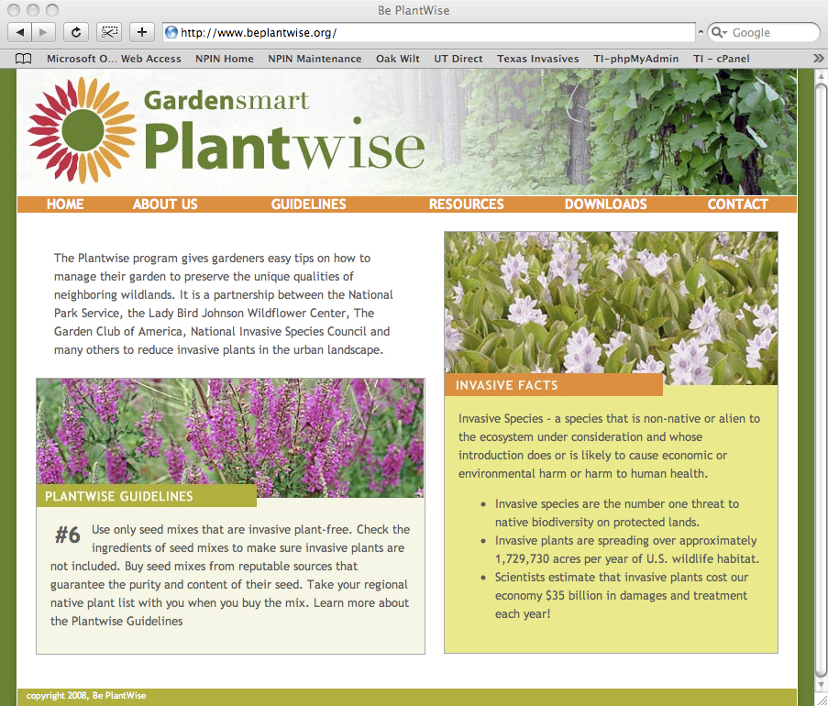
PlantWise Campaign - www.beplantwise.org
Invasive plants infest approximately 2.6 million acres in the National Park System.
Purpose: To educate the public about best management practices to control invasive plants at the urban/wildland interface.
Notes:
PlantWise: A Partnership for Conservation
PlantWise is a new partnership between the National Park Service, Lady Bird Johnson Wildflower Center, Garden Club of America, and the Student Conservation Association to educate the public and communities about best management practices to prevent harmful invasive plants from invading parklands and natural areas. Education is a critical mechanism for changing behaviors and creating an environment where citizens understand their responsibility for managing plants in their homes and communities. Invasive plant management, like litter control or fire proofing homes is an issue that can be influenced greatly by public education. The PlantWise program will develop a web-accessed, community education program on invasive plant management such as the successful Firewise (www.firewise.org) to help communities, agencies, and nongovernmental organizations manage their invasive plant problems. The standardized materials will outline the problem of invasive species and describe how homeowners and landowners can prevent introductions of invasives, manage their landscapes in the presence of introduced species, and use native plants or non-invasive plants as alternatives.

Slide 28
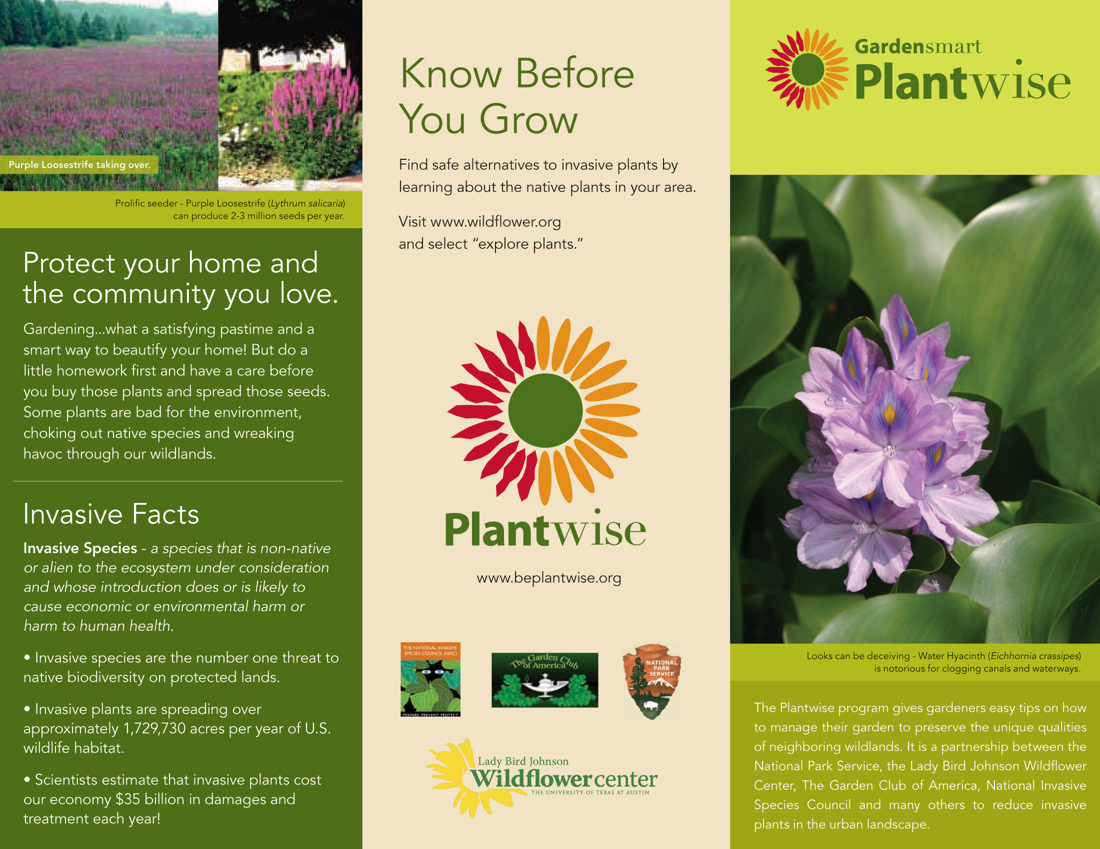
PlantWise: Brochure1
Notes:
1. Plant non-invasive plants.When gardening, plant species that are not listed on the Federal noxious weed list for your state, and find out what plants are causing problems in parks or natural areas in your region to make sure you know what species to avoid. Visit USDA Plants Noxious Weeds List for your state.
2. Use non-invasive alternatives.Ask a local nursery about non-invasive plant alternatives. Native plants often have similar characteristics as invasives without the damaging ecological side effects.
3. Watch out for invasive plant hitchhikers.Check clothes, belongings, and vehicles for seeds and pieces of plants. Many invasive plants are spread to new places when they become attached to these things and then drop off somewhere new.
4. Have a care if you share.Many invasive plants move around because they are attractive garden plants. Do not share cuttings, seedlings or plants that are invasive with neighbors and friends.
5. Use only seed mixes that are invasive plant free.Some invasive plants were introduced because they were contaminants in wildflower and grass seed mixes. Check the ingredient lists of seed mixes to make sure that invasive plants are not included. Try to purchase seed mixes from reputable manufacturers that guarantee the purity and content of their seed. Take your regional native plant list with you when you buy the mix. To learn more about native plants in your area, visit www.wildflower.org and select ﾒexplore plantsﾓ to explore your states native plants.
6. Use weed-free soil and mulch mixSome invasive plants are introduced because they were contaminants in landfill soil and mulch mixes. Try to purchase seed mixes from reputable manufacturers that guarantee the purity or weed-free content of their soil and mulch mixes. (Look for a tag that says ﾒCertified weed free.ﾓ)
7. Be especially careful with aquatic plants.Donﾕt just dump them!! Invasive aquatic plants were often introduced as attractive water garden and aquarium decorations. Visit www.habittitude.net to learn more about invasive aquatic plants and conservation of aquatic resources. See Habittatitude
8. Keep an eye on new sprouts and volunteers.Invasive plants can come from anywhere and spread very quickly. Some invasive plants make attractive additions to our gardens but can spread very quickly by producing lots of seedlings. Control your invasive garden plants by hand-pulling or mowing unwanted seedlings to prevent them from growing to maturity. (Regular mowing or use of barriers.) Be aware of what is coming up in your yard, and take care to control these new invasives.
9. Dispose of invasive plants carefully.When pruning or removing parts of or whole invasive plants consider whether there are any seeds, fruits or cuttings that could resprout. Try freezing seeds, fruits and cuttings or burning them if it is permitted in your area, as this will make them nonviable. Or consider pruning or removing invasive plants before they produce fruit or seeds. (When removing the plant either burn, bag or freeze before you dispose.)
10. If you canﾕt part with your invasive plant, remember ﾐ contain it, control it, or cage it. Please be responsible.If you have a plant in your garden that has invasive tendencies, take special steps to keep it in your garden like inserting root barriers, trimming regularly, or harvesting fruits or seeds before they are spread.

Slide 29
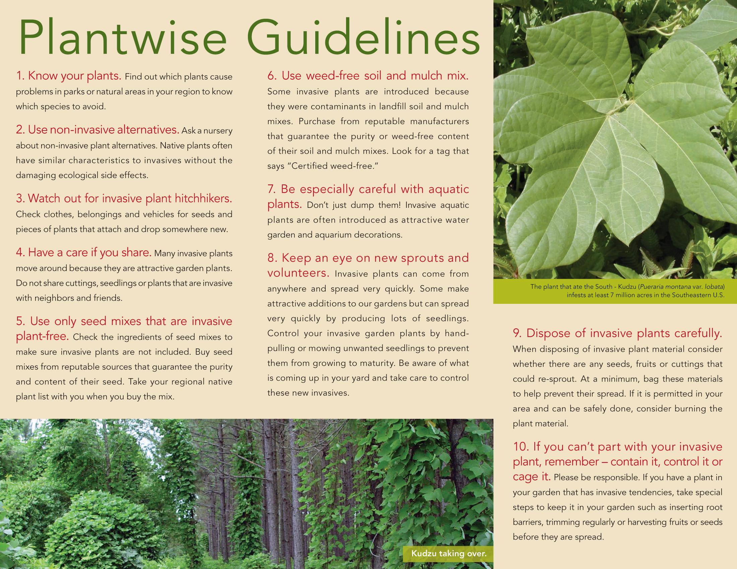
PlantWise: Brochure2

Slide 30
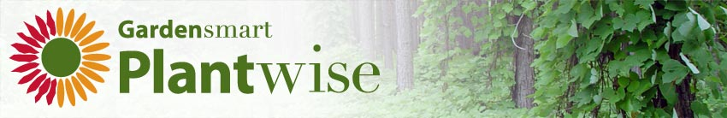
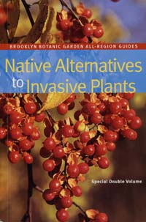
Invasive to Native Translator – www.beplantwise.org
In partnership with Brooklyn Botanic Garden and the publication Native Alternatives to Invasive Plants by C. Colston Burrell (2006).
Native alternatives for 148 invasive species of horticultural origin.
Alternatives selected to match invasives based on similarity of habit, duration, distribution and growing conditions and morphological features like flowers, fruits and foliage.
Notes:
Here is a quick list of the topics we’re going to cover today.
Is the plant locally or regionally native?Are the flowers or fruit the same color?Is the inflorescence the same shape and size?Does the plant bloom at the same time?Is the foliage similar in form, texture, and color?Is the overall shape and size of the plant similar?Does the plant have multiple seasons of interest?Is the root system similar?Is the plant easy to establish and maintain?Will it grow in the same hardiness zone and under the same site conditions
30

Slide 31
Research: Bullying the Bullies
November 2000 - Roadside population of R. rugosum ‘rosettes’ before over-seeding treatment.
June 2001 - Same plot 7 months later: G. pulchella flowers versus R. rugosum (purple stems). High seed rate.
Notes:
Dr. Mark T. Simmons
Wild turnip (Rapistrum rugosum) along Texas’ roadsides has become a high profile problem due to its widespread suppression of native spring wildflowers.
Three densities (0, 2 and 10g.m⁻²; n = 10) of G. pulchella seeds were hand sown in randomly selected sites (0.25m⁻²;) within established roadside colonies of R. rugosum in fall 2000.

Slide 32
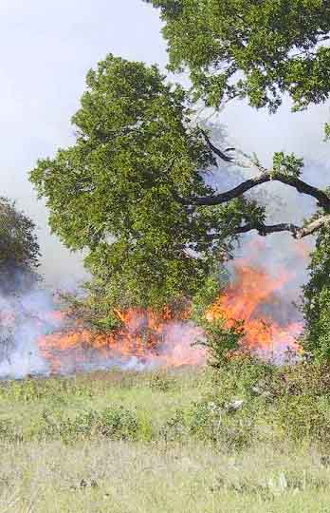
Research: King Ranch bluestem
Two Sites
Blackland Prairie
Edwards Plateau
Seven Treatments
C = control
Ms = mow single
Mr = mow repeat
Hs = herbicide single
Hr = herbicide repeat
Fe = fire early summer
Fl = fire late summer
Notes:
The response of King Ranch bluestem (Bothriochloa ischaemum var. songarica) to mowing, burning, & herbicide, in Central Texas.
Perennial, warm, introduced, fair grazing for wildlife and livestock. 18-48" tall bunchgrass with stems arising from almost a flat crown. The light green stems turn up and branch freely and turn a straw color when mature. The leaves are thicker near the collar and the upper surface is covered wtih silky hairs. The stems are naked at the top and each produces a terminal loose seed head. Both the sterile and fertile spikelets are conspicuous with slender, twisted, bent awns, and the branches have fine silky hairs.

Slide 33
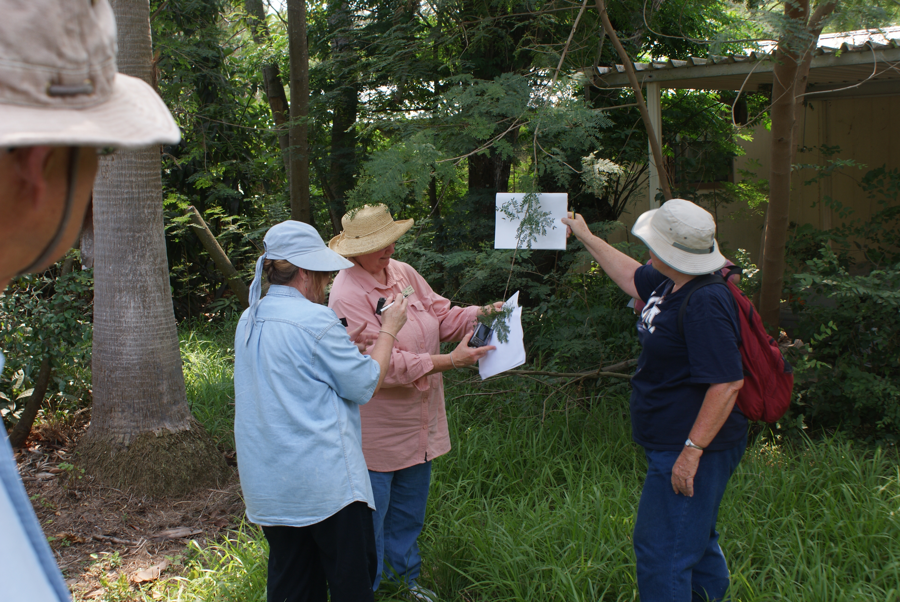
Invaders of Texas
The Invaders of Texas Program is an innovative campaign whereby volunteer "citizen scientists" are trained to detect and report invasive species in their communities.
Since 2006
Workshops: 47
Satellites: 38
Citizen Scientists: 948
Observations: >11,000
Species Targeted: 141
Notes:
INVADERS: Citizen Scientists Combat Invasive Species
At the national level, the Wildflower Center has joined with The Arizona Sonora Desert Museum to lead a consortium of museums participating in a national scientific education program entitled INVADERS: Citizen Scientists Combat Invasive Species. The INVADERS program involves recruiting, training, and providing materials to volunteers who detect and report invasive species in their communities. These volunteers find, track, describe, photograph, and collect samples of invasive species and report occurrences to their affiliated institution. The early detection data is then delivered to the U.S.G.S. National Institute of Invasive Species Science website for data hosting, analysis and mapping. The anticipated outcomes of this ground breaking program include a national network of volunteers contributing scientific data, increased public awareness of the dangers imposed by invasive species and what steps citizens can take when they encounter them; and reduced spread of invasive species through more timely control and eradication responses from regulatory agencies.

Slide 34
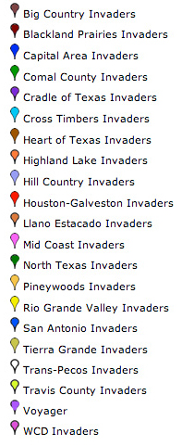
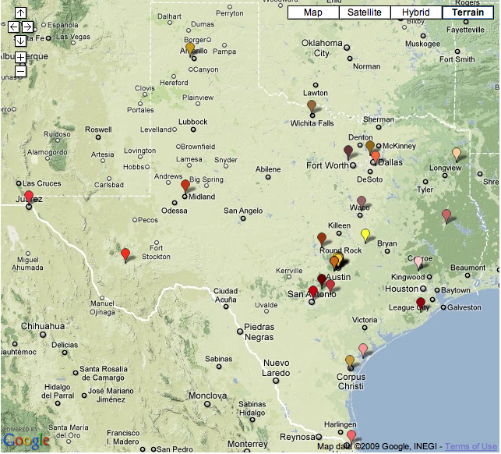
Satellites
Notes:
34

Slide 35
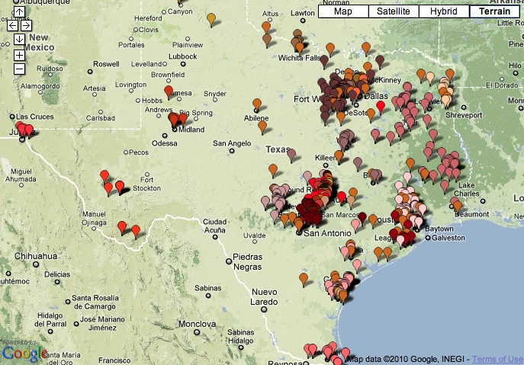
Citizen Scientists
Notes:
35

Slide 36

Google Maps
Interactive and searchable by Species or Satellite and linked to individual records.
Notes:
ARC IMS
ArcView Internet Map Server enables users to view county level distribution maps.
Open IMS System
Citizen Science data to appear in real time after validation.

Slide 37

Google Maps
Interactive and searchable by Species or Satellite and linked to individual records.
Notes:
ARC IMS
ArcView Internet Map Server enables users to view county level distribution maps.
Open IMS System
Citizen Science data to appear in real time after validation.

Slide 38

Google Maps
Interactive and searchable by Species or Satellite and linked to individual records.
Notes:
ARC IMS
ArcView Internet Map Server enables users to view county level distribution maps.
Open IMS System
Citizen Science data to appear in real time after validation.

Slide 39

Google Maps
Interactive and searchable by Species or Satellite and linked to individual records.
Notes:
ARC IMS
ArcView Internet Map Server enables users to view county level distribution maps.
Open IMS System
Citizen Science data to appear in real time after validation.

Slide 40

Species Observations
Tracks species observations submitted by volunteers.
Provides the public with full access to citizen science data.
Links to species observation detail page plant detail page and validation information.
Procedure based on Nature Conservancy Weed Information Management System.
Notes:
ARC IMS
ArcView Internet Map Server enables users to view county level distribution maps.
Open IMS System
Citizen Science data to appear in real time after validation.

Slide 41




Slide 42

Invaders Data
Export species observations from web database.
Import to ArcGIS 9.3
Create county maps
Compare with USDA/Turner

Slide 43

Results: Arundo donax
Invaders – 66
USDA/Turner – 39 (46%)
Unique Invaders- 46 (54%)
117% increase

Slide 44

Results: Melia azedarach
Invaders – 58
USDA/Turner – 78 (77%)
Unique Invaders- 23 (23% )
29% increase

Slide 45

Results: Lonicera japonica
Invaders – 36
USDA/Turner – 44 (68%)
Unique Invaders- 21 (32%)
47% increase

Slide 46

Results: Triadica sebifera
Invaders – 44
USDA/Turner – 40 (60%)
Unique Invaders- 26 (40%)
65% increase

Slide 47



Slide 48

Going Above and Beyond the Call
Notes:
48

Slide 49

















Notes:
Texas Forest Service - Assure that the state's forest, tree, and related natural resources are wisely used, nurtured, protected, and perpetuated for the benefit of all.
Forest Health Protection - Forest Service specialists provide technical assistance on forest health-related matters.
National Biological Information Infrastructure - NBII links biological databases to answer questions related to the management, use, or conservation of the Nation’s biological resources.
Houston Advanced Research Center - Dedicated to improving human and ecosystem well-being through the application of sustainability science and principles of sustainable development.
Lady Bird Johnson Wildflower Center - Protects and conserves North America's native flora by educating people about the environmental necessity, economic value, and natural beauty of native plants.

Slide 50

Closer

