Slide 1

Help in the Fight Against Invasive Species
A Workshop of the Invaders of Texas Program
June 25, 2016
Sheldon Lake State Park
Hans Landel, Ph.D.
Invasive Species Coordinator
Lady Bird Johnson Wildflower Center
Notes:
Greetings, everyone. Thank you for taking some of your precious time to be here today. It’s always heartening to see people attend the workshop.

Slide 2

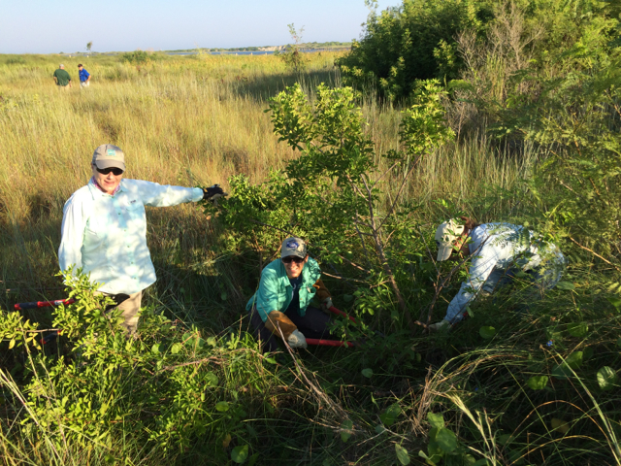
TODAY
General Concepts and Background
What Is an Invasive Species?
Why Do We Battle Invasive Species?
How Can We Battle Invasive Species?
The Invaders of Texas Program
The Sentinel Pest Network
Local Invasive Plant Identification
Training on the Invaders of Texas Citizen Scientist Program
Notes:
Let’s look at the topics I will cover today. We will start by defining what exactly an invasive species is, we will then discuss the damages of invasive species and review how we battle invasive species. We will then proceed to the training components of this workshop. These include the Invaders of Texas citizen science program, the main component of the training; the Sentinel Pest Network, in which we will train you to identify and report certain species of particular interest; spending some time learning to identify particular invasive plants for this area; and finally training to use submit observations of invasive pllants.

Slide 3
Introduction to the Invaders of Texas Program
Objectives of the Program
After the training, participants will be citizen scientists able to:
Define what invasive species are
Discuss the various ways invasive species are harmful
Discuss how invasive species spread, and how to prevent their spread
Describe how the threat of invasives is addressed at different levels
Identify several local invasive species, using appropriate plant anatomy terms
Report the locations of invasive plants using either the smartphone app or a data sheet, camera, GPS unit, and the web
Navigate the Texasinvasives.org website
Describe the Sentinel Pest Network and use it to report invasive species of special concern
Discuss the basics of management of invasive species, and state regulations
Use the Eradicator Calculator to report eradication efforts
Notes:
As an introduction to the our program, I’ve listed our objectives for today’s training. [go over each objective]

Slide 4
What Is an Invasive Species?
How would YOU define “invasive species”?
or
What are characteristics of an “invasive species”?
Notes:
First, as background, let’s define an invasive species. How would you define “invasive species”? What makes a species “invasive”? [ask for input; discuss]

Slide 5
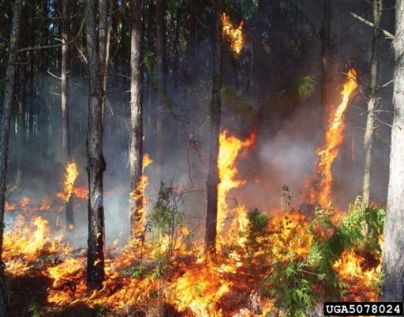
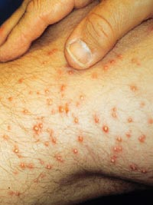
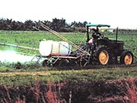
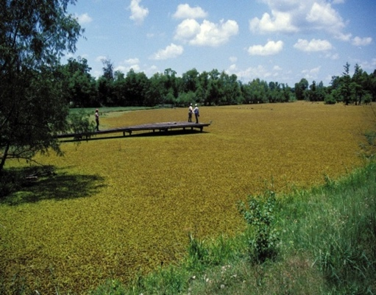
Invasive Species: Background
The Federal Definition
a species that is non-native (or alien) to the ecosystem under consideration and whose introduction causes or is likely to cause economic or environmental harm or harm to human health. (Executive Order 13112, 1999)
Notes:
In 1999, President Clinton issued executive order 13112, which defined an invasive species as a non-native species, whose introduction causes economic or environmental damages and may also harm human health. Many of these species fit into more than one category. For example, invasive aquatic plants may have economic impacts to fisheries but also will have social impacts by making rivers and lakes unusable for boating and swimming.

Slide 6
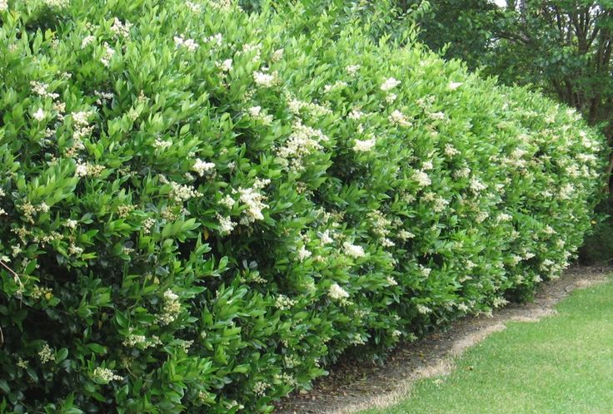
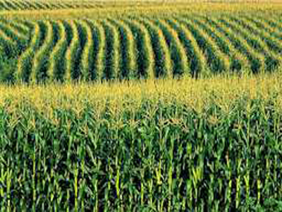
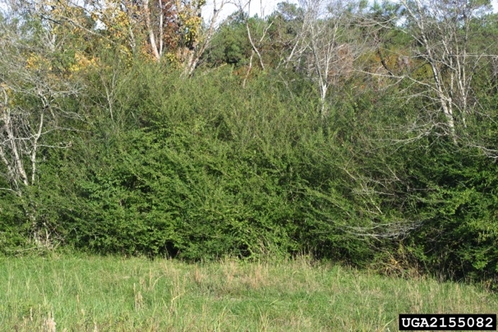
Invasive Species: Background Are All Non-native Species Invasive?
Not All Exotics Are Invasive
98% U.S. agricultural crops are non-native
Remember: Must Cause Harm
How Exotics Become Invasive
Become naturalized
Spread (more on this later)
“How” Example: Ornamental Plants
2
1
3
1: http://static6.businessinsider.com/image/4d6fea5fcadcbb2f40260000/wheat-and-corn-prices-are-surging-after-one-of-the-most-critical-crop-reports-of-the-year.jpg
2: http://www.hatchettcreek.com/wp-content/uploads/2015/07/Ligustrum-Japonica.jpg
3: http://freedomlouisiana.org/wp-content/uploads/privet.jpg
Notes:
So are all non-native species invasive?
To be clear, not all exotic species are invasive. For example, 98% of our crops or non-native. Exotic, or non-native species are considered invasive only when they cause harm. Predicting which plants will become invasive is difficult; scientists are still trying to discover why a plant can become invasive after years of causing little to no issues. Some exotic species will become well established across the landscape away from their origin, but cause no significant damages. However, some exist that are present for many years before they become highly invasive; this is called the lag time of an invasive species where a population becomes escaped and slowly builds numbers before rapidly expanding across the landscape.
Example: Privet (Ligustrum) planted in garden, and invading natural habitat

Slide 7
Invasive Species: Damages Economic
50,000 non-native species in the U.S. costs over $138 billion annually:
Examples:
Agricultural Losses: 65% of crop losses ($21 billion) attributed to non-native plant pathogens¹
Urban Pest Management: Pigeons cost over $1 billon/year in control and damages¹
Aquatic Nuisances: Zebra mussels cause $100 million/year in damages to pipes and filtration systems¹; US Great Lakes—exotic species introduced by ships cost $138 million/year in damages to 4 ecosystem services⁴
Insect Damage and Control: Fire ants cause $500 million/year in livestock, wildlife, and public health damages and control efforts in TEXAS alone²
Feral Animals: cats kill approximately 465 million birds/year and cost an estimated $14 billion/year¹
Invasive Animals: Control of Burmese python in Florida costs USFWS $720,000 annually³
¹National Invasive Species Information Center, 2006 ²Pimentel et al., 2000 ³USFWS, 2012 ⁴Rothlisberger et al., 2012
Notes:
Invasive species inflict high economic damages. It is estimated that 50,000 non-native species cost 138 billion dollars a year annually in damages and losses. Non-native plants invade about 1.7 million acres a year annually. Examples include yellow starthistle invading over 10 million acres in California of once productive grazing land. Pigeons are considered to be the most serious bird pest, costing over 1 billion dollars a year for control and in damages to property. The introduced mollusk, the zebra mussel, reduces food and oxygen for native aquatic plants and animals, costing 100 million a year in damages to pipes and filtration systems.
Asian carp barrier: $30 mil to build, $18 mil/yr to maintain
Texas legislature has allocated $9.6 million to address the problem of aquatic invasive species, illustrating how important this is.
UK: £1.7 billion ($2,6 billion) [The Economic Cost of Invasive Non-Native Species on Great Britain by F. Williams, R. Eschen, A. Harris, D. Djeddour, C. Pratt, R.S. Shaw, S. Varia, J. Lamontagne-Godwin, S.E. Thomas, S.T. Murphy
November 2010]

Slide 8
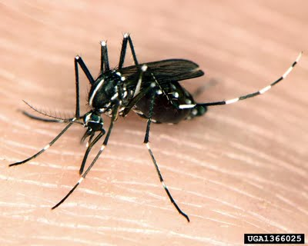
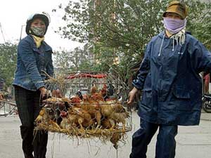
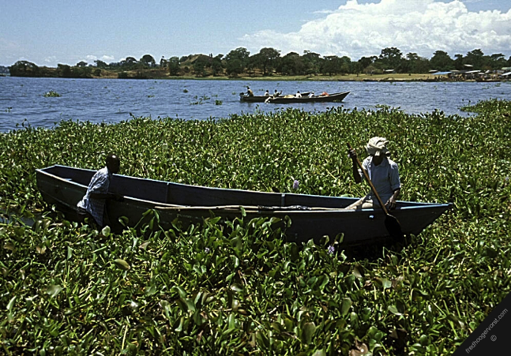
Invasive Species: Damages Human Health & Social/Recreational
Human Health
Allergies
Pollens
Insect bites/stings
Injury/disease
Insect bites/stings
Skin rashes/burns
SARS
“Bird flu”
Pesticide and herbicide application
Social/Recreational
Sport fishing & boating
Aesthetics & Outdoor activities
International travel
1
2
¹alic.arid.arizona.edu/invasive/sub9/p2.shtml ²www.fredhoogervorst.com/photo/08485/
Notes:
There is also human health, social and recreational impacts from invasive species. Diseases like SARS and west Nile virus move globally sickening humans. Some plants species are toxic or can cause burns and blindness. Many species also sting or bite. An example is giant hogweed, whose sap causes horrible burns to skin when exposed to sunlight. Social and recreational impacts also decrease recreational access and travel.

Slide 9
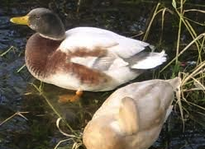
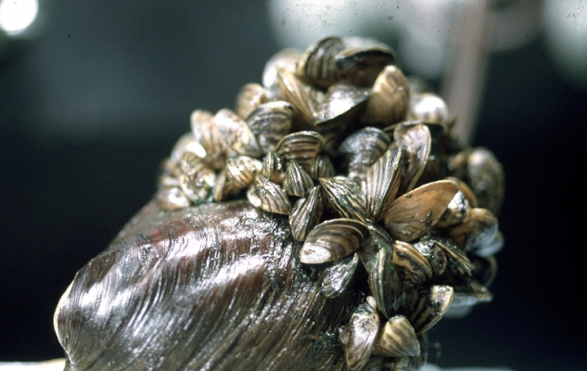
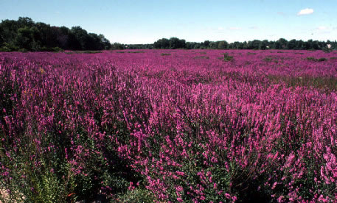
Invasive Species: Damages Environmental
Genetic & Individual Impacts:
Hybridize with native species
Changes in morphology
Changes in behavior
Population Impacts:
Competition
Predation
Nutritional
Physical
Diseases
1
2
3
¹messybeast.com/genetics/hybrid -birds.htm ²forestryimaages.org ³gettinginthegroove.com
Notes:
The environmental damages of invasive species are vast. Many species can hybridize with native species like this hybrid mallard or hybridizing Typha cattails. These genetic impacts change the morphology and behavior of the native species, which often cannot be reverted. There are also population impacts, where native species are pushed out of their habitats by more aggressive invasive species. There can also be predation, as illustrated by feral cats killing native bird species or physical impacts such as non-native mollusks attaching to native species. The lower right photo shows purple loosestrife that has crowded out the native wetlands plants.

Slide 10
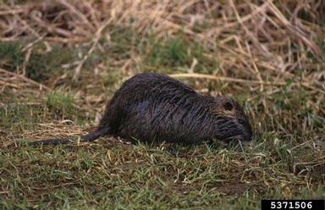
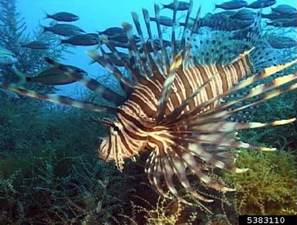
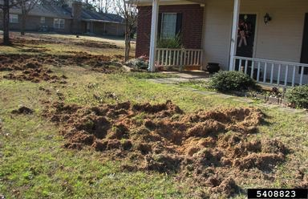
Invasive Species: Damages Environmental
Community Impacts:
Species composition
Lower biodiversity
Species interactions
Extinction
Bugwood.com
Notes:
Community damages include changes in species composition within the environment, as plant and animal distributions change with the arrival of the invasive species. Ultimately, many native species cannot compete. Finally, invasive species have caused species extinction, by altering and changing the habitats where rare and endemic species are located, or through direct predation.
Photo: Nutria, lionfish, damage by feral hogs (they do the same to wildland habitat)

Slide 11

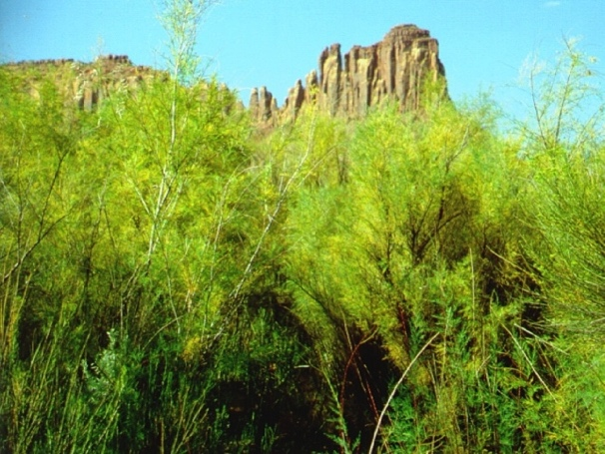
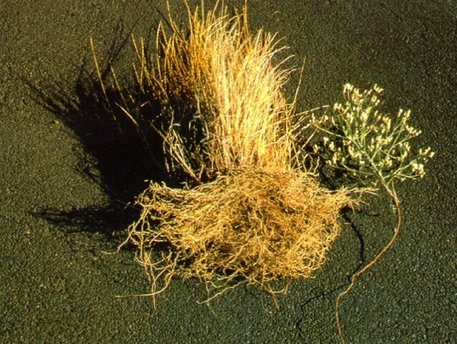
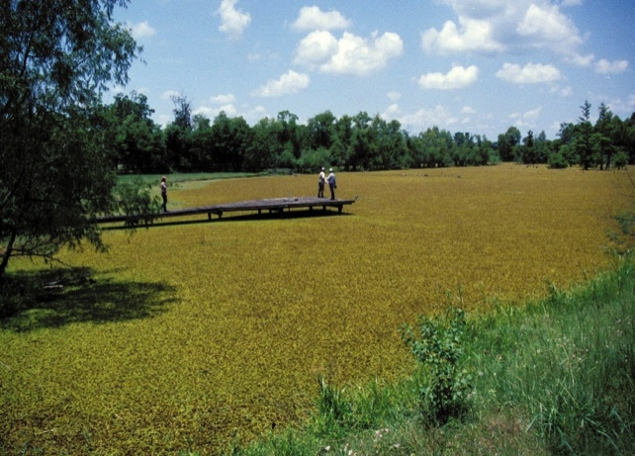
Invasive Species: Damages Environmental
Impacts on Ecosystem Function:
Fire regimes
Soil health
Hydrology
Erosion
Aquatic nutrients
Notes:
Ecosystem function can also be altered by the invasive species. Fires may burn more frequently or with higher intensity due to increased biomass. Hydrology may be altered as woody species invade riparian areas and riverbanks (top right photo is of tamarisk). Erosion may increase, as the native understory is shaded out by taller species that die back during high flow seasons (bottom left photo compares native grass roots to invasive herb roots – clearly the native grass would hold soil better). Aquatic nutrients may increase or decrease and cease to support the natural food web (lower right photo shows giant salvinia having spread across the whole pond, which impacts nutrient cycling, among other impacts).

Slide 12
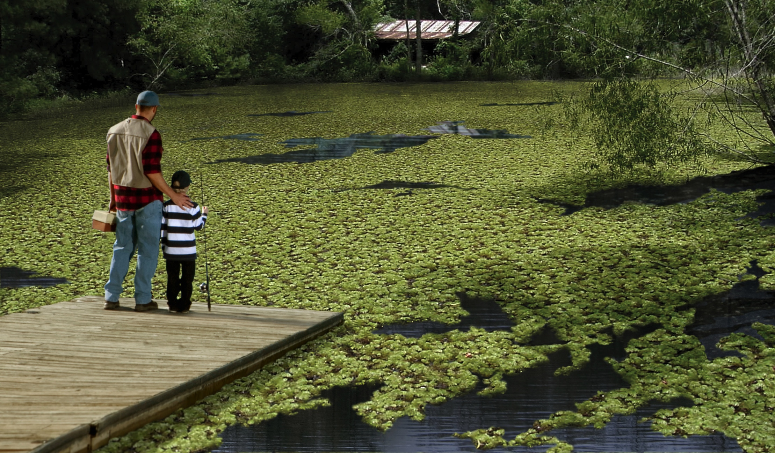
Monthly iWire Invasive Species Email Newsletter.
Hello Zebra Mussels.
Goodbye Texas Boating.
Hello Bastard Cabbage. Goodbye Bluebonnets.
Hello Giant Salvinia. Goodbye Texas Lakes.
Notes:
This picture illustrates the problem: lost recreation, ecological damage. All in one photo. Nice summary slide.

Slide 13
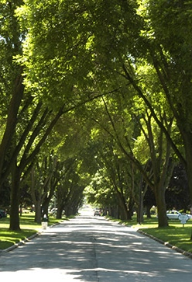
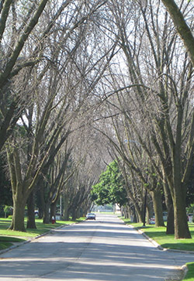
Emerald Ash Borer Damage
(Ohio)
June 2006
Credit: D. Herms
August 2009
Credit: D. Herms
http://www.americanforests.org/magazine/article/will-we-kiss-our-ash-goodbye/
Notes:
Illustration of damage that an invasive can do. EAN has killed millions of trees. Clearly shows cost to cities and homeowners

Slide 14
How Invasive Species Spread
Invasive Species:
Cause Harm
Spread
Increase population
Notes:
So we’ve already learned that an invasive species is one that causes harm, but it also spreads and increases in population size.

Slide 15
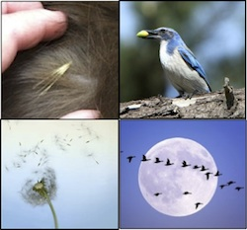
How Invasive Species Spread
Natural Dispersal
Production of offspring
Wind- or water-borne seeds or larvae
Animal-borne seeds or larvae
Movement of adults
Swim, fly, walk/run, etc.
But…. can’t always explain expansion
2
1
¹National Health Museum, 2009 ²Alan Vernon, Fliker
Notes:
How do invasives spread? All organisms, reproduce, and the seeds or young can move naturally. The natural elements such as wind, water and earth movement are sometimes responsible for spreading invasives. You can imagine seeds floating long distances in a flood event. Birds and other wildlife also move invasive species. Animals, of course, can just get up and go, to spread to new areas.
But natural dispersal doesn't always explain the expansion of an invasive organism’s range. For example….

Slide 16
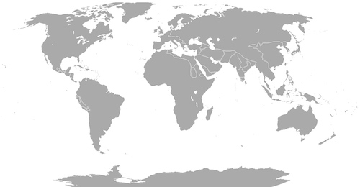
How Invasive Species Spread
Example:
How did the Zebra Mussel get from the Caspian and Black Seas…
… to North
America?
Notes:
How did the zebra mussel get from the Caspian and Black Seas…
… to North America?

Slide 17
How Invasive Species Spread
Example:
How did the Emerald Ash Borer get to Boulder CO?
Hundreds of miles
Mated females: estimated average of only 3 km per day (live about 3 weeks)*
Intervening inhospitable habitat
*(Taylor et al. 2006, in USDA–APHIS 2015)
Notes:
Or, how did the Emerald Ash Borer get to Boulder Colorado, considering….

Slide 18

How Invasive Species Spread
Natural Dispersal
Production of offspring
Wind- or water-borne seeds or larvae
Animal-borne seeds or larvae
Movement of adults
Swim, fly, walk/run
Can’t always explain expansion
With Human Assistance
Notes:
So how did the emerald ash borer and the zebra mussel travel such large distances? WITH OUR HELP

Slide 19
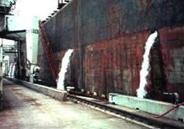
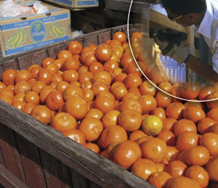
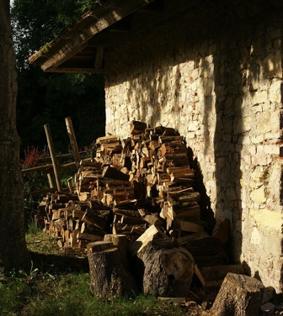
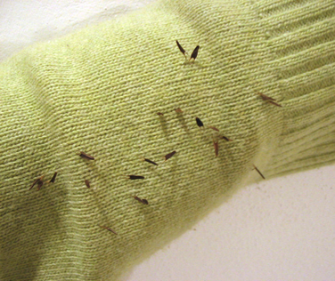
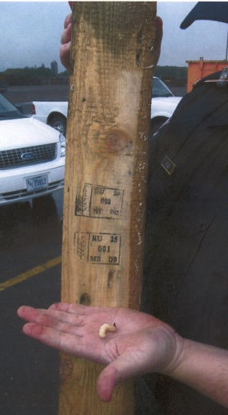
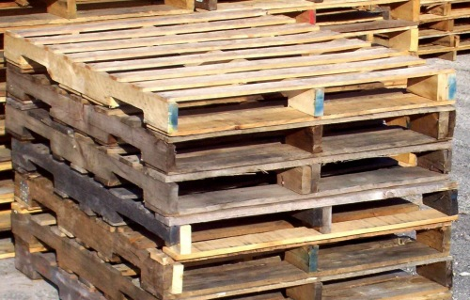
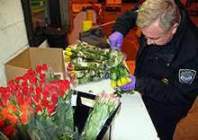
How Invasive Species Spread
With Human Assistance
Accidental
Produce
Nursery stocks
Ship ballasts
Packing materials & shipping containers
Recreational travelers
Hay
Flowers
Mowing practices
Vehicles
Firewood
Boots and gear
3
¹XXXXXXXXXXXX ²XXXXXXX ³Aelwyn Fliker 2007
Notes:
Human-assisted introductions can be accidental. Species have been introduced in packing material, as crop contaminants or in the ballast of ships, or other means as in this list.

Slide 20
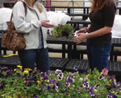
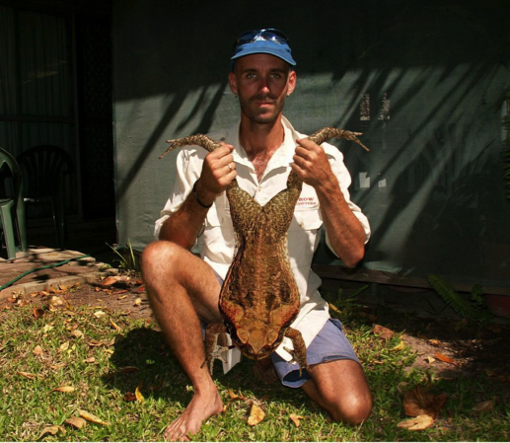
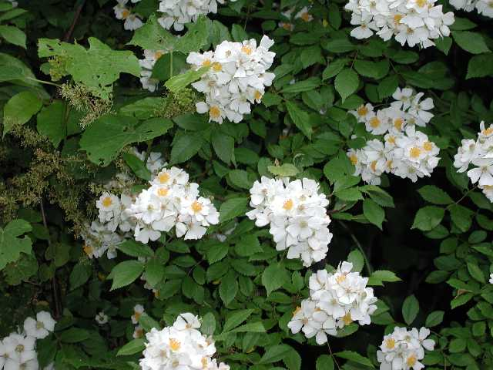
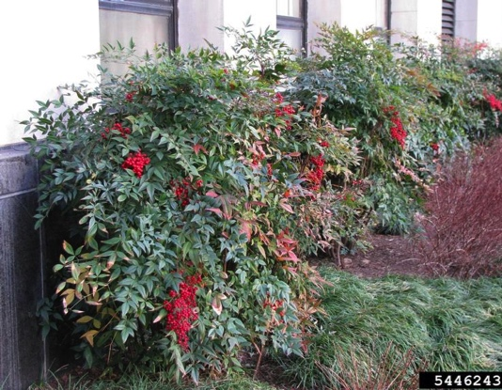
How Invasive Species Spread
With Human Assistance
Purposeful
Ornamental planting
Erosion control
Wildlife value
Agriculture/Sport
Pets/Aquariums
Biological Controls
1
2
3
4
¹Aelwyn Fliker 2007 ²http://io9.com/5833022/10-of-the-worlds-worst-invasive-species
³http://www.eddmaps.org/ipane/ipanespecies/shrubs/Rosa_multiflora.htm ⁴Leslie J. Mehrhoff, University of Connecticut, Bugwood.org
Notes:
But, many have also been introduced deliberately; some species have been brought in to control other invasive species such as Asian carp, or introduced as sport fish, as ornamental plants or released pets. Globalization and trade have allowed organisms to move from one continent to another in a matter of hours. This has always occurred, but transportation advances have sped this process up exponentially. These initial populations then have escaped into the natural environment.
Pictures: nursery plantings; cane toad likely released by pet owners; multiflora rose, which was planted for erosion control and wildlife value (from Japan); Nandina (Heavenly bamboo)(east Asia)

Slide 21
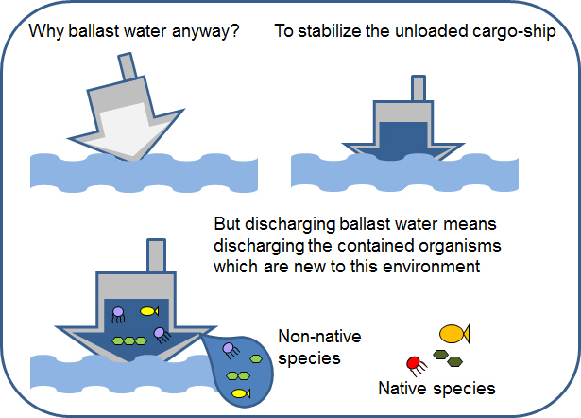
How Invasive Species Spread
Example: Zebra Mussel Spread
Notes:
Let’s return to the example of a zebra mussels to explore how we can move species around the globe. In the case of zebra mussels, they were transported in ballast water carried in ships.
Explain what ballast water is, and how ballast water carries invasive species, and that this is how zebra mussel got all the way to NA

Slide 22
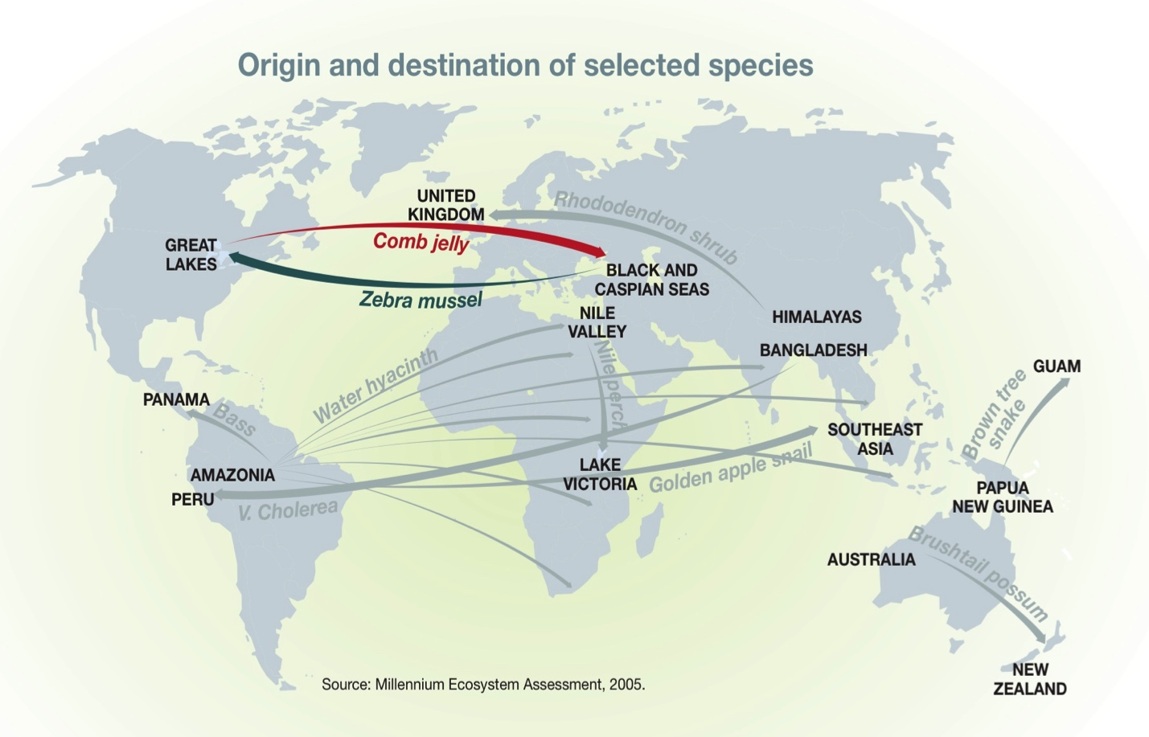
How Invasive Species Spread
Zebra Mussel Spread
UNEP/GRID-Arendal: http://www.grida.no/graphicslib/detail/origin-and-destination-of-selected-species_976c
Notes:
Transport is two-way: we got zebra mussels, they got a comb jelly. )Map also shows the transport of other species, illustrating this is a global problem. Will see this in another slide.)

Slide 23
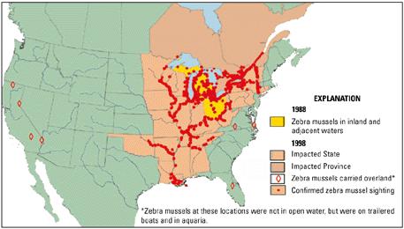
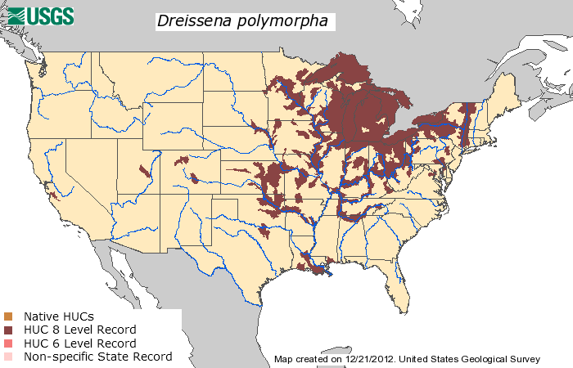
How Invasive Species Spread
Zebra Mussel Distribution
2012
1988, 1998
Notes:
These maps show that once the mussel made it to NA, it spread, again partly by hitch-hiking on boats and such.

Slide 24
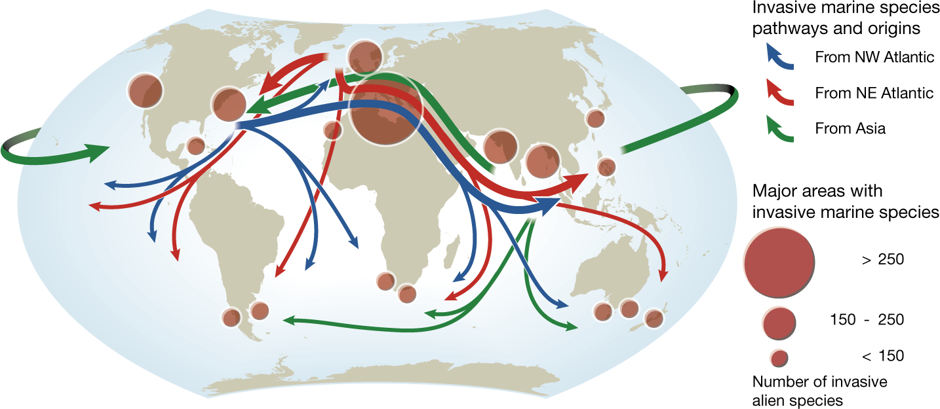
How Invasive Species Spread
Zebra Mussel – just one of many throughout the world!
UNEP/GRID-Arendal: http://maps.grida.no/go/graphic/major-pathways-and-origins-of-invasive-species-infestations-in-the-marine-environment
Notes:
This map shows the global extent of the problem.

Slide 25
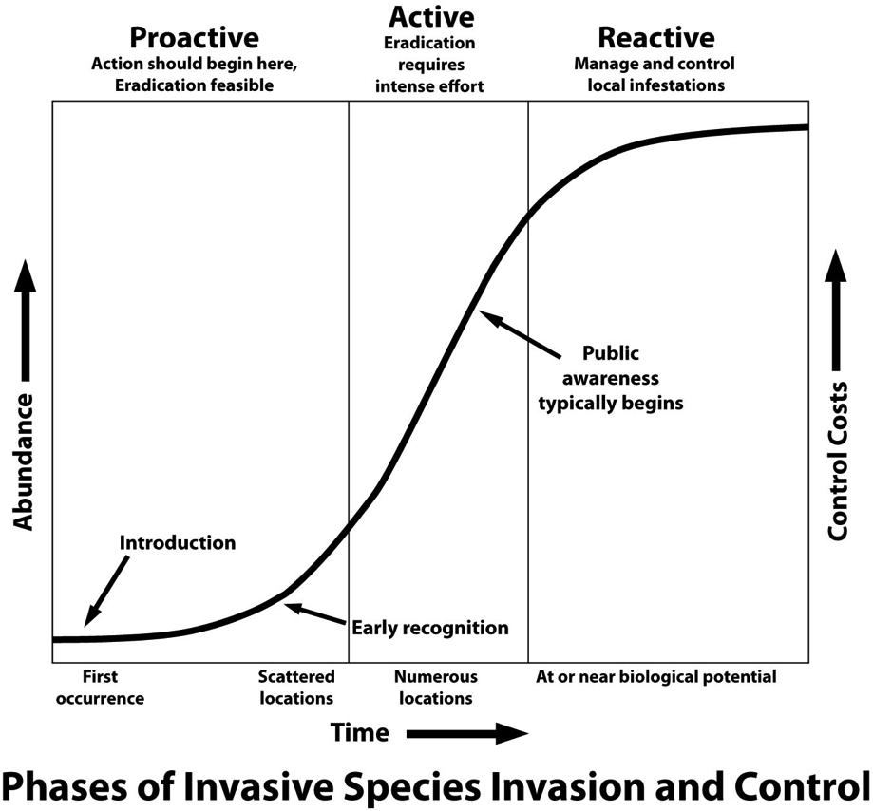
Invasive Species: Spread
When do we notice?
Lag time
Too late?
Notes:
This graph illustrates one of the problems with invasive species. Lag time: It can take a while for a population to grow large enough for us to notice. By then, is it too late? Notice that the cost of control goes up as it becomes more difficult to control the invasive. We’d like to find the invasive early, so that it can be controlled before it gets to difficult and expensive to manage it.

Slide 26
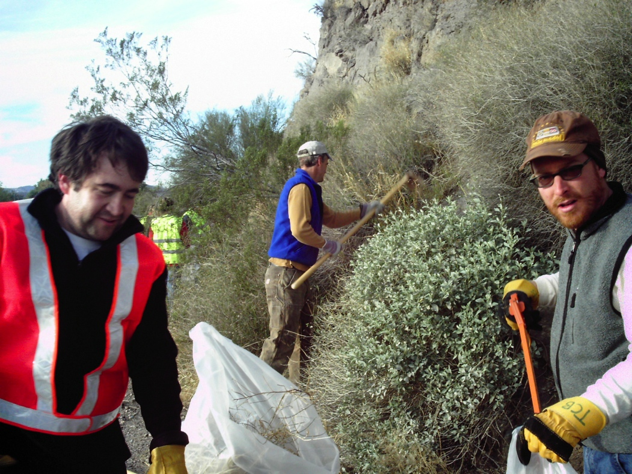
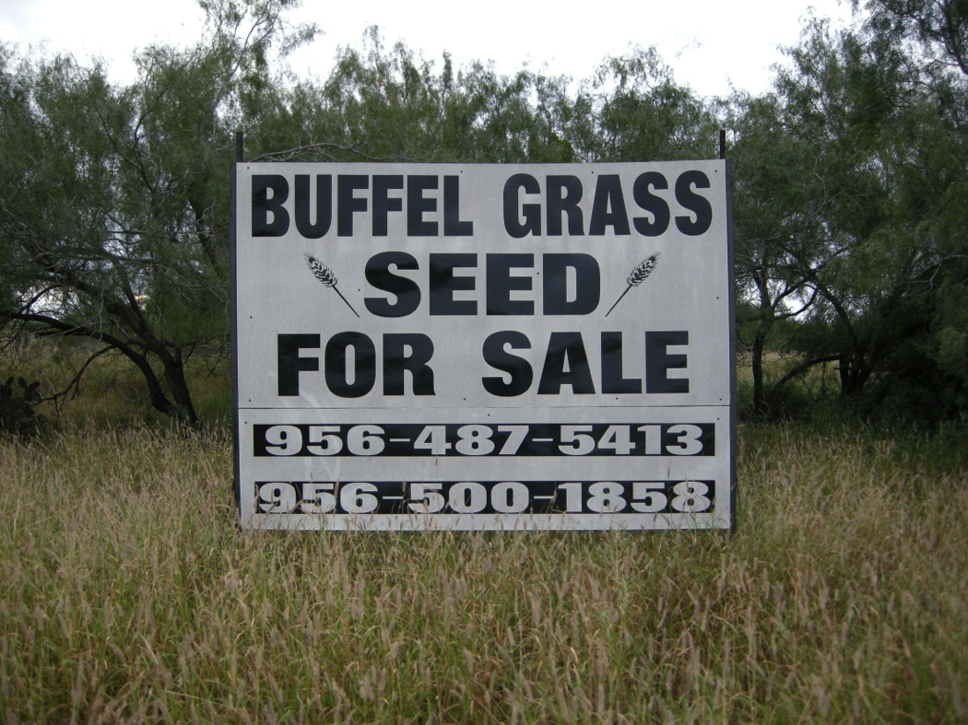

Invasive Species: Contradictions
Notes:
One ecosystems trash is another’s treasure. The invasive species world can be full of contradictions. We often see species spread and sold by industries, when at the same time biologists and conservationists are fighting to remove the species due to environmental damages, as seen here. Other examples include ornamentals such as Heavenly bamboo (Nandina) and the privets (Ligustrum)

Slide 27
Battling Invasives

Slide 28

How We Can Battle Invasives
Responses to Invasive Species
Organizations
Action
Outreach
Notes:
So, now we know the damage and harm that invasive species can cause. What is being done to address this? Let’s see, by looking at these categories.

Slide 29






Invasive Species: Response Committees and Agencies
Administrative Committees: Examples
National Invasive Species Council
Federal Interagency Weed Committee
Texas Invasive Plant and Pest Council
Texas Invasive Species Coordinating Committee
Agencies:
Department of Agriculture (USDA)
Animal and Plant Health inspection Service (APHIS)
Natural Resources Conservation Service (NRCS)
Forest Service (FS)
Department of Commerce
Department of Interior
Texas Parks and Wildlife Department (TPWD)
Many more…..
Austin:
City of Austin Invasive Species Management Plan
Notes:
In 1999, President Clinton issued executive order 13112, which created the National Invasive Species Council. Federal agencies participate in the council in order to better respond to invasive species threats on a national level.
Briefly go over list
FICMNEW = Federal Interagency Committee for the Management of Noxious and Exotic Weeds

Slide 30

Texas Invasive Plant & Pest Council (TIPPC)
The Council is comprised of stakeholders from government agencies, conservation organizations, academia, green industry and the public to form one unified body in addressing the threat of invasive species.
TIPPC seeks to:
promote understanding and awareness
to provide a forum for the exchange of information
support research and restoration activities that reduce impacts of invasive plants and pests in Texas.
Notes:
The Texas Invasive Plant and Pest Council (TIPPC), brings together stakeholders from all sectors of Texas to serve as an advisory council regarding funding, research, awareness, policy and management of invasive species. TIPPC originated as a motion from the floor at the second statewide invasive species conference held at the Wildflower Center in 2007.

Slide 31
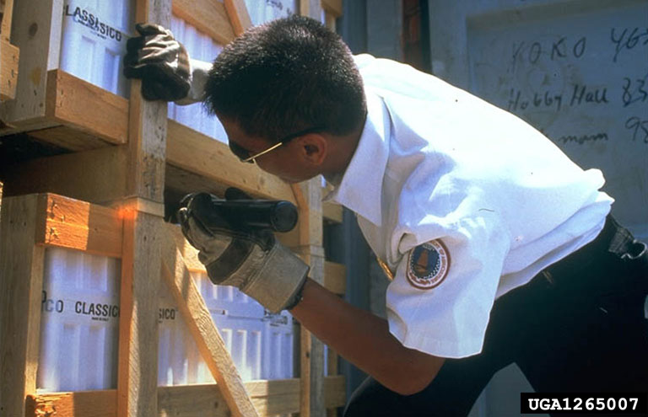
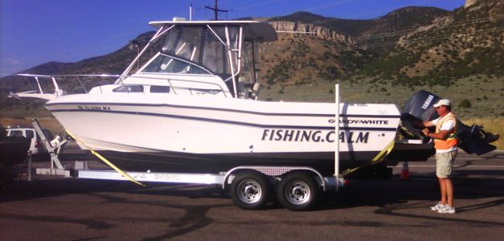
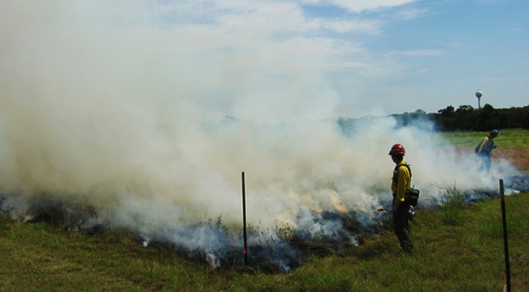
Invasive Species: Response Action
Regulation
Import and export restrictions (USDA-APHIS)
Inspections and surveillance
Example: Texas Department of
Agriculture Noxious Plants List
Research
Species biology/ecology
Ecological impacts
Detection/monitoring
Control/management methods
Biological controls
Restoration
Control and Management
Monitoring
Restoration
Notes:
The best method for combatting the effects of invasive species is to prevent their initial introduction.
Regulation, including import restrictions, inspections and prohibited lists work to stop movement and introduction of invasive species. The USDA APHIS is primarily tasked with preventing introductions to the nation, in which it prevents entry and establishment through intrastate and international trade.
Many universities, such as the University of Texas are performing invasive species research to better understand the biology, impacts and control measures for invasive species that have been established.
Once the invasives have been located and identified, control and management programs are implemented.
Sites need to be monitored, to ensure the invasives don’t return.
In many cases, the removal of the invasives leaves a disturbed site that could be reinvaded bo other invasives. Clearly, restoration must be done to prevent this.

Slide 32
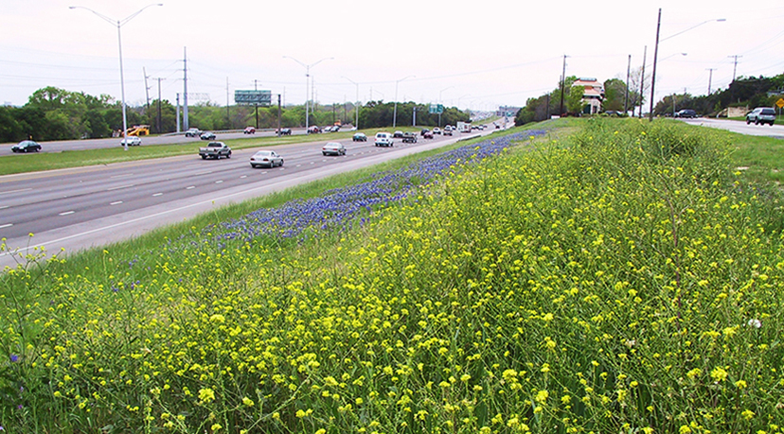
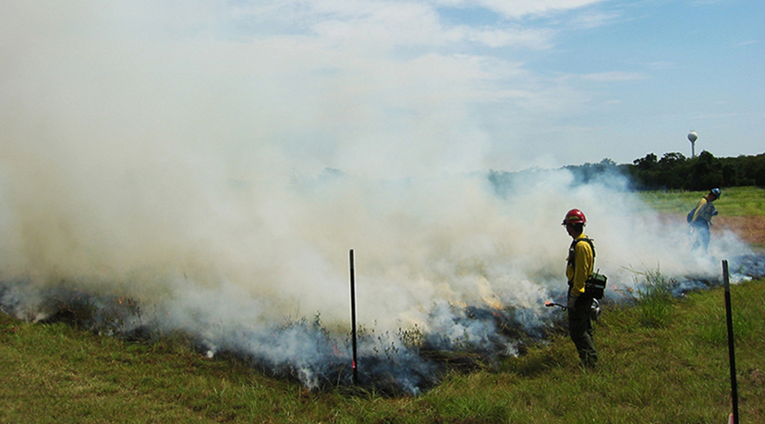
Invasive Plant Control and Restoration Research
Research involves:
invasive plant biology and ecology
detection and monitoring
management of invasive species
restoration of the landscape
Studies have determined:
seasonal fires can eliminate some invasive plants species while leaving native plants, flora and foliage intact.
some invasive species can be removed by sowing native seed mixes.
Notes:
The Wildflower Center staff, along with its partners, work to better understand and manage invasive species and to restore the landscape after invasive species removal. This research has produced information that has been applied on many projects statewide to manage invasive species and restore the landscape.

Slide 33
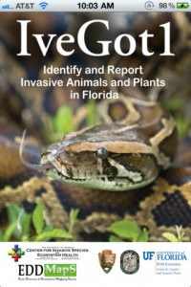




Invasive Species: Response Outreach
Early detection trainings
Native Plant Diagnostic Network
First Detector
Vermont Invasives
EDRR Local (Washington State)
Invaders of Texas
Educational programming
National Invasive Species Awareness Week
100th Meridian Initiative
Don’t Move Firewood
Center for Invasive Species Management
Webinars
Notes:
There has also been a national coordinated response by providing education and outreach to raise awareness of these issues. Many states now host early detector trainings, and offer educational programs to inform the general public.

Slide 34


Public Awareness Campaigns
Hello Zebra Mussels.
Goodbye Texas Boating.
Hello Bastard Cabbage. Goodbye Bluebonnets.
Hello Giant Salvinia. Goodbye Texas Lakes.
Don’t Move Firewood
Notes:
Public awareness of invasive species and the damage they can cause is key to successful action. We have held several public awareness campaigns to educate the public about key issues. Currently, we are working with TPWD to raise awareness of zebra mussels. We are educating boaters on how to properly clean, drain and dry their boat and equipment to prevent spreading this invasive mussel.

Slide 35


Public Awareness Campaigns
The iWire monthly email newsletter
Important updates
Invasive species spotlights
News from TX and beyond
Citizen Scientist of the Month (person, group or project)
Workshop Schedules
Notes:
We also publish a monthly email newsletter, the iWire, which contains species alerts, information on upcoming events and news features. You can sign up for it; I’ll tell you how later in the workshop.

Slide 36
Take Action!
Management
&
The Eradicator Calculator
Notes:
In this next section we will briefly discuss managing invasive species (plants).

Slide 37
Managing an Invasive Species
Assess
Treat
Plant/Restore
Monitor/Re-treat/ Maintain
Notes:
This slide presents the timeline you would likely follow.
Assess property for presence and types of invasives
Treat invasives as appropriate
Plant/restore area that had the invasives
Monitor/retreat/maintain as necessary FOR AS LONG AS IT TAKES!

Slide 38
Types of Plants
Grasses Broadleaf
Annual Herbaceous
Perennial Annual
Perennial
Shrubs
Trees
Vines
Terrestrial Riparian Aquatic
Notes:
When assessing and deciding on treatments, you will need to consider:
Type of plant, and
Habitat of the invasives
This information will inform your treatment options and decisions. For example, some herbicides kill grasses and not braodleaf plants, and vica versa (which is why you can kill broad-leaf weedsin your lawn). Or, some herbicides can’t be used in or near aquatic habitat.

Slide 39
Best Management Practices
Choose appropriate management techniques
mechanical
biological
chemical
License required?
Read label instructions
Caution near aquatic habitats
Wear protective gear
Beware “drift”
IPM: Integrated Pest Management
Repeat!
Monitor (seed bank/resprout)
Treat early!
Prevent spread – Plant Natives!
Notes:
Explain BMP.
Emphasize
Follow instructions
Wear protective gear
Hire professional when appropriate
Monitoring is really important

Slide 40

Aquatic Example
Elephant Ears (Colocasia esculenta)
Control:
DO NOT cut!
Treat with herbicide approved for aquatic use
Licensed
Use protective gear
Avoid drift
Charles T. Bryson, USDA Agricultural Research Service, Bugwood.org
Notes:
Let’s look at 3 examples of controlling invasives to illustrate the BMP.
This is and example of an aquatic species, elephant ears (Colocasia esculenta). It’s a perennial native to Southeast Asia and India that infests the edges of bodies of water.(this is the Llano River). It grows from a large corum (or underground plant stem). It spreads by rhizome and above ground stolons, which can break off, flow downstream, and establish a new population. This means you should NOT dig it up or cut it up! Need to trea with an herbiced approved for aquativ use, and a licensed applicator would need to be hired. Note the person treating the elephant ears in the photo is wearing protective gear; gloves and a long sleeve shirt. (This is a TPWD employee)

Slide 41

Tree Example
Chinaberry tree (Melia azadarach)
Control:
Cut-stump and basal bark applications of herbicides.
Cut trees left untreated will grow back with several branches emanating from a single stump.
Removal of seedlings must include the entire root system.
James H. Miller, USDA Forest Service, Bugwood.org
Notes:
Our next example is a tree, Chinaberry. Applications of herbicide with to the stupm after cutting, or as a basal bark application, are recommended. The tree will sprout if simply cut. It could be pulled from the ground if small enough, but no roots should be left behind. This is a tenacious plant!

Slide 42


Grass Example
King Ranch Bluestem (Bothriochloa ischaemum var. songarica)
Control:
VERY DIFFICULT to control especially once established
Combination herbicides & discing/tilling
Repeated treatment necessary
Difficult to treat without impacting other plants
Early detection and treatment is ideal
Michelle Villafranca, Fort Worth Nature Center & Refuge, Bugwood.org
Karan A. Rawlins, University of Georgia, Bugwood.org
Notes:
Our lase example is a grass. Grasses are notoriously difficult to control, especially once established, because the grow among natives, making the application of herbicides without damaging natives really difficult. Repeated treatment is necessary because of the seed bank that typically has developed. Furthermore, you’d want to overseed with native plants to outcompete the recurring grass, and to prevent the invasion by other non-natives. Early detection and spot treatment is ideal.

Slide 43

Take Action! Eradicator Calculator
Objectives:
Publicize invasive species management events throughout Texas.
A unified statewide database to track volunteer-based management efforts.
Provide data to help quantify the economic costs and environmental benefit of invasive species management.
Notes:
We offer a feature of the Texas Invasives.org called the Eradicator Calculator as a way to advertise and track volunteer based control efforts. This feature has a calendar of community events and documents invasive species removal. If you plan to do an eradicatoin event, you could advertise it here, and you should definitely enter the information after the event.

Slide 44

Take Action! Eradicator Calculator
A tracking system for volunteer-based invasive species eradication efforts.
Offers an interactive calendar of events.
Tracks:
Date and Time
Volunteer Hours
Volunteer Cost (Match)
Staff Hours and Cost
Supplies and Equipment Cost
Notes:
The eradicator calculator also captures information on control efforts. Since 2009, over 500 evens have been logged across the state.

Slide 45
Texasinvasives.org
Let’s look at the
Eradicator Calculator
website
Notes:
Show how to enter data, how to see eradications (Click on link)

Slide 46
Take Action!
Stop the Spread of Invasives
Notes:
Next we’ll discuss how YOU can help prevent the spread of invasives.

Slide 47




How to Stop Species from Spreading?
Prevent Transport
WE aid the spread of invasives
WE can help prevent the spread of invasives
Clean, Drain, Dry
Don’t Move Firewood
Remove seeds from boots, clothes
Plant Natives
Notes:
WE help spread invasives, so we can change our behavior so as to prevent their spread.

Slide 48
How to Stop Species from Spreading?
Prevent Dispersal!
Two-pronged approach:
Early detection
Prevent transport by humans
Different for terrestrial vs. aquatic species

Slide 49

How to Stop Species from Spreading?
Detection
Trapping
Monitoring
Vigilance
Notes:
Detection is one way to prevent their spread. We monitor to try to detect them as soon as possible, so that steps can be take to prevent their spread into an area. This would be EDRR: “Early Detection and Rapid Response”. This is an insect trap, used for monitoring.
Need to remain vigilant!

Slide 50

How to Stop Species from Spreading?
Detection
Texas: Sentinel Pest Network
Notes:
In Texas, we have developed the Sentinel Pest Network as an EDRR system.
You will be trained on this system later today.

Slide 51
How to Stop Species from Spreading?
Prevent Transport
Humans = major mover of species
Prevention involves education
Terrestrial:
Don’t move firewood
Aquatic:
Clean, drain and dry watercraft
Notes:
We’ll talk about preventing the transport of invasives, and look at a terrestrial example and an aquatic example.

Slide 52

How to Stop Species from Spreading?
Prevent Transport – Terrestrial
http://www.ifish.net/gallery/data/500/Logsplitter_1a.JPG

Slide 53

How to Stop Species from Spreading?
Prevent Transport - Terrestrial
PROBLEM: Firewood can carry invasive pests
Emerald Ash Borer
Asian Longhorn Beetle
Redbay Ambrosia Beetle
Gypsy Moth
Soapberry borer
Brown Fir Longhorned Beetle
Sirex Woodwasp
Notes:
[Read slide]

Slide 54


How to Stop Species from Spreading?
Prevent Transport - Terrestrial
PROBLEM: Firewood can carry invasive pests
Depending on species:
Eggs, Larvae, Pupae, Adults
Some combination of these
Depending on life stage
Can survive weeks
Plenty of time to be moved to another area
Eric R. Day, Virginia Polytechnic Institute and State University, Bugwood.org.
Notes:
[Read slide]

Slide 55


How to Stop Species from Spreading?
Prevent Transport - Terrestrial
SOLUTION: Burn ONLY local or heat-treated firewood
Burn “Texas-born” wood
Texas Poster
Notes:
[Read slide]
Mention the DontMoveFirewood.org website

Slide 56

How to Stop Species from Spreading?
Notes:
Many campaigns across the nation – these are examples

Slide 57

How to Stop Species from Spreading?
Prevent Transport - Terrestrial
Texas Laws and Policies
Can’t move stumps from Red Fire Ant quarantine areas
Can’t move any ash product or living ash tree from Harrison County ( due to EAB)
Other States, Federal Laws and Policies
Depends on state and pest
Restrictions, quarantines
Fines
Notes:
[Read slide]

Slide 58
How to Stop Species from Spreading?
Prevent Transport – Aquatic

Slide 59





How to Stop Species from Spreading?
Prevent Transport - Aquatic
PROBLEM: Watercraft can transport invasives
Includes ANY watercraft, even paddlecraft
Also includes equipment
Invasives may
Attach to the craft
Be carried in water in or on the craft
Stick to the craft
Some combination of these
Carried in bait water, live-buckets
Notes:
[Read slide]

Slide 60
How to Stop Species from Spreading?
Prevent Transport - Aquatic
PROBLEM: Watercraft can transport invasives
Hydrilla
Water hyacinth
Zebra mussel
Crested floating heart
Yellow floating heart
Giant salvinia
Milfoils
Notes:
[Read slide]

Slide 61

How to Stop Species from Spreading?
Prevent Transport - Aquatic
SOLUTION: Clean, Drain, Dry
When removing watercraft from water
Clean all visible organisms off
High-pressure
Hot (140°F)
Drain all water from craft, and containers such as bait or fish buckets
Dry craft, equipment
Can use cleaning stations
Notes:
[Read slide]

Slide 62



How to Stop Species from Spreading?
Prevent Transport - Aquatic
SOLUTION: Clean, Drain, Dry
ADDITIONAL INFORMATION IS AVAILABLE ON THIS FROM OTHER AGENCIES ACROSS THE U.S.
Notes:
[Read slide]

Slide 63
How to Stop Species from Spreading?
Prevent Transport - Aquatic
Texas Laws and Policies
Cannot “possess or transport any [listed] exotic aquatic plant or animal”
Must “immediately remove and lawfully dispose of any harmful or potentially harmful aquatic plant that is clinging or attached to a vessel, watercraft, trailer, motor vehicle, or other device used to transport or launch a vessel or watercraft”
Must “drain all water from [watercraft]”
Follow rules for bait
$25 - $500 fine
Notes:
[Read slide]

Slide 64
Summary
Invasive species spread naturally and with human help
Preventing their spread requires our vigilance and modified behavior
Don’t move firewood: use local or treated wood
Clean, drain and dry watercraft and equipment
Be aware of laws and policies
Notes:
[Read slide]

Slide 65
10 minute break!

Slide 66
Invasives in Texas

Slide 67

Invasive Species in Texas Rauschuber C. 2002.
How Many Invasives are in Texas?
67 terrestrial plants
12 aquatic/wetland plants
10 mammals
4 birds
7 fishes
11 insects
11 mollusks and crustaceans
The Worst of the Worst:
Saltcedar (Ispp.)
Hydrilla (Hydrilla verticillata)
Giant Salvinia (Salvinia molesta)
Nutria (Myocaster coypus)
Red Imported Fire Ant (Solenopsis invicta)
Channeled Applesnail (Pomacea canaliculata
Notes:
So, let’s focus on Texas now. Exactly how many invasive species are in Texas? In 2002, Rauschuber presented a comprehensive inventory titled Invasive Species in Texas. (122 total)

Slide 68


Invasive Species in Texas Texas Parks and Wildlife Prohibited Aquatic & Exotic Species
Notes:
In response to the aquatic impacts of invasive species, the Texas Department of Parks and Wildlife Department created a list of prohibited and Exotic Species. Under Texas state law, no person may import, possess, sell or place these species into waters of the state without a permit issued by TPWD. The list includes 19 aquatic plant species, shown here. It also lists over 50 shellfish, fish and other animal species.

Slide 69

Invasive Species in Texas Texas Department of Agriculture Plant List
Notes:
The Texas Department of Agriculture maintains a regulatory list of noxious plants. Species on this list have been deemed to meet legal requirements of damaging Texas so that it is a legal offense to sell, distribute, or import any life form of the species. You will notice that these species are primarily agricultural invasive plants and it does little to address wildland invaders.

Slide 70
Invasive Species in Texas City of Austin Top 25 Invasive Plant Species
Herbaceous
Giant reed
King Ranch Bluestem
Malta star-thistle
Bermudagrass
Japanese netvein hollyfern
Golden bamboo
Bastard cabbage
Johnsongrass
Vines
Japanese honeysuckle
Catclawvine
Kudzu
Woody
Tree of heaven
Paper mulberry
Chinese parasoltree
Glossy privet
Chinaberry tree
Heavenly (sacred) bamboo
Chinese pistache
Scarlet firethorn
Salt cedar
Chinese tallow tree
Aquatic
Elephant ears
Common water hyacinth*
Hydrilla*
TDA Noxious Plant List (§19.300) species *TPWD Prohibited Aquatic & Exotic species
Notes:
Another invasive plant list in Texas is the City of Austin top 25 invasive species list. This list combines listed TPWD, Department of Agriculture and un-listed species to best represent invasive species in this one geographic area.

Slide 71
Texasinvasives.org
A partnership between the Texas Forest Service, USDA-APHIS, Texas Parks and Wildlife Department, and others.
Designed to present a coordinated approach to address invasive species throughout Texas.
Goals
Facilitate communication among the state's invasive species stakeholders
Implement a coordinated response to address invasive species issues on a statewide level
Provide a venue for sharing information about key invasive strategies
Create public awareness of the problems posed by invasive species in Texas
Notes:
The Wildflower Center and its partners created the Texasinvasive.org partnership as a statewide coordinated response to invasive species. This is the web-based information hub and clearinghouse for invasive species information in Texas.

Slide 72
Texasinvasives.org
Invasives Database
Illustrated Descriptions
Ecological Information
Distribution & Habitat
Biology & Spread
History of Introduction
Ecological Threats
Control & Management
Native Look-a-likes
References
Notes:
The Texasinvasives.org website houses the Invaders database: 175 Plants, 20 Animals, 46 Insects, 4 Pathogens

Slide 73





Invasive Species in Texas Invasive Plant Eco Alerts by Region
Salt cedar
Kudzu
Water hyacinth
Giant reed
Notes:
The website also presents alert species for each Eco region because Texas is such a diverse state—one single state list would be difficult to create.

Slide 74
Texasinvasives.org
Let’s look at the website
Notes:
Click on the link and demonstrate its use.

Slide 75
Take Action!
The Invaders of Texas
Citizen Scientist Program
Notes:
The meat and potatoes for today: An introduction to the Invaders of Texas program.

Slide 76

Invaders of Texas Detect and Report Invasive Species
Innovative campaign whereby volunteer "citizen scientists" are trained to detect and report invasive species in their communities.
10-year anniversary
This is YOU!!
Notes:
To collect information on the distribution of invasive plants statewide, we developed the Invaders of Texas Citizen Science Program in 2005, which has since trained over 2,500 participants (2,588 on July 21, 2015).

Slide 77
Introduction to the Invaders of Texas Program
History of the Program
Recognized that battling invasives is going to take more than the government resources available.
Volunteer "citizen scientists" are trained to detect and report invasive species in their communities.
Established in 2005.
Designed to move the target audience beyond awareness to action on invasive species.
Covers all of Texas.
Data collected systematically and reported nationally.
Data available to local, state, and federal resource managers to facilitate their management efforts.

Slide 78
Introduction to the Invaders of Texas Program
The more trained eyes watching for invasive species, the better our chances of lessening or avoiding damage to our native landscape.

Slide 79

Invaders of Texas Detect and Report Invasive Species
Notes:
Since 2005, we have trained over 2,500 participants (2,588 on July 21, 2015).

Slide 80


Invaders of Texas Satellite Groups and Voyagers
Notes:
Participants are organized into satellite groups, or as voyagers. Satellite groups are organized into teams who participated in an in-person workshop together, who will later report invasive species together in their community. Voyagers participated in self-paced online training, and are not organized into community teams.

Slide 81

Invaders of Texas Data Distribution of Citizen Scientists
Invaders of Texas
Program Summary
2005-2015
90+ workshops
85+ satellites
2,500+ trained citizens
20,000+ observations
6,000+ hours

Slide 82



Invaders of Texas Data Data Collection
Notes:
Data collection. On the left is a datasheet for collecting observation information; it would be paired with a GPS and digital camera. This information would later be uploaded via the web interface you see in the middle. We also offer a mobile app, TX Invaders, which is available on Apple and Android mobile device platforms.

Slide 83

Invaders of Texas Data Detection Database
Tracks species observations submitted by volunteers (YOU!).
Provides the public with full access to citizen science data.
Links to species observation detail page, plant detail page and validation information.
Procedure based on Nature Conservancy Weed Information Management System.
Search & Export Data by:
Species, Satellite or Observer
Notes:
These recorded observations are then submitted to the invaders database for validation by our team of reviewers. It is then available for the public and agencies for review. The data collected is based on the WIMS protocol, developed by The Nature Conservancy.

Slide 84



Invaders of Texas Data Contribution – Data Mapping
Interactive and searchable by Species or Satellite and linked to individual records.
Notes:
Here is an example of the data collected. Via the web interface, you can map observations by species, or satellite group as seen on the right. Choosing a record will display the specific information and also show the photo submitted for the record.

Slide 85


Invaders of Texas Data Your contribution improves national understanding
Example: Arundo donax (giant reed)
Notes:
The Invaders of Texas data is publically available using Google technology at Texasinvasives.org. This data is also shared on the national stage when we regularly share our information with the Early Detection and Distribution MAPping System (EDDMapS).

Slide 86


Invaders of Texas Data Your contribution improves national understanding
USDA/Turner – 60 Counties Invaders of Texas– 157 Counties
Unique Invaders- 40 Counties 149% more counties observed
Notes:
Here is an example illustrating how the 18,000 observations are assisting control and management. On the left you will see the official federal distribution of Arundo donax, on the right you will see this contrasted against the Invaders of Texas data. You will notice many more counties with this species in the Invaders data. With improved distribution information, invasive species managers and decision makers can better decide where to focus limited resources and staff.

Slide 87
Texasinvasives.org
Let’s look at the website

Slide 88
Take Action!
The Sentinel Pest Network

Slide 89
Sentinel Pest Network: Background
Serves as a sentinel network
increase the probability of early detection of pests of high regulatory significance
What are “pests of high regulatory significance”?
From the APHIS PPQ (Plant Protection and Quarantine):
plant pests that can create an economic impact on the nation’s natural resources and agriculture
Notes:
To contrast the two programs, the Invaders of Texas Program is specifically designed to use citizen scientists to detect and report invasive plant species that are present in Texas. The Sentinel Pest Network is designed to increase the probability of early detection of pests and plants that are not yet present or widespread in Texas that have been significantly damaging in other areas.

Slide 90
SPN: Focus on Pests of High Significance
What are “pests of high significance”?
Some examples:
can affect the nation’s food supply
can impact the nation’s ability to facilitate safe trade of agricultural products (protect export markets)
threaten America’s trees and forests

Slide 91

Why Texas?
268,581 sq. miles
9 ecoregions
3,822 miles of border
Major transportation hub for international goods
Directly exposed to intruders from South, Great Plains, West and Mexico
Annual influx of migratory birds
Notes:
Why Texas? Texas is a giant state that encompasses 9 ecoregions, has over 3,500 miles of border and is a major transportation hub for trade. International and interstate trade are major factors for the Texas economy, all of which could potentially introduce pests from other areas.

Slide 92


Sentinel Pest Network Training Citizen Scientists to Detect & Report Invasive Pests
Trains citizens to identify and report pests that threaten the natural biodiversity of the state.
Participants will:
Lean to identify symptoms of pests
Work with state and federal agency partners to report detections
Educate and engage other citizen scientists in early detection and monitoring
Participate in outreach campaigns to disseminate information to the public
Notes:
The Invaders of Texas program was so successful, that we then worked with partners like USDA-APHIS to expand the training to include 12 of the worst species that are not yet established, or widespread in Texas. The participants act as first detectors at introduction, so that agencies and partners can react quickly to an introduction of these high consequence species.

Slide 93



Report It! Early Detection and Rapid Response (EDRR)
YOU!!
Does not require an Invaders of Texas Citizen Scientist login account!
Notes:
It is important to note that the Sentinel Pest Network does not require an invaders account or training. Anyone can create an early detection report that is transmitted directly to agency first responders.

Slide 94











The “Dirty Dozen” Pest List
COMMON NAME | SCIENTIFIC NAME
Asian Longhorned Beetle | Anoplophora glabripennis
Brown Fir Longhorned Beetle | Callidiellum villosulum
Cactus Moth | Cactoblastis cactorum
Emerald Ash Borer | Agrilus planipennis
Gypsy Moth | Lymantria dispar
Sirex Woodwasp | Sirex noctilio
Cogongrass | Imperata cylindrica
Giant Hogweed | Heracleum mantegazzianum
Onionweed | Asphodelus fistulosus
Tropical Soda Apple | Solanum viarum
Tropical Spiderwort | Commelina benghalensis
Giant African Land Snail | Lissachatina fulica
Notes:
Through discussions with USDA APHIS and other partners, we developed a list of 12 pests that are wreaking havoc in other areas of the nation, but are not yet present or widespread in Texas. If these species were to become established in Texas, containment alone could cost tens of millions of dollars.

Slide 95












The “Dirty Dozen” Pest List Where are they now?
Notes:
Here is a general map of where the “Dirty Dozen” currently reside. NOT YET ESTABNLISHED IN TEXAS

Slide 96
Texasinvasives.org
Let’s look at the
Sentinel Pest Network
website
Notes:
Show how to enter data, how to see eradications

Slide 97
Select Sentinel Pest Network Species
Giant African Land Snail
Cactus Moth
Emerald Ash Borer
Notes:
Show how to enter data, how to see eradications

Slide 98


Giant African Snail Lissachantina fulica
Family: Gastropoda
Order: Achatinidae

Slide 99


Giant African Snail Introduction and Distribution
Native Range: Africa
Primary Transmission:
Illegal pet and food trade
First Detection: Florida 1966
First imported: Smuggled by a child from Hawaii
TX Counties: None
USDA-APHIS
Notes:
Believed to be originally from East Africa, the giant African snail has established itself throughout the IndoPacific Basin, including the Hawaiian islands. In 1966 a boy smuggled three Giant African Snails into Florida from Hawaii. His grandmother later released the snails into their backyard. Seven years later, there were more than 18,000 adult snails and thousands of eggs. There have been recent reports of these snails being illegally imported by individuals for classroom exhibits, as pets or for food.

Slide 100

Giant African Snail Identification
Eggs and Immature Snails
Have both male and female reproductive parts
Produce 100 to 500 eggs per clutch
Lay every 2 to 3 months (1,200 eggs per year)
Small eggs

Slide 101

Giant African Snail Identification
Adults
Large size
8 inches in length
5 inches in diameter
Shells
Dark coloration with light brown swirls
7 to 9 body whorls at maturity

Slide 102

Giant African Snail Damages
Federally regulated species
Impacts
Consumes over 500 species of plants
Banana
Cucumber
Pumpkin
Known to eat building exteriors
Human Health
Eosinophilic meningitis
Aeromonas hydophila bacterium
Cost
Miami outbreak, $1 million/10 years
Notes:
THREAT
Ecological Impacts: Tropical soda apple is on the Federal Noxious Weed List (USDA NRCS). It reduces biological diversity in natural areas by displacing native plants and disrupting ecological integrity. Plant prickles can restrict wildlife grazing and create a physical barrier to animals, preventing movement through infested areas. It contains solasodine, which is poisonous to humans. This invader also serves as a host for viruses that infect important vegetable crops. (USFS, 2005, WOW)

Slide 103

Giant African Snail Control
Prevention and outreach
www.usda.aphis.gov
www.texasinvasives.org
www.hungrypests.com
Early Detection & Rapid Response (EDRR)
International Plant Protection Convention (IPPC) import standards
Customs and Border Protection inspections
Quarantine zones (FL)
Treatment
Molluscicide (iron phosphate)
Hand removal
Notes:
THREAT
It is very important that the snails, eggs and bedding are collected by state or federal inspectors, instead of being released in the wild or disposed of in a landfill. In addition to the health risk they may pose, giant African land snails have a huge appetite. They are known to eat at least 500 different types of plants. If fruits or vegetables are not available, the snails will eat a variety of ornamental plants, tree bark and even paint and stucco on houses. Giant African land snails also reproduce rapidly, laying as many as 100 to 400 eggs in a single session. Snails contain both male and female reproductive organs and can lay up to 1,200 eggs per year. Although these snails thrive in tropical and subtropical areas, they can survive cold conditions and snow. In northern areas, the snails would become slow and sluggish, almost in a hibernating state, until warm weather returns. There is also a chance that the snails could be transported to a warmer climate, where they would thrive and place the agricultural and natural resources of southern states at risk.
The final reason for turning the snails in to state or federal officials instead of releasing them or disposing of them is so that the origin of the snails can be traced, which will help reduce the risk of more snails finding their way into classrooms, pet stores or private homes.
(UDSA APHIS Michigan , yr?)
Threat(s): The Giant African Snails’ greatest lethal threat to humans is eosinophilic meningitis. This condition is caused by the rat lungworm parasite, angiostrongylus cantonesnsis. Most often this parasite is transferred by eating the snail, as some humans consider snails a delicacy. In addition the Giant African Snail can carry the gram-negative bacterium, aeromonas hydrophila, causing a wide variety of symptoms, especially in persons with a weak immune system.
Giant African Snails cause great economic peril to farmers due to their propensity in consuming large amounts of crops/plants. Their diet consists of over 500 different plant species. A wide variety of horticulture and medicinal plants are known to be attacked by this snail. Not only does this decrease the income for agricultural producers, but it also impacts their living conditions (often requiring relocation) and decreases food and medical resources for humans, animals and other species.
The economic consequences persist in eradicating these creatures, sometimes costing millions of dollars. Another economic penalty involves the decrease in tourism. As noted earlier, Giant African Snails thrive in warm, tropical conditions – often tourist destinations.
(heather stokes, 2006)
ACTION

Slide 104


Cactus Moth Cactoblastis cactorum
Order: Lepidoptera (Moths and butterflies)
Family: Pyralidae (Snout moth)
Notes:
The next pest we will be discussing is the cactus moth, Cactoblastis cactorum.

Slide 105

Cactus Moth Introduction and Distribution
Native Range: Argentina
Primary Transmission: Introduced to Caribbean islands to control prickly pear
First Detection: Florida Keys 1989
Infestation:
Range: Bull Island, South Carolina to west of the Mississippi River in Louisiana
Concentrate on barrier islands and coast
Notes:
The cactus moth is a native snout moth from Argentinia. It was introduced to the Caribbean islands to control prickly pear cactus. It was later found in the Florida Keys in 1989 and has spread through Florida. It has since spread into South Carolina and Louisiana. They are most widespread on the barrier islands and coast. Spread is primarily due to flight, storm winds and movement of nursery stocks.

Slide 106


Cactus Moth Biology: Host Species
Attacks
Prickly pear cacti (Opuntia spp.)
31 species in the U.S.
20 occur in Texas
Notes:
This pest attacks over 31 species of Opuntia cactus species, over 20 of which occur in Texas.

Slide 107


Cactus Moth Biology: Life Cycle
“Egg-stick”
60-100 eggs/stick
Underside or protected area of cactus pad
Egg-stage 2-3 weeks
Notes:
The life cycle begins with the “egg stick”. The adult lays a series of eggs, typically there are 60 to 100 eggs per stick. Sticks can be found on the underside or other protected area of the cactus pad.

Slide 108


Cactus Moth Biology: Life Cycle
Larvae
Burrow into pad
Feed in groups
Larval-stage 4-5 weeks
Notes:
The mature larvae are more distinct with a characteristic orange to red color interrupted by dark banding or spots on the body and are relatively easy to distinguish from those of native species.

Slide 109

Cactus Moth Identification
Larvae
Orange to Red color
Dark banding or spots on body
In home range, 2 generations occur per year
U.S. Gulf Coast 3 generations per year
Notes:
Larvae are orange to red in color and have dark banding or spots on the body. Due to the warmer climate on the US Gulf Coast, populations have been noted to have three generations per year.

Slide 110

Cactus Moth Identification
Adult
22-35 mm
Greyish brown
Plumose (feather-like) antennae
Characteristic wing banding
Difficult to ID without microscope and dissection
Notes:
After spinning white cocoons and pupating, the adult cactus moths emerge from the pad. The adults are non-descript brown-grey moths between 22 and 35 mm in length.

Slide 111


Cactus Moth Biology: Life Cycle
Notes:
The cacutus moth may be confused with another snout moth, the Melitara. Inspection of the antennae will reveal that Cactoblasis has a more plumose, or featherlike antennae.

Slide 112



Cactus Moth Signs and Symptoms
Oozing wounds at spines
Desiccation
Hollowing
Notes:
Signs and symptoms of cactus moth can be seen any time of year by inspecting cactus pads for internal feeding. However, in cold weather, the larvae will retreat from the galleries into the lower parts of the plant, where signs are difficult to find. However, as temperature rise, the larvae will move higher into the plant.

Slide 113

Cactus Moth Damages
Cactus Industry ¹
Trade, nursery, landscape, crop and forage value
Food source
Mexico value - $50-100 mil
US value - $70 mil
Environmental
Food
Habitat
Erosion control
Threatened Species
53 threatened and 38 endemic spp. In Mexico
¹www.gri.msstate.edu/research/cmdmn/
Notes:
The prickly pear cactus is a cultural icon in Mexico where its image is on the Mexican flag and coins. Prickly pears are commonly relied upon as food, where the fruit is processed into jam and syrup and the plant itself is boiled or pickled. The cactus is also commonly used as a nursery and landscape plant, and also is used for livestock forage in dry years. Environmentally, prickly pear cactus prevent erosion on the landscape.

Slide 114


Cactus Moth Control
Prevention and outreach
www.texasinvasives.org
www.gri.msstate.edu/research/cmdmn
www.dontmovefirewood.org
Early Detection & Rapid Response (EDRR)
Pheromone trap monitoring
Cactus Moth Detection and Monitoring Network
Treatment
Cacti removal
Sterile male biocontrol
Notes:
Concerned with damage caused by the moth, stakeholders have formed an inter-agency partnership to monitor the distribution in the Cactus Moth Detection and Monitoring Network. Trained volunteers monitor and report where the species has and has not been identified. Control is limited to cacti removal, although sterile males have been released in large number in the hope of providing competition to the non-sterile species.

Slide 115


Emerald Ash Borer Agrilus planipennis
Order: Coleoptera (Beetle)
Family: Buprestidae (Metallic wood boring beetle)
Notes:
Next, we will be learning about the emerald ash borer, Agrilus planipennis.

Slide 116

Emerald Ash Borer Introduction and Distribution
Native Range: Eastern Russia, Northern China, Japan and Korea
Primary Transmission: Wood material shipping, firewood, infested nursery stock
First Detection: Michigan 2002
Notes:
The emerald ash borer is native to Eastern Russia, Northern China, Japan and Korea. It was first detected in 2002 in Michigan and was introduced with infested wood shipping materials. The EAB can fly short distances, but primarily is spread with infested shipping materials, firewood and infested nursery stock.

Slide 117



Emerald Ash Borer Biology: Host Trees
Attacks Ash trees (Fraxinus sp.)
17 species of ash in North America
9 ash species in Texas
Green Ash
Texas Ash
White Ash
Notes:
The emerald ash borer attacks ash species, of which 17 are found in America, and nine of which can be found in Texas.

Slide 118




Emerald Ash Borer Biology: Life Cycle
Biology: Life Cycle
Egg
Larva
Adult
Pupa
Notes:
Research shows that the beetle can have a 1 or 2 year life cycle which likely depends on climate. Adults emerge in mid to late may, with peak emergence in June. Females then lay eggs about 2 weeks after emergence. Eggs hatch after 1-2 weeks, when the larvae then bore through the bark and into the cambium. The larvae then overwinter in a small chamber before pupating in spring.

Slide 119


Emerald Ash Borer Biology: Life Cycle
Larvae:
Creamy-white
Flattened, 10 bell-shaped segments
Small appendages at end of body
Notes:
Larvae are creamy white, and have 10 flattened bell-shaped segments. The chewing mouth appendages can be seen at the end of the body. The larvae reach approximately 1.25 inches in length.

Slide 120



Emerald Ash Borer Biology: Life Cycle
Adult:
Bright, metallic green
½” long, flattened back
Surface of abdomen, coppery-red
Notes:
The adult emerald ash borers are most active from May to October after emerging from the trees. They are very small, growing to ½ long. They are a bright, metallic green color and have a coppery-red abdomen. Females are generally larger and brighter than males.

Slide 121

Emerald Ash Borer Signs and Symptoms
Canopy die-back
D-shaped exit holes
Epicormic shoots (sprouts from roots and trunk with abnormally large leaves)
Vertically split bark over s-shaped feeding galleries
Increased woodpecker activities
Notes:
Symptoms can be difficult to detect in new infestations because there can be few external symptoms until populations grow to a large size. Symptoms include, canopy die back.

Slide 122

Emerald Ash Borer Signs and Symptoms
Canopy die-back
D-shaped exit holes
Epicormic shoots (sprouts from roots and trunk with abnormally large leaves)
Vertically split bark over s-shaped feeding galleries
Increased woodpecker activities
Notes:
The exit holes of emerging adults are also distinctively D shaped, these will be located on branches or the trunk—especially on trees with smooth bark.

Slide 123

Emerald Ash Borer Signs and Symptoms
Canopy die-back
D-shaped exit holes
Epicormic shoots (sprouts from roots and trunk with abnormally large leaves)
Vertically split bark over s-shaped feeding galleries
Increased woodpecker activities
Notes:
Another symptom is known as epicormic shoots. You will notice sprouts from the roots and trunk with abnormally large leaves. These are often found at the margin of live and dead tree tissue.

Slide 124


Emerald Ash Borer Signs and Symptoms
Canopy die-back
D-shaped exit holes
Epicormic shoots (sprouts from roots and trunk with abnormally large leaves)
Vertically split bark over s-shaped feeding galleries
Increased woodpecker activities
Notes:
The bark above larval galleries often split vertically as they feed. Under this section of bark you will see S-shaped feeding galleries.

Slide 125

Emerald Ash Borer Damages
Urban forests
1/3 of urban trees nationally are susceptible
Compensatory value $669 billon.
Agricultural
Timber industry
Maple syrup
Nursery production
Recreational tourism
Notes:
Since it’s introduction in 2002, the emerald ash borer has killed over 50 million ash trees. This number is steadily growing as the species spreads to new areas like Colorado. There are significant impacts to the timber and nursery industries.

Slide 126

Emerald Ash Borer Control
Prevention and outreach
www.stopthebeetle.info
www.hungrypests.com
www.dontmovefirewood.org
Early Detection & Rapid Response (EDRR)
International Plant Protection Convention
(IPPC) import standards
Customs and Border Protection inspections
Quarantine zones
Treatment
Tree removal, chemical injection
Parasitoid wasp (Spathius agril)
Notes:
The emerald ash borer is primary spread through human transportation of infested wood materials. The USDA has quarantined infested areas, which require wood treatment prior to movement out of the quarantine. Citizens can assist the prevention of this species by buying firewood where they plan to burn it, so as not to inadvertently spread pests such as this. Treatment includes tree removal, with destruction of materials, chemical injection into the tree to kill emerging adults and also the use of a patristic stingless warp, which is native to the beetles home range.

Slide 127
Summary

Slide 128
Invasive Species in Texas Summary
Invasive Species are a Cause for Concern because:
Introduced species cause economic, environmental, or human health damages:
Cost U.S. estimated $138 Billion Annually¹
42% of U.S. native threatened or endangered species are at risk due to invasive species.²
Spreading exponentially
Into U.S.: Global commercialization
Within U.S.: Contaminated nursery stocks, firewood, vehicles and gear
How to Take Action:
Educate yourself: Texasinvasives.org
Control the spread:
Plant with native species, wash vehicles and gear, don’t move firewood
Volunteer: Invaders of Texas, Sentinel Pest Network, Eradicator Calculator, local parks, preserves, etc.
Notes:
In summary, invasive species cause economic, environmental or human health damages. In recent years, these impacts have been growing exponentially and threaten our landscape and way of life. You can take action by joining us at TexasInvasives.org and can also volunteer to help document your local invasive species.

Slide 129

Invaders Resources Links to Remember
Invaders of Texas – Create Account: www.texasinvasives.org/workshop/
Eradicator Calculator – http://www.texasinvasives.org/calculator/
TX Invaders App Download:
iOS:
https://itunes.apple.com/app/texas-invaders/id572419215?mt=8
Android:https://play.google.com/store/apps/details?id=com.bugwood.texasinvasives
Notes:
These are links to create an account; you can also find resources such as the citizen science handbook and comprehensive species identification information. The TX Invaders app is available in the apple iTunes or Google Play store at no cost.

Slide 130
LUNCH break!

Slide 131
Leaf Characteristics
Used in Identification
Notes:
Next we’re going to learn to identify several of your local invasive plants. To be able to do so, we need to first go over some useful terminology describing the characteristic of leaves that help us in identification.

Slide 132
Leaf Characteristics Used in Plant Identification (see handout)
Arrangement on the stem
Simple or Compound
Shape
Margin
Color
Hairiness
Notes:
Explain each of these using the handout

Slide 133
Local Invasive Plants
Descriptions and Identification
Notes:
Now we’ll take time to learn to identify several of yourlocal invasive plants.

Slide 134


Example Invasive Plants of [Location] Area
What would follow here would be a series of slides describing 10 or 12 local invasive plants, to assist with identification.
This slide should list the species.

Slide 135
Invasive Species Common Name (Scientific name) (ID code)
Family:
[plant life form, such as perennial grass, tree, etc.]
Native: where it came from
List of identifying characteristics.
Photo (with credit)
James H. Miller & Ted Bodner, Southern Weed Science Society, Bugwood.org

Slide 136
Invasive Species Common Name (Scientific name) (ID code)
Pictures (with credits) illustrating characteristics

Slide 137
Invasive Species Common Name (Scientific name) (ID code)
Lookalike
Information on native lookalikes and how to distinguish them from the invasive

Slide 138
10 minute break!

Slide 139
Gathering Data

Slide 140
Gathering Data
Two methods:
Data sheet, camera, GPS unit → website submission
Smartphone app
Tips
Do not trespass!
Safety first!
Point vs. line vs. polygon?
Locations are exact, so be aware of privacy issues
Remember that pictures are for validation!

Slide 141
Gathering Data
Tips for Taking Pictures
Remember: pictures are used for validation
Only one picture can be submitted so make it count
Take 2 – 3 pictures, then choose the best to submit
Close-ups if possible
Prefer landscape orientation
Capture characteristics that help to identify the plant (know your plant)
In focus!
A contrasting background is really helpful

Slide 142

Photos
Notes:
Actual submitted photo.
What is this a picture of? Which tree?

Slide 143

Photos
Notes:
Actual submitted photo.
Better: close, with a nice background for contrast. Shows opposite leaves, leav shape, and that it’s a vine. Hand for scale/

Slide 144

Photos
Notes:
Actual submitted photo.
Good: Noce background, up close, includes characteristics such as the berries and the compound leaves. Hand for scale.

Slide 145

Photos
Notes:
Actual submitted photo! BE SURE IT’S IN FOCUS!!

Slide 146

Photos
Notes:
Actual submitted photo. What is this?????

Slide 147
Registration
You will need to register now to be able to submit data.
Go to http://www.texasinvasives.org/workshop/ to complete the registration form.
NOTE: location will be exact and may be made public, so choose the location of the workshop, or a public park near your home, if you are concerned about privacy
Notes:
Actual submitted photo. What is this?????

Slide 148



TX Invasives phone app
Notes:
Explore the app. They will likely have to download the app.
Show how to enter data.
How to log in.
How to delete an observation before submitting it.
How to submit data.
How to submit SPN Reports.
Remind them about privacy issues of locations
Practice recording data. They can take a picture of anything. In the notes section have them note the observation is for training, so I can delete it if necessary.
When done, have them log in on the website. They should be able to see what they submitted, and delete it.

Slide 149
Gathering Data
Let’s practice!

Slide 150
Thank you and good luck!
Hans Landel, Ph.D Mike Murphrey
Invasive Species Coordinator East Texas Invasive Species Coordinator
Lady Bird Johnson Wildflower Center Texas A&M Forest Service – Forest Health
(512) 232-0107 (936) 639-8670
hlandel@wildflower.org mmurphrey@tfs.tamu.edu
Notes:
Thank you for you time.
Please fill out the evaluations.

